Slide 1
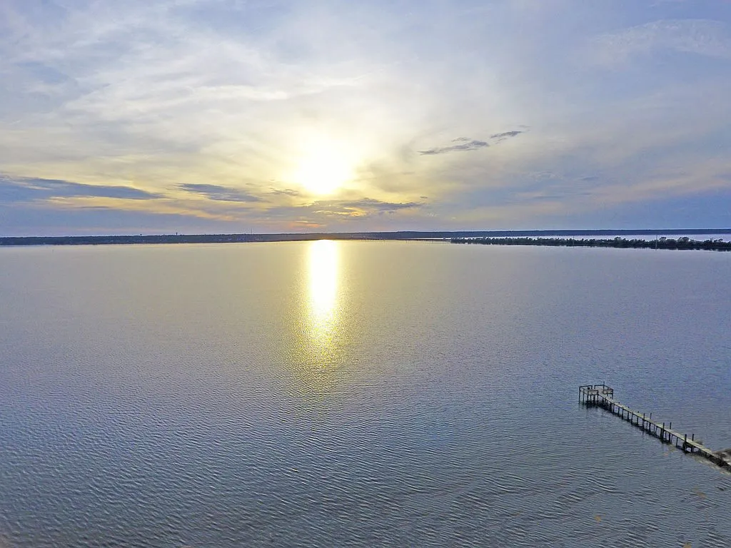
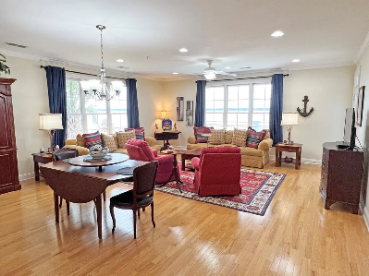
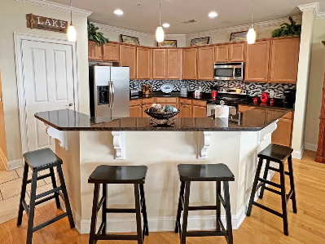
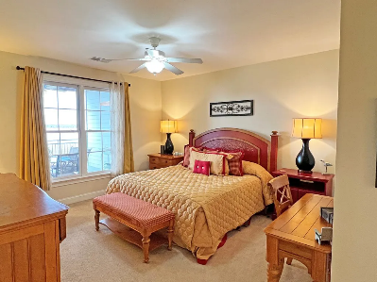
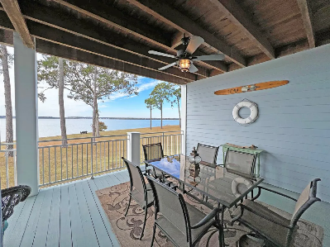

Waterfront Condo on Lake Marion
1142 Bridgeview Ln #203
Summerton, SC 29148 | MLS# 155479 | $449,000
3 Beds | 3 Baths | 1,922 sqft
The 2nd Floor Amazing View Condo has 3 bedrooms, 3 full baths, huge porch with dinning area and sitting area, spacious bedrooms to fit 2 queens each, tons of cabinet space, large laundry room, Hardwood floors and much much more. North Shore offers plenty of green space for walking the dog, a pool, a clubhouse with a full kitchen and meeting room, a wonderful view and breath taking sunsets. Jump on the boat from your private dock that conveys with condo and sail to Charleston for the weekend or just hang out with friends on a sandbar for the afternoon. Don't forget the fishing poles as Lake Marion offers some of the best Fishing around. Bring the suit case and relax - this condo come mostly furnished (minus the personal items). See this today! It will not stay on the market long! HOA Includes: See HOA
Lake Homes Realty, LLC
Elloree, SC 29047
www.SCLakeLife.com
Kristie Anderson
(803) 387-9459
kristie@sclakelife.com

