Slide 1
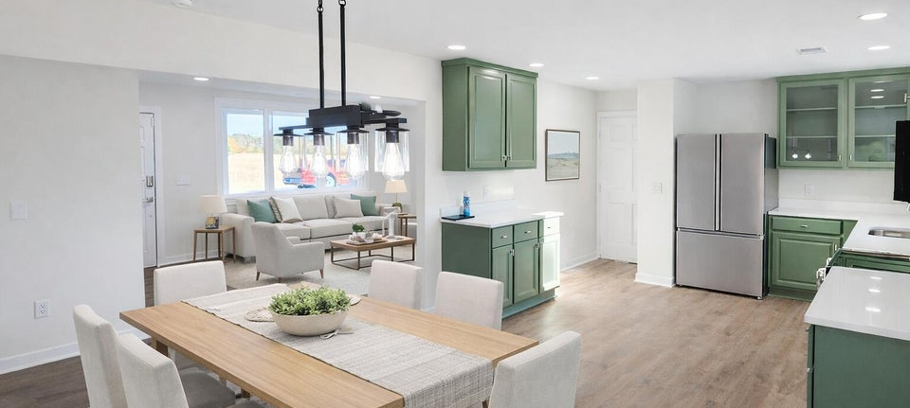
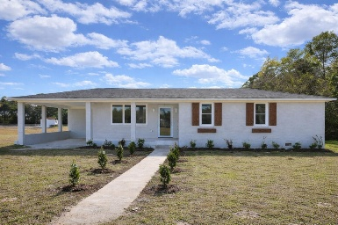
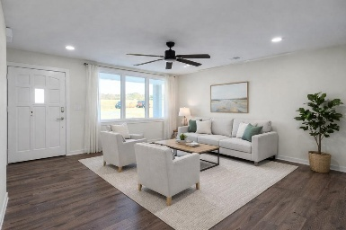
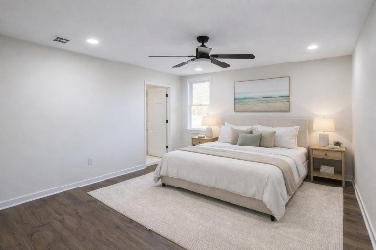
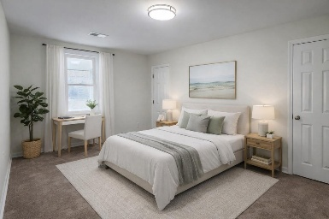
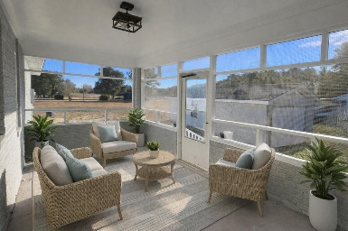


1142 Pearson Road Summerton | Manning, SC 29102 | MLS# 25032907 | $334,900
Country Living + Modern Upgrades Near Lake Marion
Open House
Wednesday, 7/20
3-5PM
Welcome to 1142 Pearson Road in Manning, a fully renovated brick ranch offering space, comfort, and peaceful country living. Situated on 1.8 acres with no HOA, this move-in-ready home combines modern updates with a serene rural setting, all less than 15 minutes from downtown Manning and conveniently close to Lake Marion.
This 4-bedroom, 2-full-bath home features 1,840 square feet of thoughtfully updated living space, including new windows, a new roof, and a new HVAC system, providing long-term efficiency and peace of mind. LED lighting throughout enhances the bright, welcoming interior.
The spacious living room offers plenty of room for relaxing or entertaining, while the modern kitchen showcases hard-surface countertops, stainless steel appliances, and abundant cabinet space - perfect for everyday living and hosting guests.
The primary bedroom is cozy and inviting, featuring dual closets and a luxurious en-suite bath with dual vanities, a tiled walk-in shower, and beautifully tiled floors. Three additional guest bedrooms provide flexible space ideal for family, guests, or home office needs.
Enjoy the peaceful tranquility of country living with room to spread out, while still being conveniently located near shopping, dining, and outdoor recreation.
Homes with this level of renovation, acreage, and location are in high demand...schedule your private showing today and act now before this opportunity is gone.
Brandon Ray
(843) 499-1928
brandon.ray@carolinaone.com
www.lakelifescstyle.com
Carolina One Real Estate
900 N Main St
Summerville, SC 29483

