Slide 1
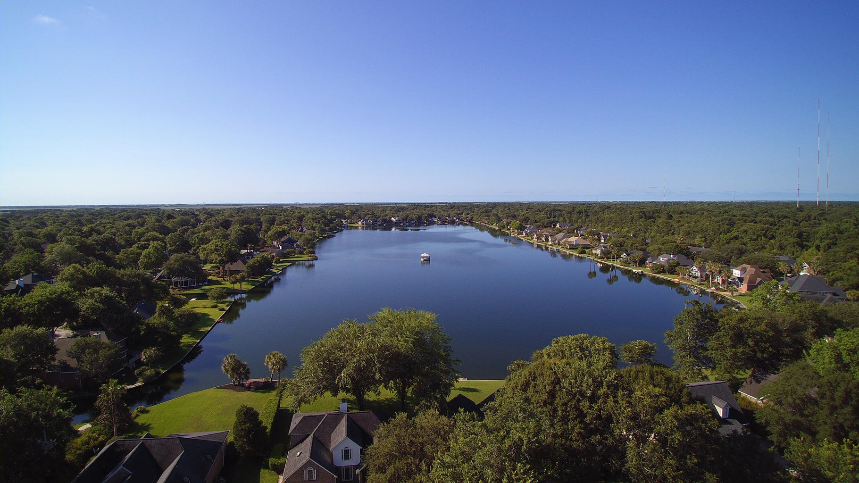
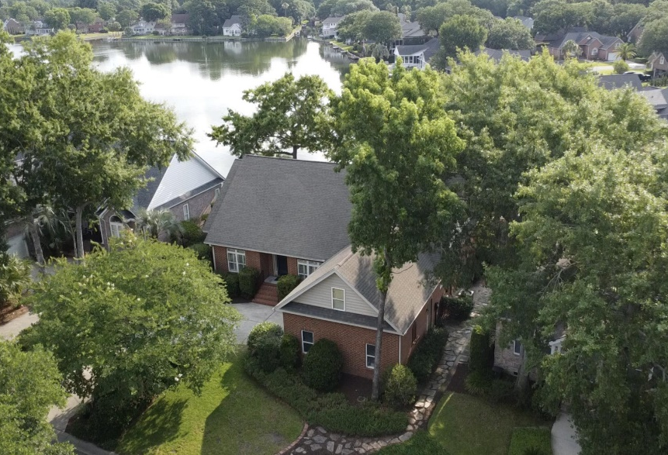
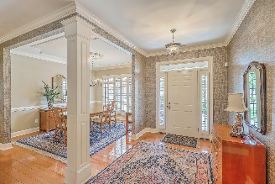
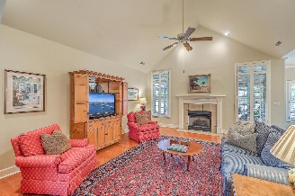
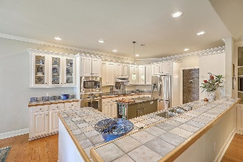
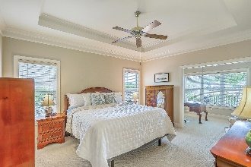
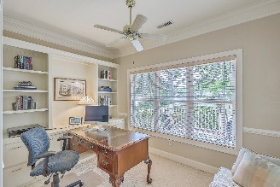
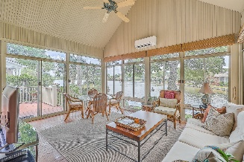
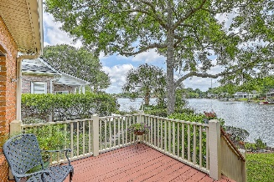
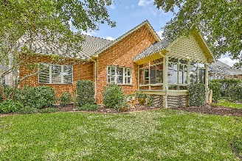
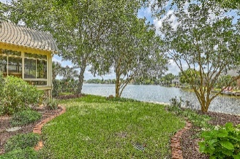
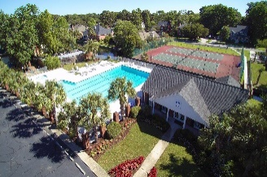

Open House - 11am-2pm Saturday July 27th
1142 Waterfront Drive
Hidden Lakes
Mount Pleasant, SC 29464
MLS# 24015566
$1,299,000
3 Bed | 2 Bath | 2,700 SF
Opportunities to purchase a home on the big lake in Hidden Lakes don't come along very often, so make sure to come see this beautiful home quickly! Wonderfully maintained by the original owners, this one-story, 3 bedroom/2 full bathroom home features a huge Primary bedroom suite on one side; large open-concept kitchen/living room in the middle; and two great guest rooms + full bath connected by a hallway on the other side of the home. Wide hallways and well-thought-out spaces abound, with one of the best features being the huge enclosed porch with mini-split HVAC unit overlooking the big lake! For those wanting more space, the FROG (currently used as a storage attic) could easily be converted to finished space. New Roof Shingles 2024.
Hidden Lakes neighborhood features incredible amenities too, including recreational use of the lakes and canals (electric, paddle, or wind powered vessels OK - no gas engines); a neighborhood lake-drawn irrigation system (saving you heaps of money on water costs annually); a clubhouse; tennis/pickleball/basketball courts; a kids playground; and a Boat/RV storage yard (for an additional annual fee). Hidden Lakes is located right in the heart of Mount Pleasant, near the beaches and shops and restaurants of Towne Centre and Seaside Farms.
Enjoy a video tour!

