Slide 1
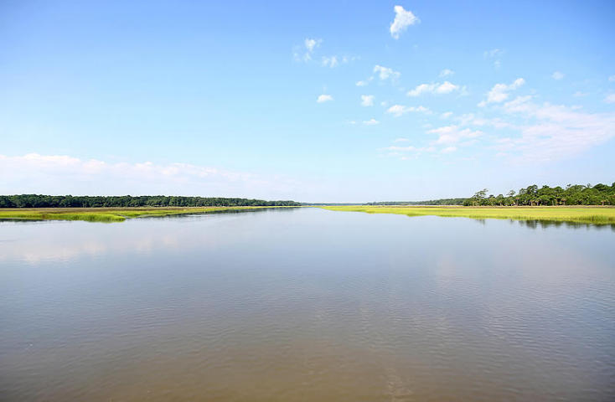
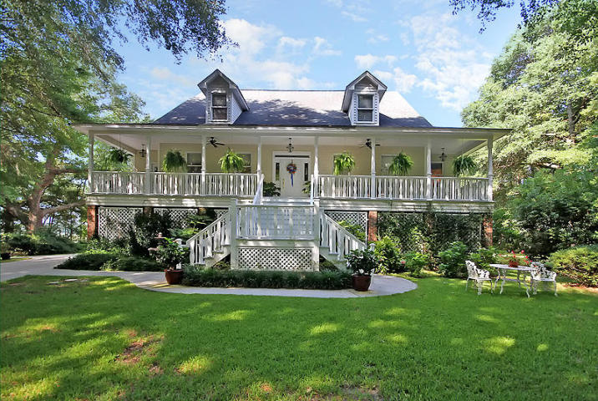
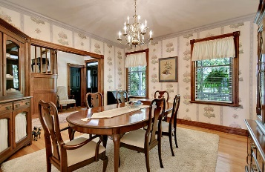
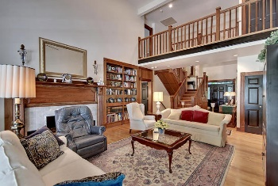
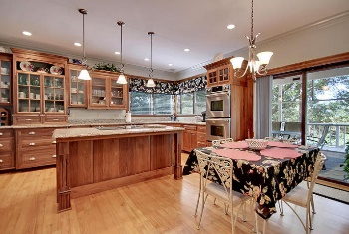
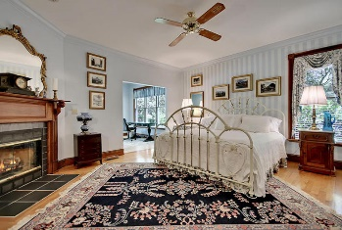
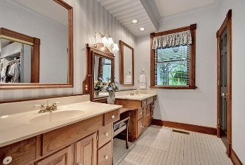
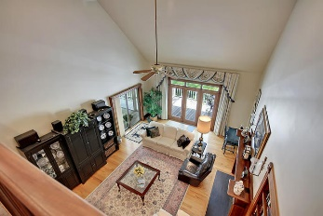
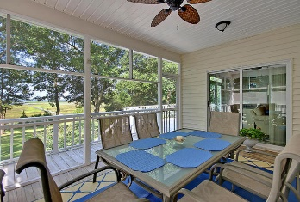
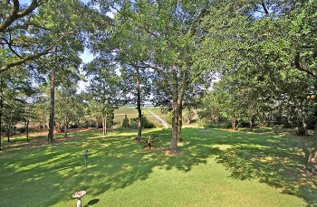
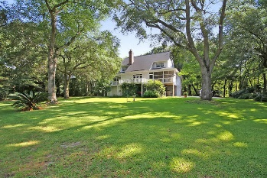
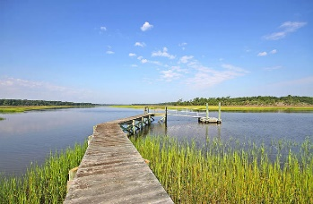

1143 Fifteen Mile Landing Rd
Wappetaw Landing
Awendaw, SC 29429
MLS# 15019172
$974,500
4 Bed
4½ Bath
3,600 sf
Breathtaking Views
Price Reduced!
BREATHTAKING views on the bend of the Wando River! Beautiful Low Country home with a wraparound porch, 4 bedrooms, 4.5 bathrooms, 4+ acres with PRIVATE DOCK. Gorgeous custom woodwork throughout main and 3rd levels. Gourmet updated eat-in kitchen has stainless steel appliances, granite countertops, double ovens, and two pantries. Two fireplaces in living room and master bedroom share a chimney. Master bedrooms also offers an owners retreat, walk-in closet and private bath with separate shower, dual sinks, and jetted garden tub. The garage has heat and air and the home has an abundance of storage! Newer roof and other updates. Wappetaw Landing is close to local shopping and grocery stores and is a short drive to downtown Charleston with 5-star restaurants, world class shopping and iconic history as well as a short drive to the beaches, the airport, Boeing and Daniel Island. Come see this wonderful home that is perfect for the person who likes to boat, crab, and entertain!
Stan Huff
843-670-2835
stan.huff@agentowned.com
Jill Marcacci
843-297-5590
jill@agentowned.com
www.agentownedrealty.com
AgentOwned Realty Co. Preferred Group, Inc. | 824 Johnnie Dodds Blvd | Mt Pleasant, SC 29464

