Slide 1
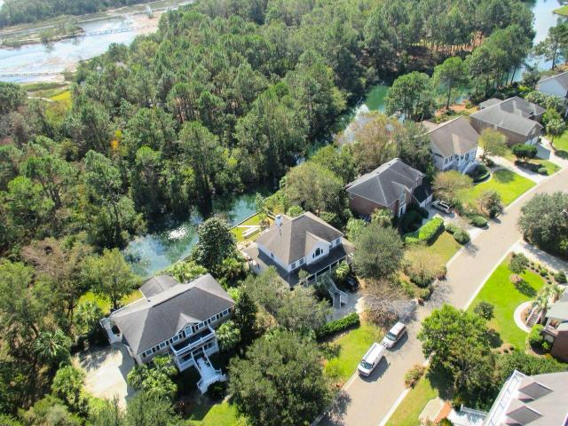
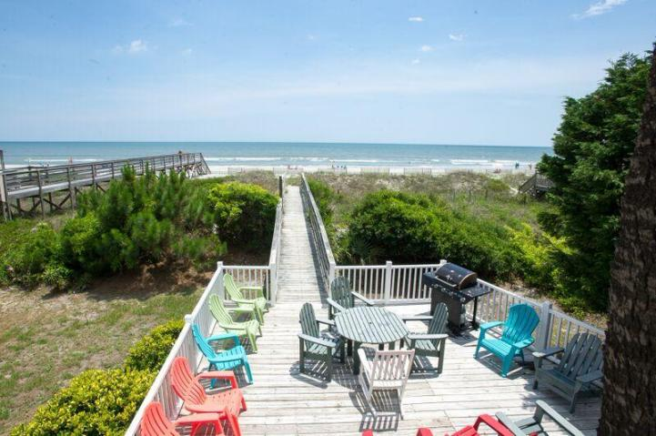
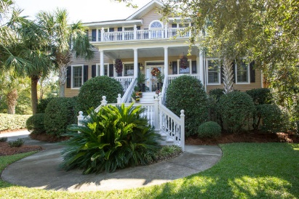
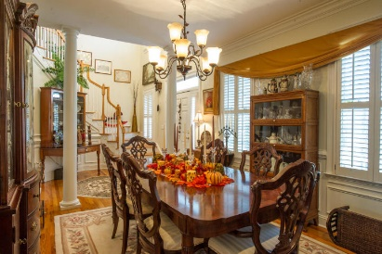
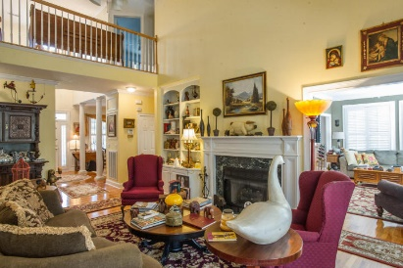
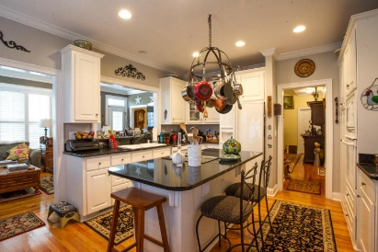
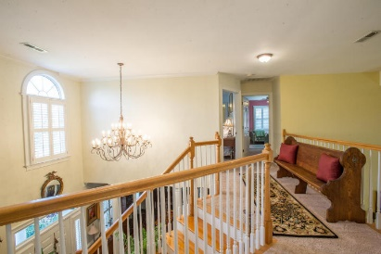
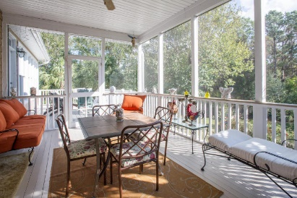
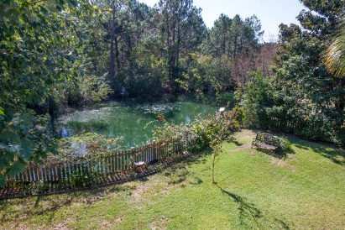
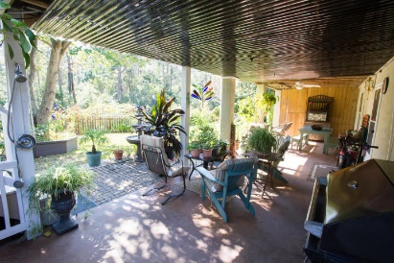


Magnificent 4BR Home In Seaside Plantation
1143 Sea Eagle Watch
Seaside Plantation
Charleston, SC 29412
MLS# 16027385 ~ $679,000
4 Bed | 3½ Bath
***Stunning home in HIGHLY SOUGHT AFTER SEASIDE ESTATES SECTION of Seaside Plantation-the premiere neighborhood in Seaside Plantation just past the new development of Freemans Point. Wainscoting, Crown Molding new seawall, interior shutters (almost 20K worth) new granite in gourmet style kitchen of 10K, fenced yard to the pond, MASTER BATHROOM AND MASTER BATH SPA-ESQUE on Main level. Sitting room and large den with fireplace. Stunning dining room and breakfast area off kitchen. Home CAN BE MODIFIED FOR ELEVATOR. Flow of space is incredible and completely separate areas and bathrooms for guests. Tucked away office area and serious storage and garage space. Must see this-best home to come on the market in Estates. Folly/Downtown/Boeing extremely close and public boat landing. Must see.****
Bryan Thompson
Office - (843) 769-5100
Mobile - (843) 452-1686
bryan.thompson@agentownedrealty.com
www.bryanthompsonrealestate.com
AgentOwned Charleston Group | 902 Savannah Hwy | Charleston, SC 29407-7802

