Slide 1



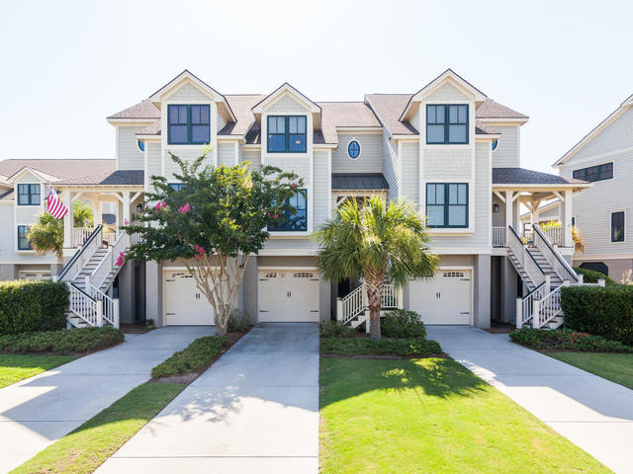



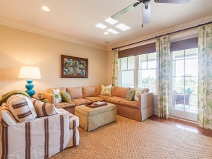
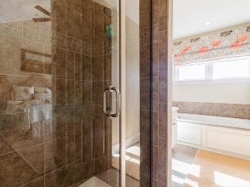
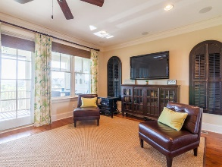

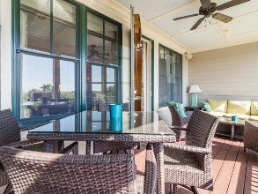
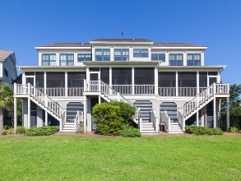
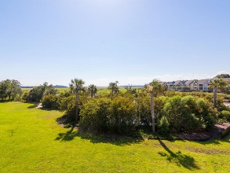


Stunning Seabrook Island Townhome
1143 Turtle Watch Lane
Seabrook Island, SC 29455
MLS# 16018612 ~ $599,900
Just Reduced!
This absolutely gorgeous and well cared for Salt Marsh townhome is a must see! This beautiful home features many custom touches, a wonderful screen porch, hard wood floors throughout, and an open floor plan. 1143 Turtle Watch Lane is the perfect primary residence or beach retreat. This 3 bedroom, 3 bathroom town home has a three-stop elevator, all the way from the garage to the top floor where the master suite is located. Stunning and breathtaking views of the marsh from the screen porch, main living areas and master retreat. The kitchen features granite counter tops, a large island, and stainless steel Bosch appliances. The master suite has vaulted ceilings a large master bathroom with separate shower and tub, stunning views of the marsh, Horseshoe Creek and Bohicket. Also located on the second floor is a large guest bedroom with private bath and a nicely sized laundry room offering cabinet space and shelving. Back on the first level, you'll find a second guest suite and full bathroom. The 2 car garage has lots of storage space for bikes, kayaks, a separate owners closet and everything else you can imagine! Salt Marsh is a private gated community with a resident only pool and day dock with a fishing pier where you can launch kayaks or take in the beautiful Seabrook surroundings. This home is truly a must see! 1143 Turtle Watch Lane also features hurricane rated windows and upgraded lighting fixtures. Contribution to capital within PUD upon the initial sale and resale is 1/2 of 1% of the sale price. Purchase also requires membership to the Seabrook Island Club. Sold Unfurnished.
Laura Street laura.street@goldenbearrealty.com
www.simplylowcountryrealestate.com
Golden Bear Realty | 1900 Seabrook Island Rd | Seabrook Island, SC 29455
Cell (843) 330-4097 | Office (855) 352-9088 | Fax (561) 721-3311

