Slide 1
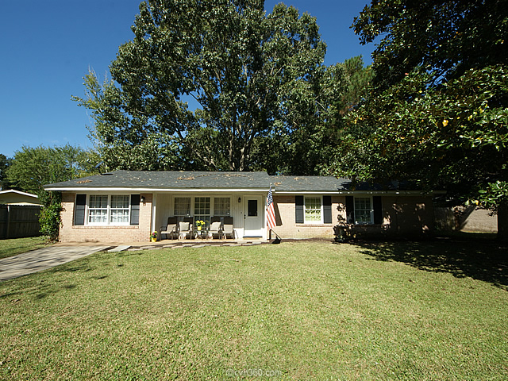
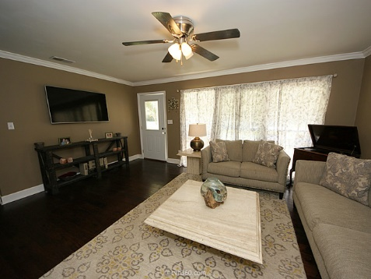
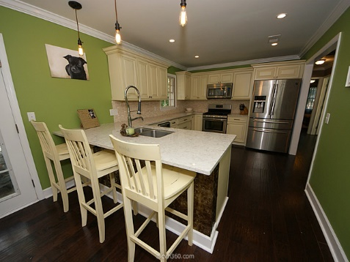
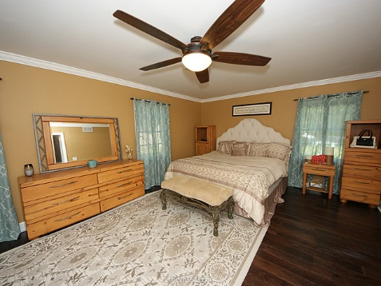
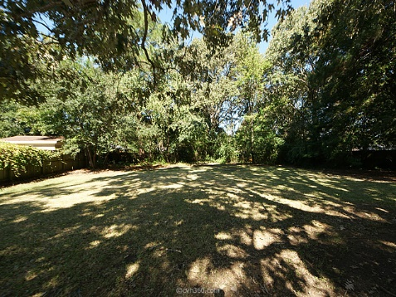


Beautiful Renovation in Lawton Bluff! 1144 Quail Drive | Charleston, SC 29412 | MLS# 15026352 | $320,000
137 Beaufain Street
MLS# 15000837 - $1,150,000
Beautifully renovated ranch-style home in the heart of James Island! Walk in to the large living area with new hand-scraped floors & fresh paint throughout. Kitchen has stunning new cabinetry, stainless appliances including a wine fridge and quartz counter-tops! Complete with dining area and bar top for extra seating. Large bedroom to the left of the kitchen with easy access to laundry room. 2nd bath boasts new tile, fixtures etc. 2nd bedroom would make a great office or child's room! Master is huge with walk-in closet and stylish new bathroom with unique tiled shower, double sink vanity and new flooring! Don't miss out on this HUGE privacy fenced lot in James Island! 2 minutes to Harris Teeter and short commute downtown!
Check out the virtual tour for more pix!
Melissa Britt Thierfelder, MRP melissabritt@remax.net
Office: 843-442-8787 | Cell: 843.725.8016
www.melissabritt.remax-carolina.com
RE/MAX Elite | 91 Broad St | Charleston, SC 29401

