Slide 1
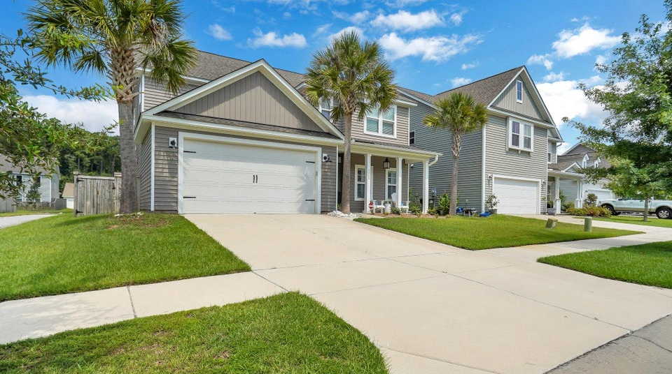
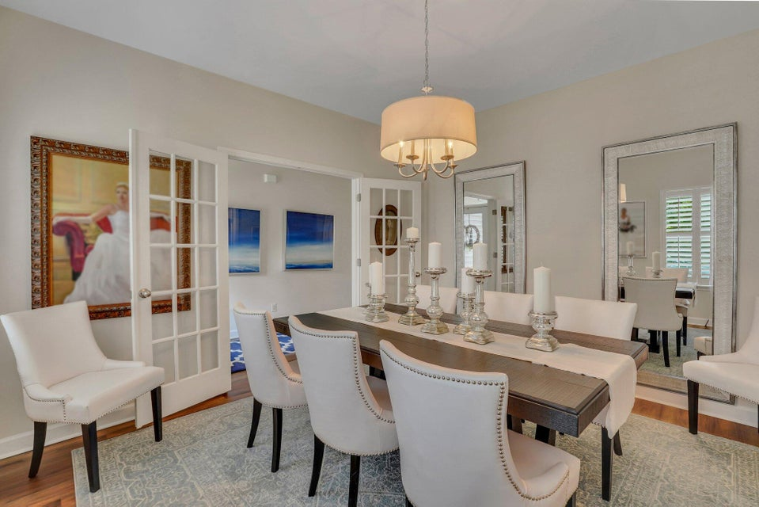
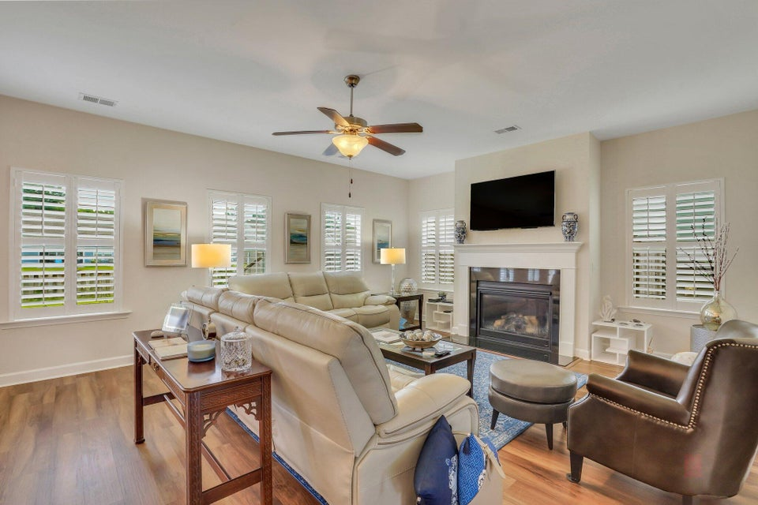
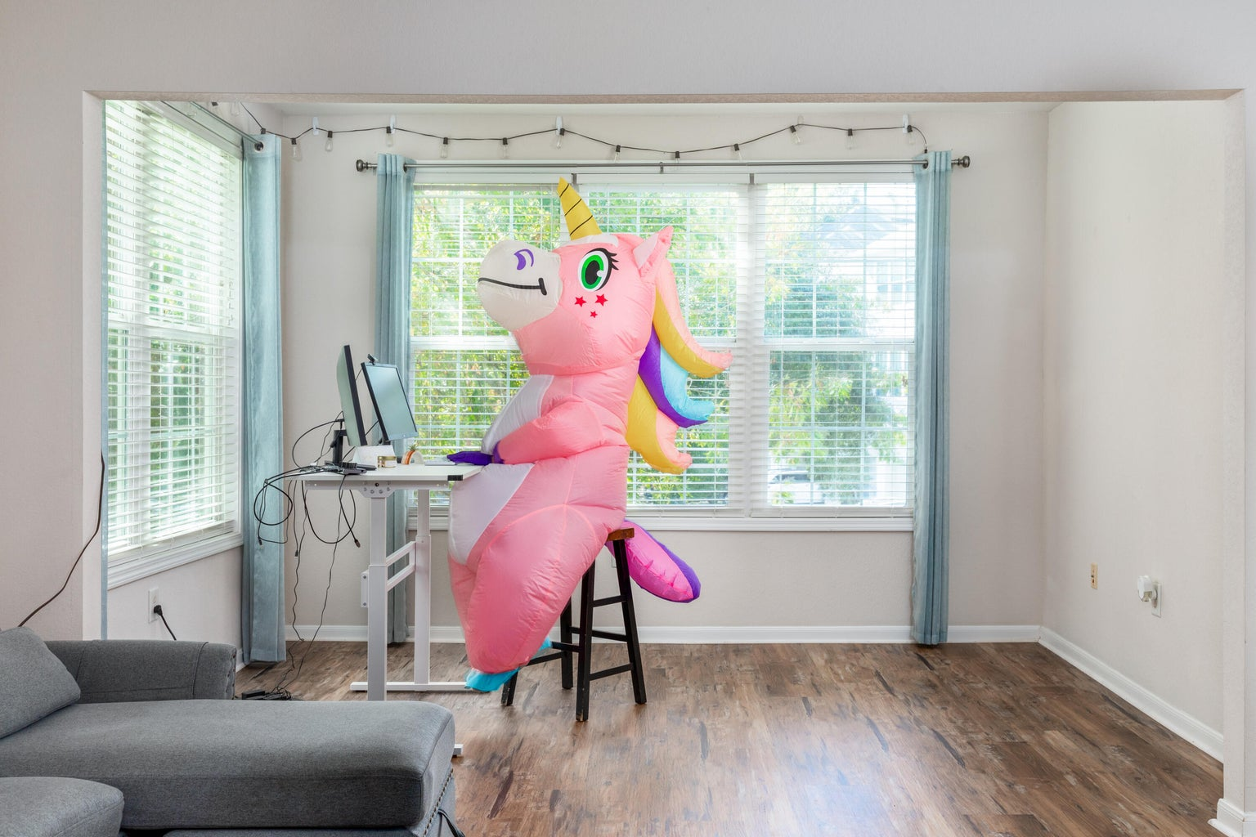
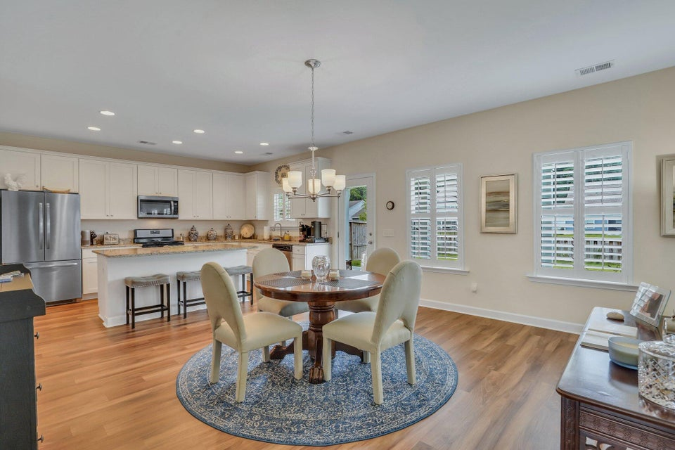
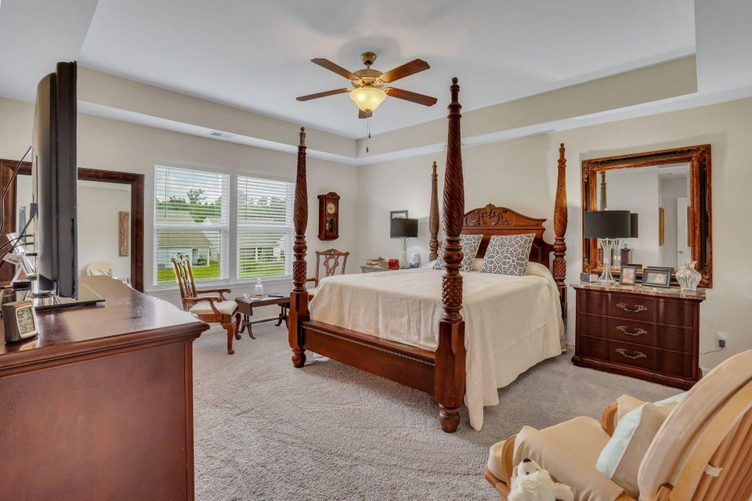
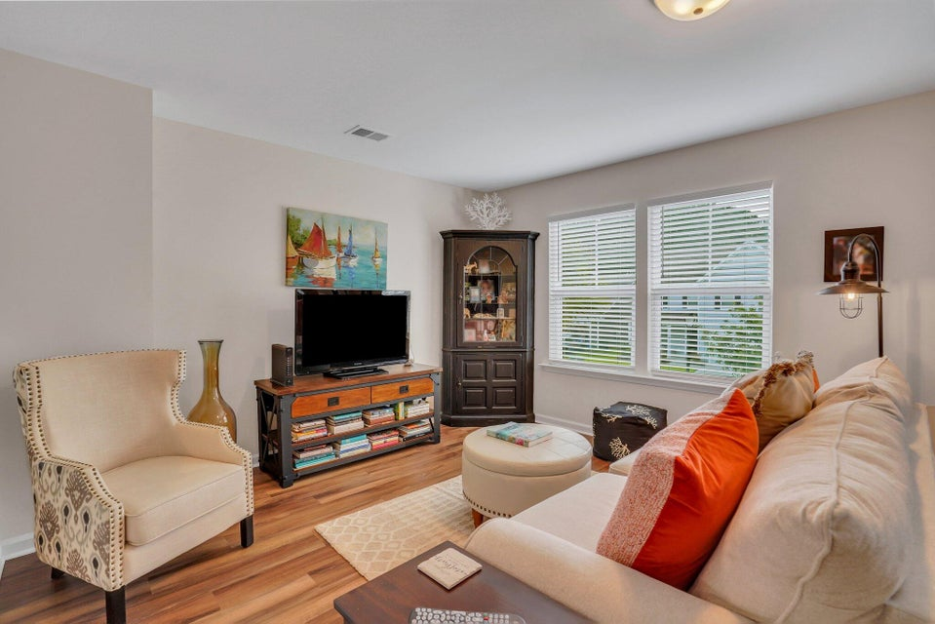
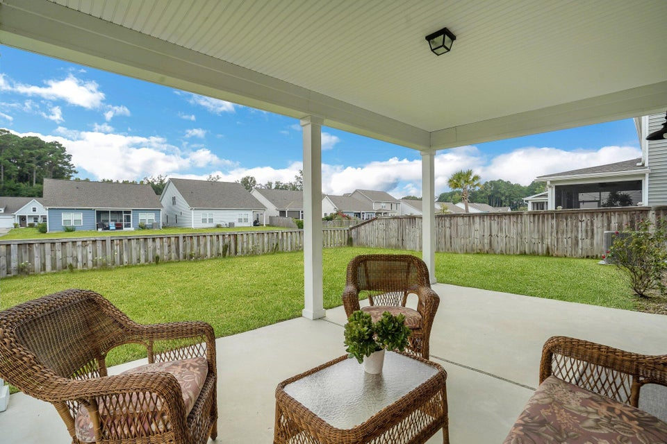
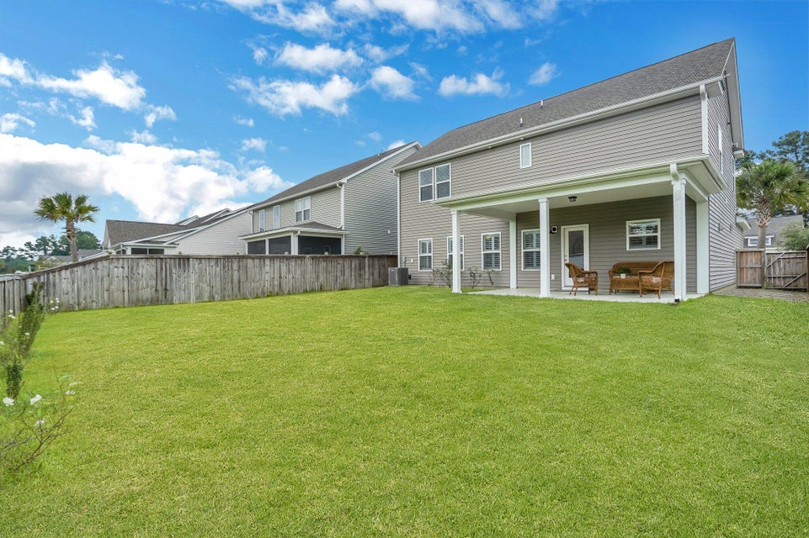

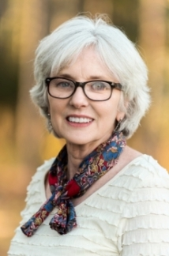
Just Listed on Johns Island – Open House Sunday 2-4
1145 Turkey Trot Drive
Riverview Farms | Johns Island, SC 29455
MLS# 24020586 | $639,999
Welcome to this meticulously designed 3 bedrooms, 2.5 bathroom home, nestled in the highly sought-after Riverview Farms community on Johns Island. This residence combines convenience with comfort, offering a blend of amenities such as ponds, walking trails, a community garden and a playground along with stylish charm. Upon entering, you'll be greeted by wood floors that lead you through the entryway. French doors open to a versatile space that can serve as either a dinning room or home office-the choice is yours. The open floor plan is perfect for entertaining with plenty of natural light streaming through plantation shutters adding a touch of sophistication. The well-appointed kitchen features granite countertops, stainless steel appliances, a gas stove and a spacious pantry, making it a chef's delight. The living area is anchored by a gas fireplace that turns on with a simple flip of a switch providing warmth and ambiance. Upstairs, you'll find a versatile loft area, perfect for media room, den or play area. The primary suite is a spacious sanctuary with an ensuite bathroom that includes ceramic tile, a walk-in shower, dual sinks and a massive walk-in closet. Two additional bedrooms, a full common bathroom, a laundry room and linen closet complete the upper level. Outside, the fenced backyard offers a large covered porch, perfect for entertaining or relaxing. Additional features include a two-car garage with coated flooring and cabinets, completed attic for storage, regular service for the HVAC and pest control, plus a termite bond for your peace of mind. No flood insurance required. Constructed in 2018, this home also comes with a 10-year warranty. This residence offers unparalleled convenience to local restaurants such as The Royal Tern, Wild Olive and Blackbird Market and downtown Charleston just 10 miles away and the pristine beaches of Kiawah, Seabrook, Folly Beach a short 15-mile drive, this home truly offers both convenience and comfort!
The washer and dryer do not convey.
Patty Stover
843-819-7924
pstover60@gmail.com
www.pattystoverrealty.com
Keller Williams Realty Charleston West Ashley
1180 Sam Rittenberg Ste 300
Charleston, SC 29407

