Slide 1
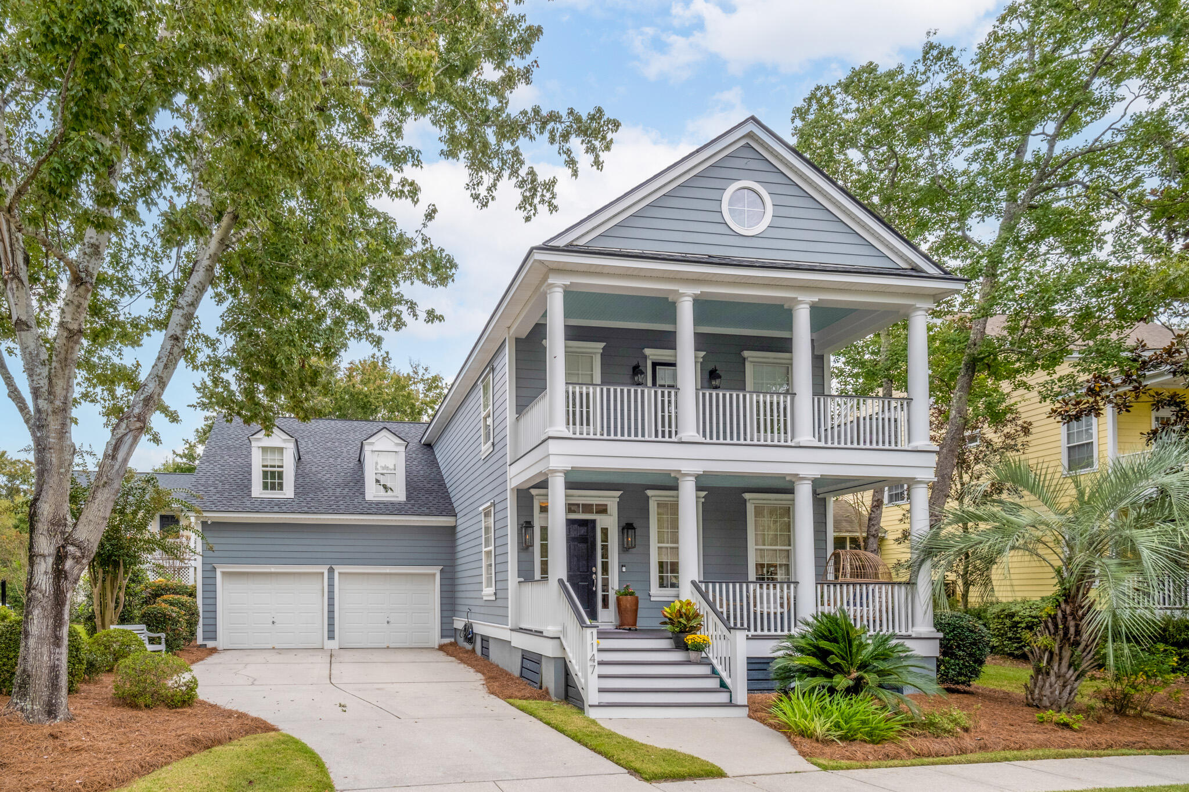
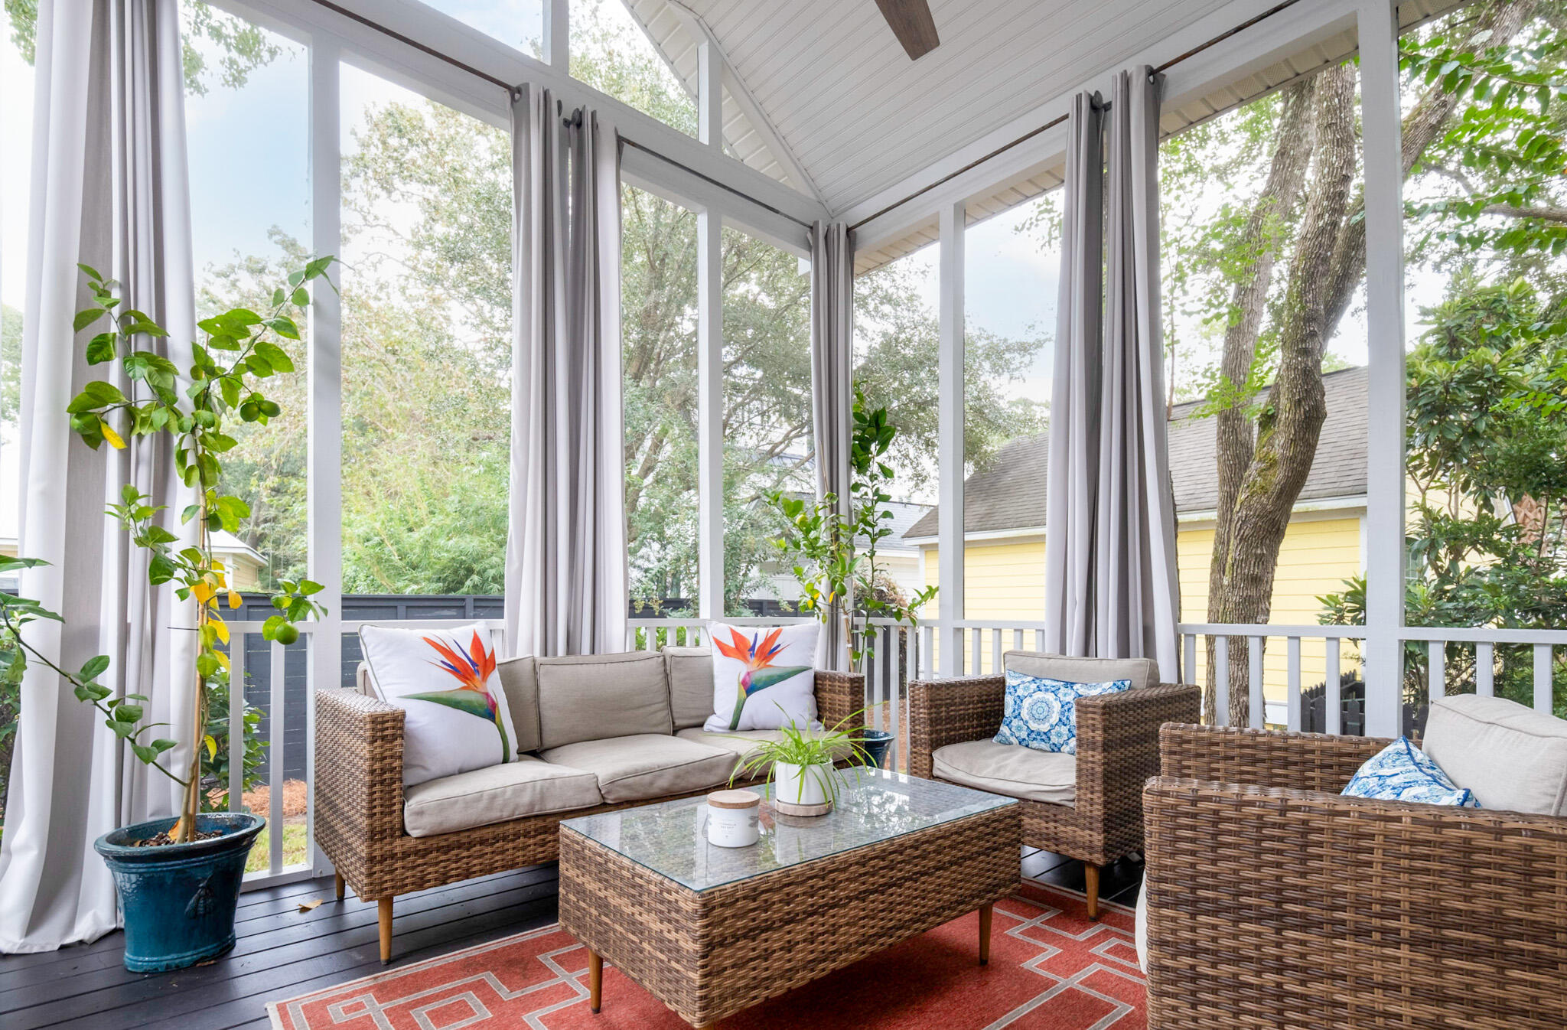



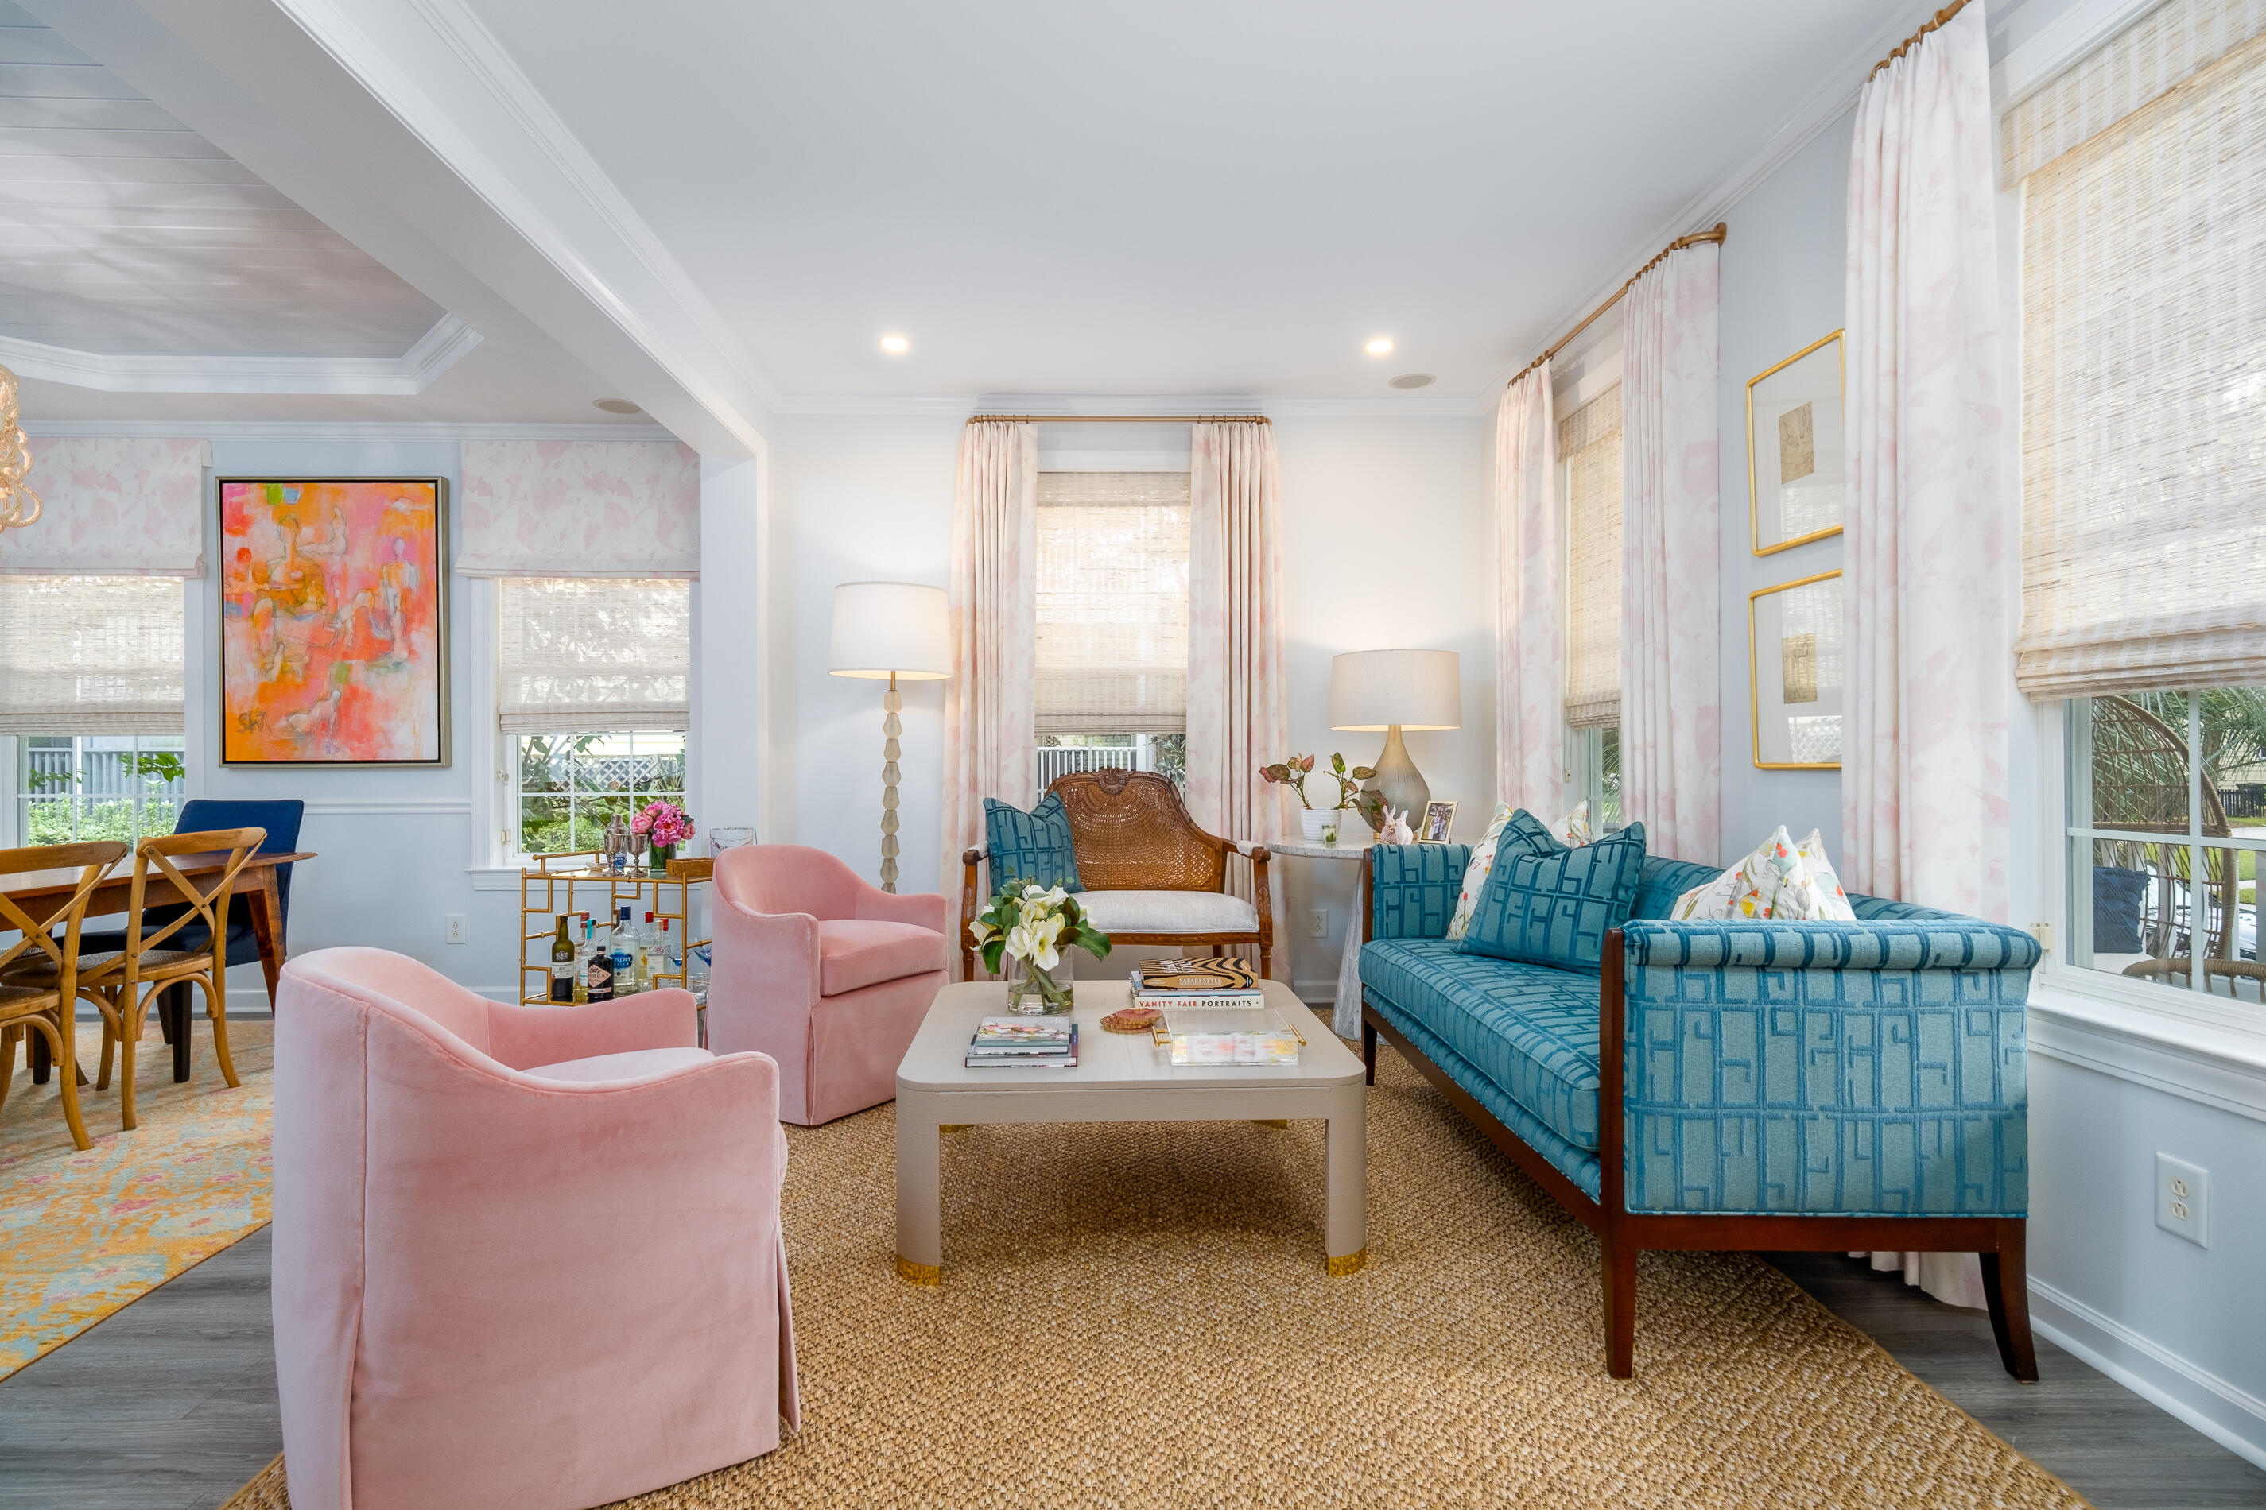
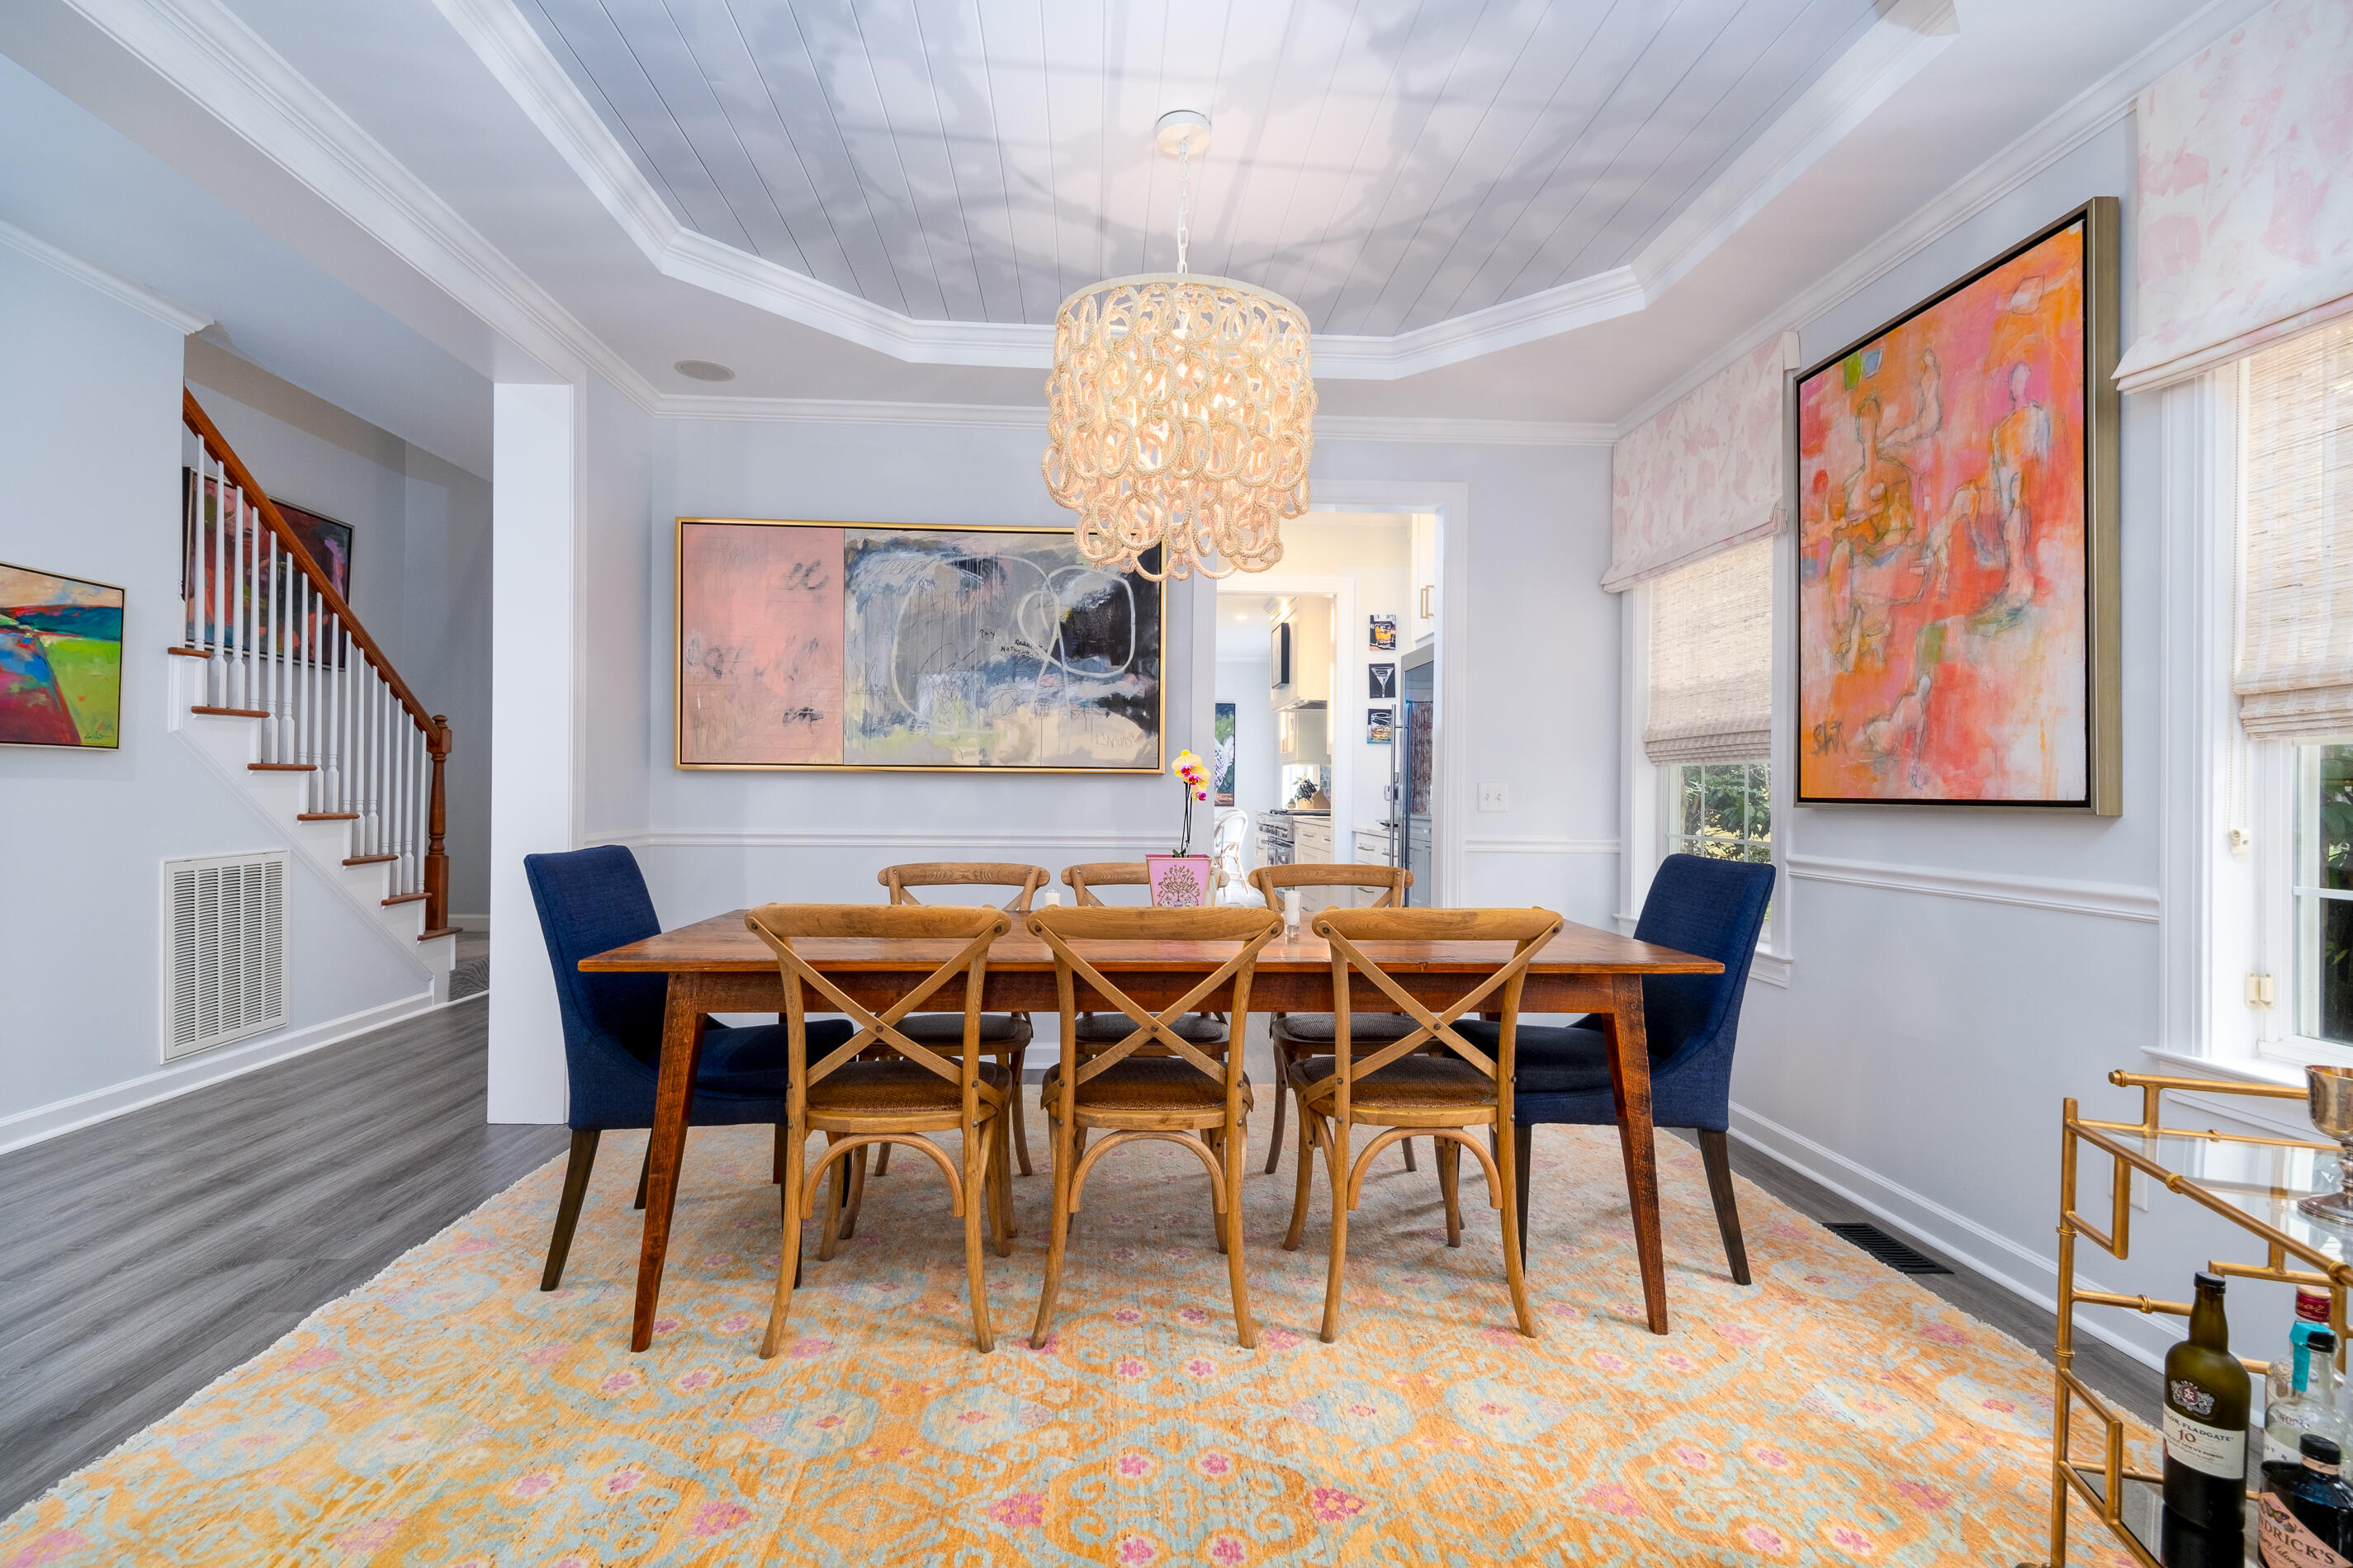
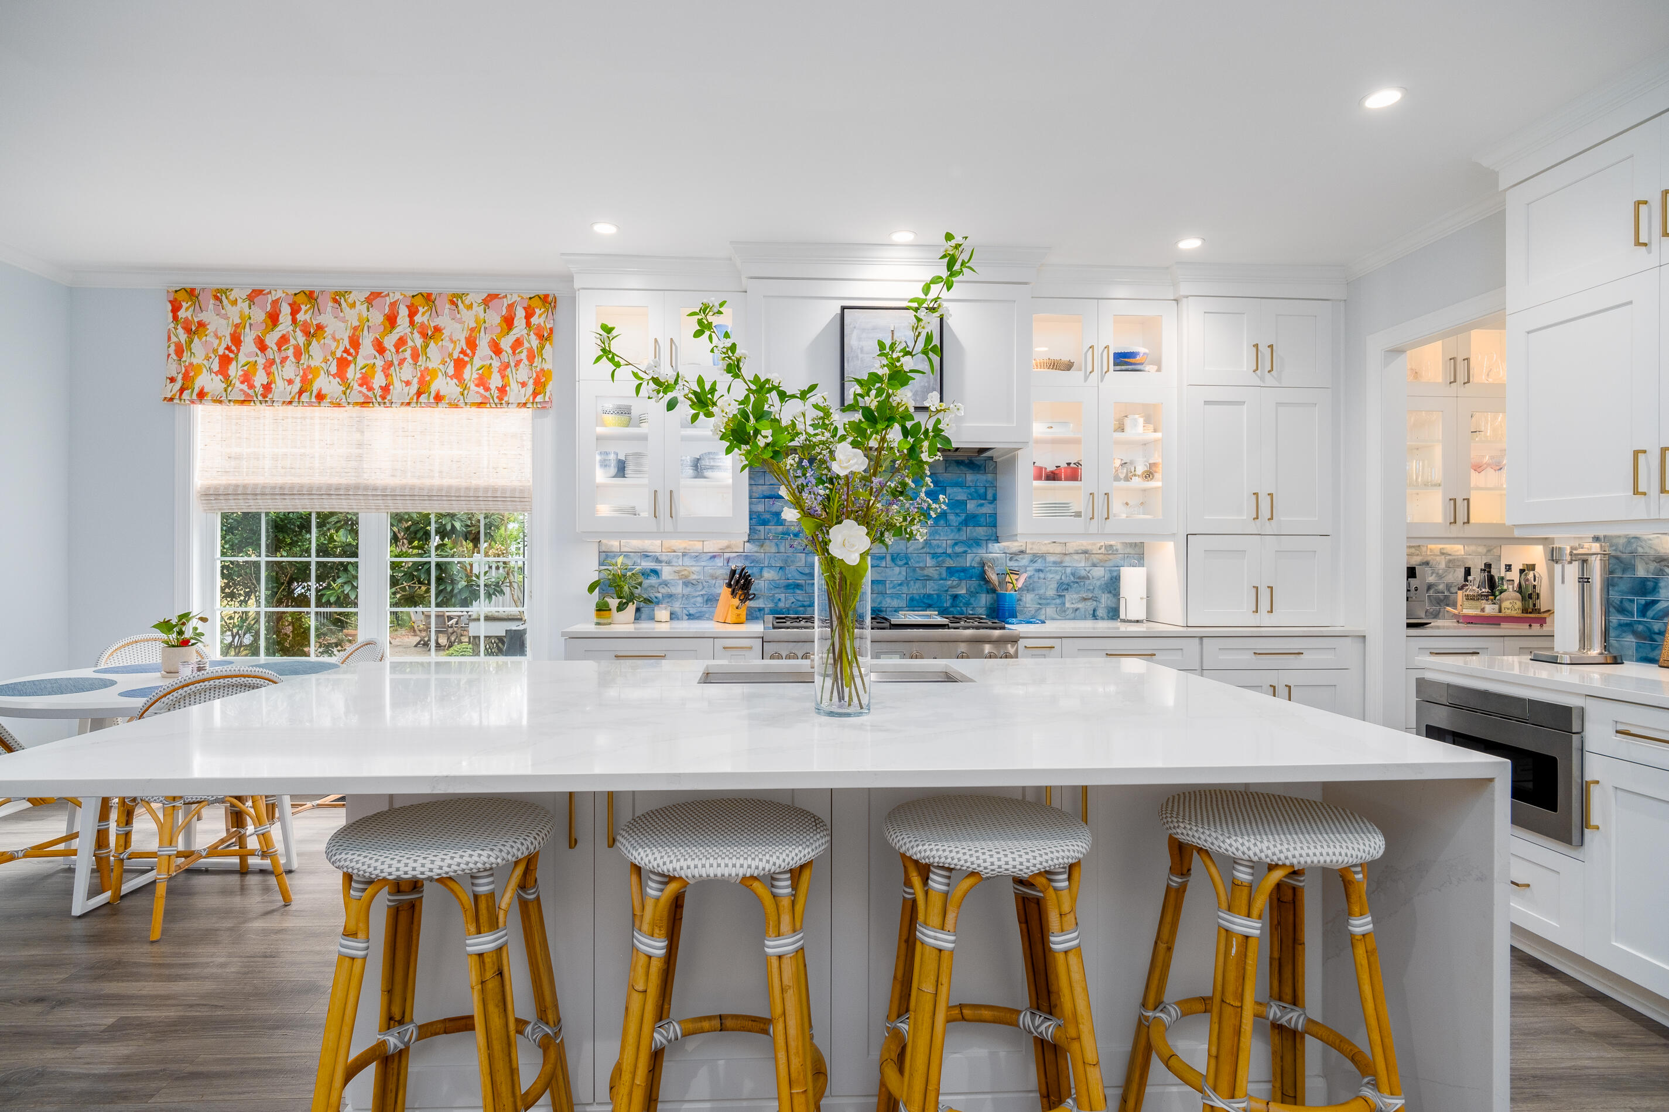
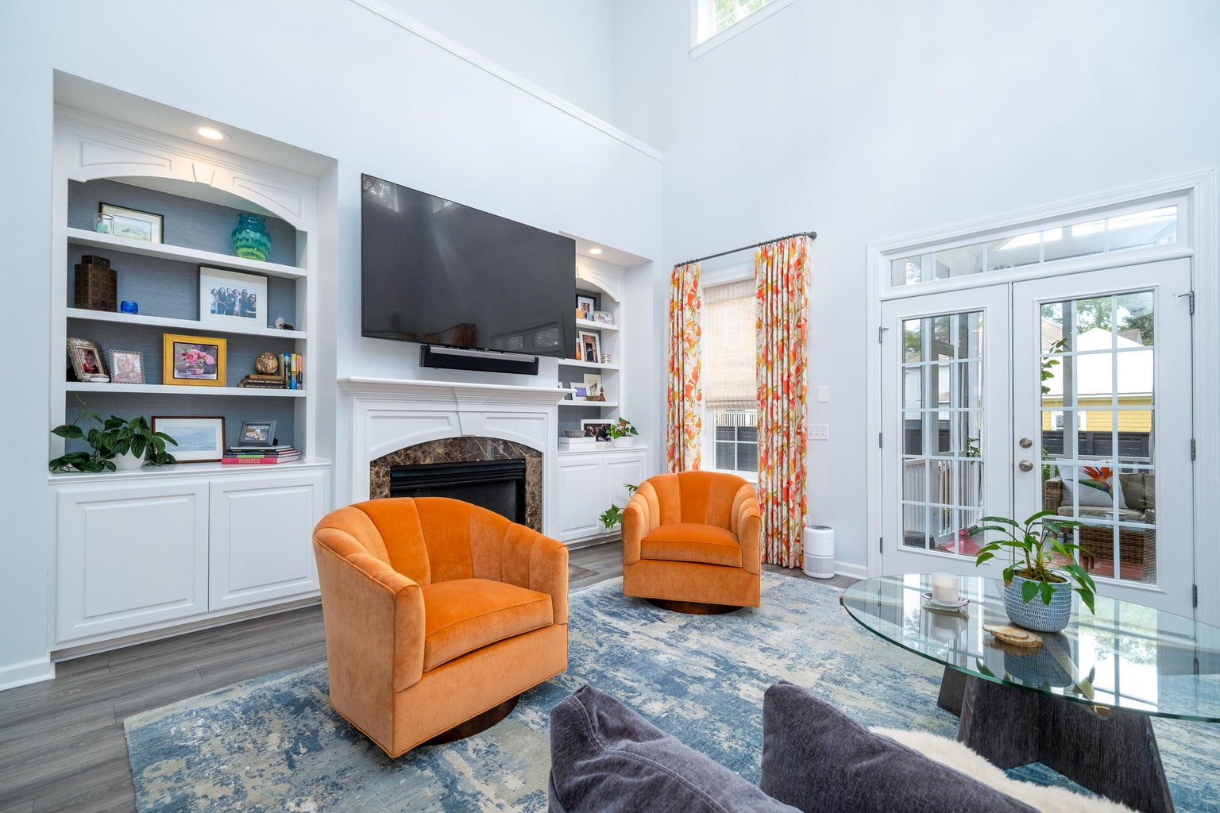
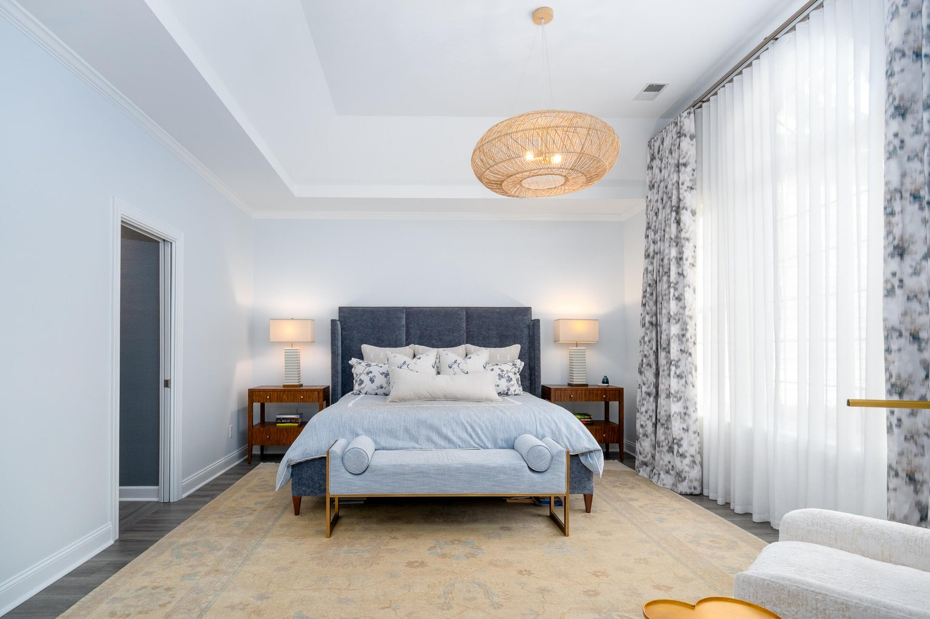

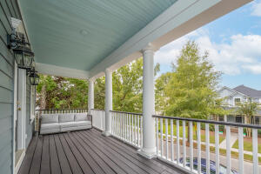
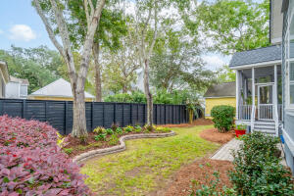


Open House Sunday November 19th from 12-3
1147 Blakeway Street
Daniel Island, SC 29492 | MLS# 23023377 | $1,850,000
1147 Blakeway Street is a spectacular home that captures the architecture of Charleston while thoughtfully combining it with the best of modern conveniences. Traditional architectural features of double-stacked front porches and flickering gas lamps from New Orleans welcome you to this beauty. The inside renovations done to the home perfectly combine form and function. The floor plan has been expanded to create a more open space while maintaining a warm and welcoming atmosphere. The kitchen is a chef's dream with Thermador appliances, a full size wine refrigerator and plenty of cabinet space. You also can't miss the custom tile work, light fixtures and wall treatments. Adjacent to the kitchen is an elegant powder room with hand painted Phillip Jeffries wallpaper.
Beyond the kitchen is a spacious family room with custom built-ins and a cozy gas fireplace. French doors then lead to a sunny screened in porch perfect to enjoy the Lowcountry weather. The private backyard is perfect for entertaining or a relaxed evening in. The spacious primary bedroom suite is conveniently located on the first floor with a wall of windows to bring in the outdoors. The primary bathroom is exquisite with an extra large walk in shower and stunning fixtures. A well appointed laundry room can be found on the first floor. The second floor consists of a spacious office accessed through French doors, and four spacious bedrooms finish off the pleasing upstairs space.
Enjoy this video tour
4
3
1,844
Cara Schaafsma
843-345-3612
cara.schaafsma@carolinaone.com
http://www.carasellscharleston.com
Carolina One Real Estate
1101 St. Thomas Island Dr
Charleston, SC 29492

