Slide 1
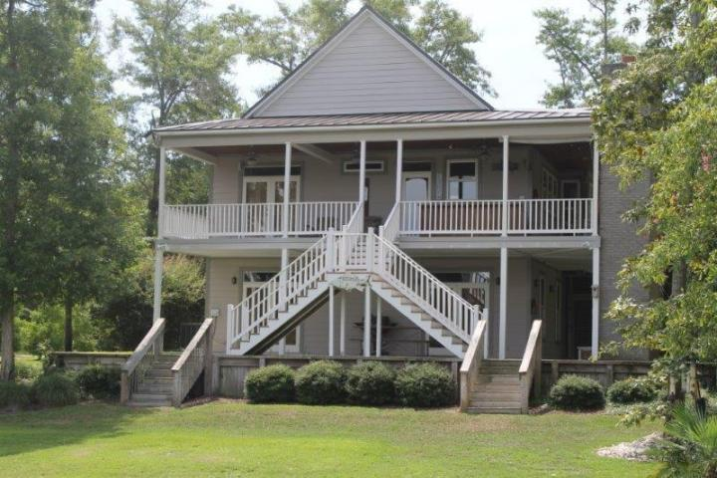
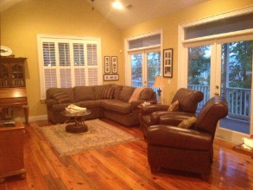
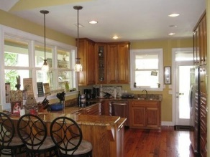
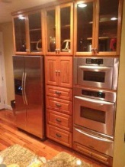
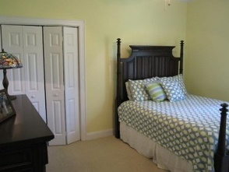
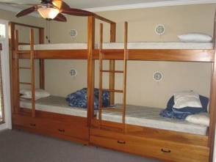
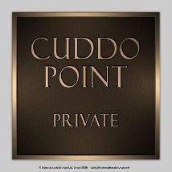
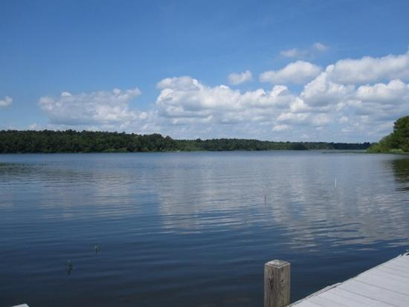
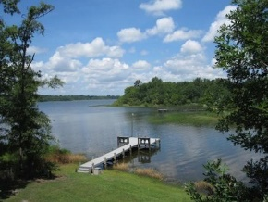
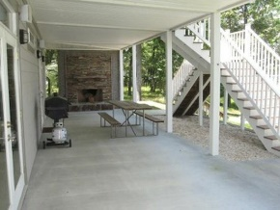
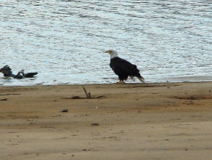
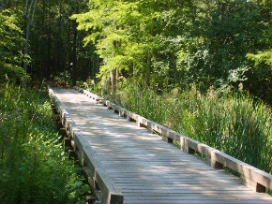
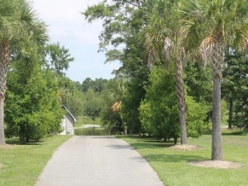

1148 Cuddo Point Road Summerton, SC 29148 MLS# 15019069 $499,900 4 Bedrooms | 3 Baths | 2,280 sf
Lake Home with Private Dock!
Loaded with Updates
EXQUISITE LAKE HOME WITH PRIVATE DOCK IN GATED COMMUNITY!
This beautiful home is one hour from Summerville and would be worth much, much, more in the Charleston area. Take a short drive and find the lake front luxury home of your dreams! Wonderful custom 4 bedroom 3 bath home with Hardiplank, standing seam metal roof, Timber Tex porch, HUGE 12'wide porches w/cypress ceilings and outdoor bar w/tile top, sink, fridge, 15,000 BTU cooker. GORGEOUS 2 story outdoor brick fireplace with a handsome stacked stone surround. Interior has custom paint, crown molding, 10' ceilings, cypress cabinets, heart pine floors, stainless steel appliances, and granite counters. PERFECT home for people who love to boat, fish, and entertain! There is a marginal lease associated with the property of $749.00 a year.
Stan Huff
843-670-2835 stan.huff@agentowned.com
Jill Marcacci
843-297-5590 jill@agentowned.com
www.agentownedrealty.com
AgentOwned Realty Co. Preferred Group, Inc. | 824 Johnnie Dodds Blvd | Mt Pleasant, SC 29464

