Slide 1
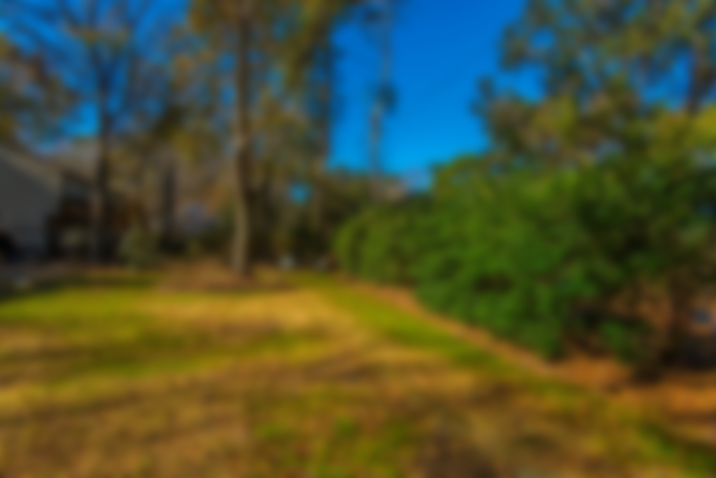
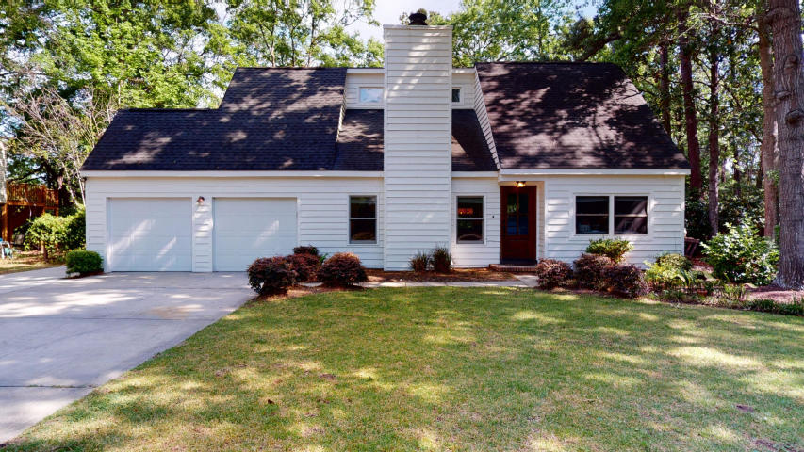
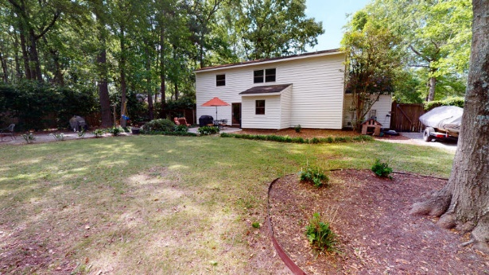
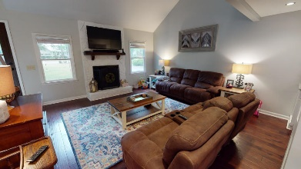
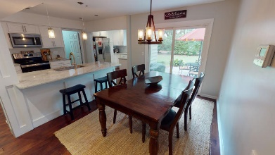
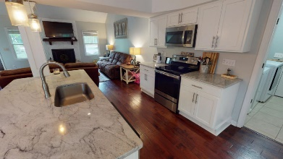
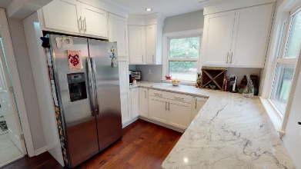
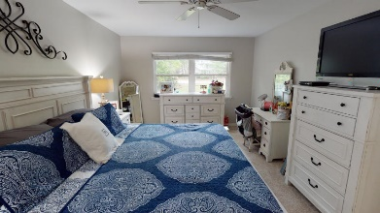
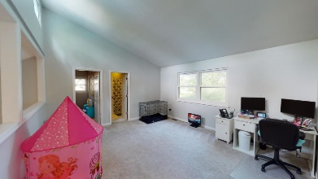
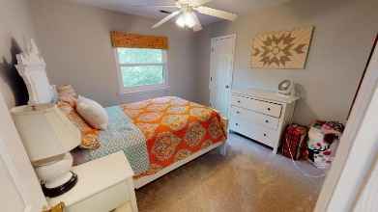
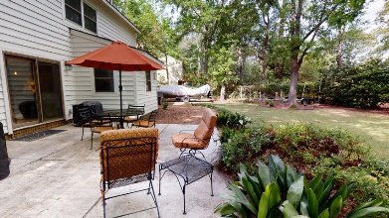


Open House Saturday 1~3
1148 Shady Grove Lane
Mount Pleasant, SC 29464 | MLS# 20009914 | $469,000
This 4 bedroom 2 bathroom home sits on almost 1/2 an acre. Located in a double cul de sac, it features a beautifully updated kitchen with white cabinets and granite countertops. Loads of storage in this kitchen! Stainless steel appliances round out this gorgeous kitchen. Exterior of the home has been painted within the last 2 years. Large master bedroom located downstairs with en suite. 3 spacious bedrooms round up the upstairs along with a full bathroom. The loft area can be used for anything -home office, second living room. The backyard is fenced and huge with plenty of room to play or to store your boat. Come by and see it today!
A $1,500 Lender Credit is available and will be applied towards the buyer's closing costs and pre-paids if the buyer chooses to use the seller's preferred lender. This credit is in addition to any negotiated seller concessions.
Snee Farm offers private club membership with golf, tennis, swim and social. Come take a look today!
Lauren Courcoux
Mobile - (843) 224-8613
lauren.courcoux@carolinaone.com
www.laurendelucacourcoux.com
Carolina One Real Estate | 2713 Highway 17 North | Mt Pleasant, SC 29466

