Slide 1
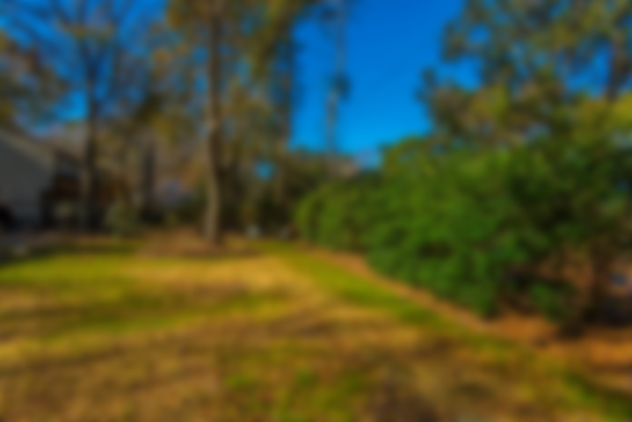
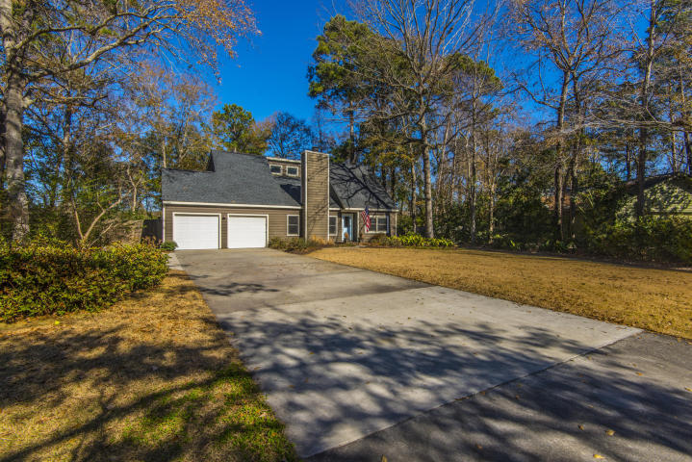
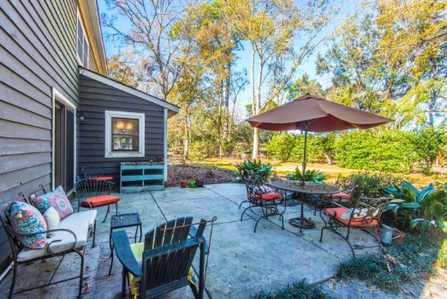
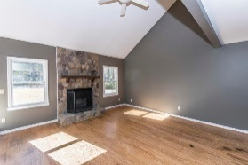
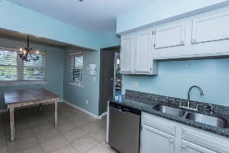
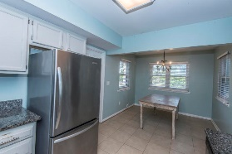
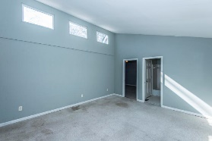
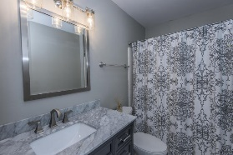
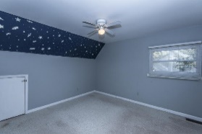
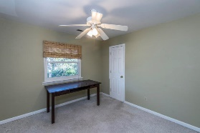
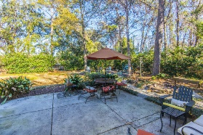
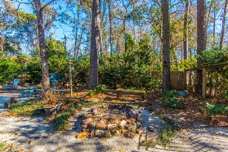
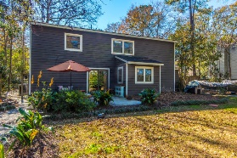


Lowest Priced Home in Snee Farm
1148 Shady Grove Lane
Mount Pleasant, SC 29464 | MLS# 18001488 | $409,000
Sellers say SELL! Home reduced for quotes received for flooring, paint, and sliding glass door. Wonderful home in a cul-de-sac in Snee Farm ready to be moved into! This home has 4 bedrooms and 2 bathrooms. It also boasts both a large front and fenced back yard with a well irrigation system. Master bedroom is downstairs with 3 additional bedrooms upstairs with a loft area. 2 car garage with loads of storage. Large family room with wood burning fireplace is great for entertaining or curling up on a chilly evening. Stainless steel appliances in the kitchen less than 2 years old (except for stove). Granite countertops in the kitchen. Washer and dryer are less than 1 year and convey with the sale. Roof replaced within the last 5 years. Snee Farm offers private club membership with golf, tennis, swim, and social. Please come take a look today. Sellers will entertain all offers!
Lauren Courcoux
Mobile - (843) 224-8613
lauren.courcoux@carolinaone.com
www.laurendelucacourcoux.com
Carolina One Real Estate | 2713 Highway 17 North | Mt Pleasant, SC 29466

