Slide 1
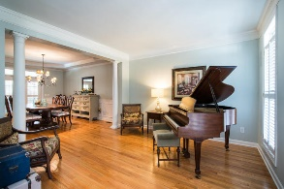
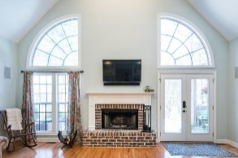
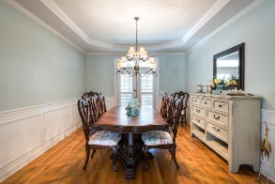
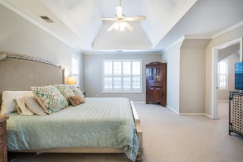
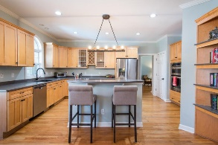
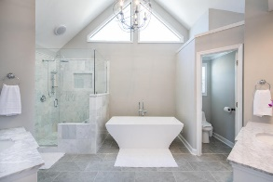
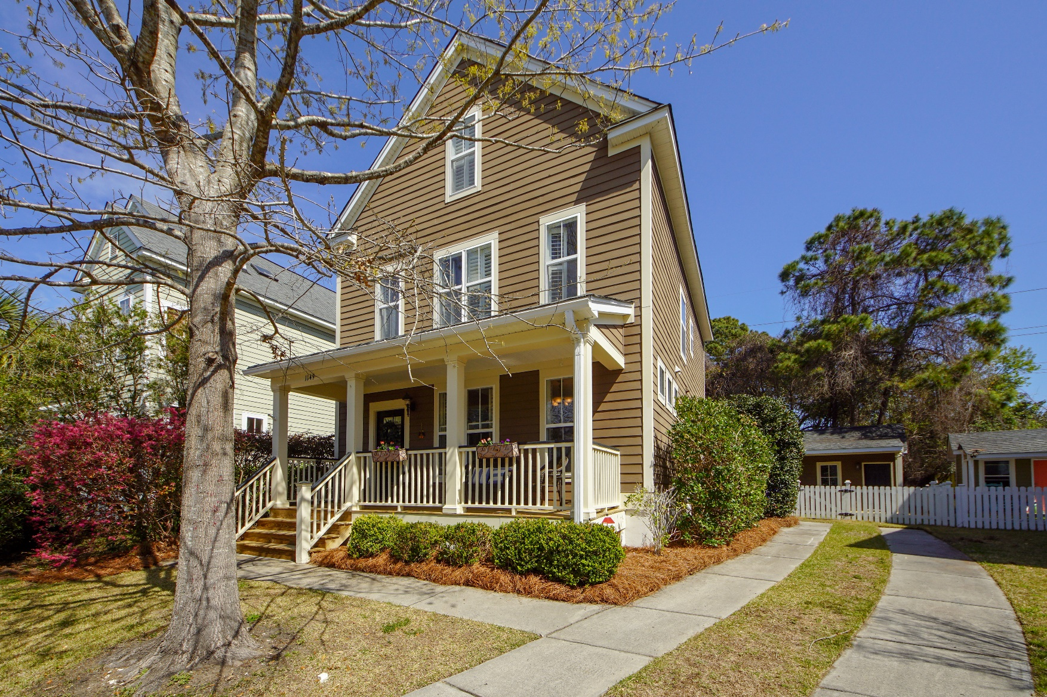
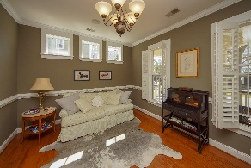
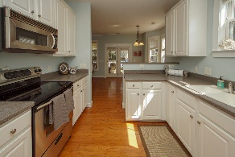
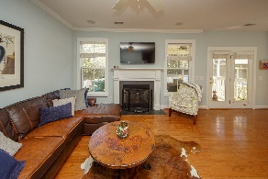
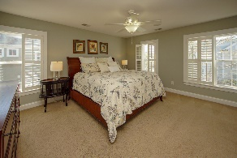
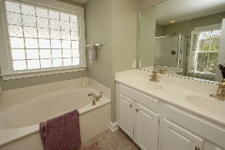
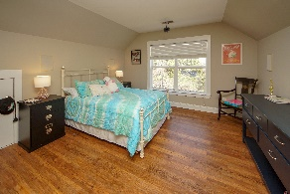
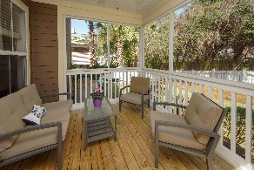
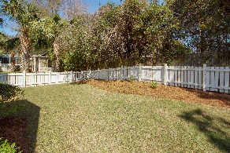
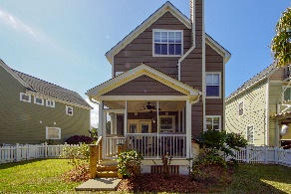


1149 Dawn View Terrace New Parrish Village ~ Mount Pleasant, SC 29464 MLS# 19007554 ~ $510,000
NEW PRICE!
Rent to Own!
Location, Location, Location!!! Centrally located to everything in Mt Pleasant- walk or ride your bike! Only 2 miles to Sullivans Island Beach, walking distance to many shops and restaurants off Coleman Blvd, 2 miles to I526 and Mt Pleasant town center. This gorgeous home has upgrades galore! Nice hallway entrance with the formal dining room to the right and built-in bench on the left. Eat-in kitchen includes corian countertop, stainless steel appliances, white cabinets and an area for barstool seating. Spacious family room has a gas burning fireplace, surround sound, and lots of natural light! Half bath with pedestal sink is conveniently located downstairs. Step outside onto your private screen porch overlooking the freshly manicured fenced yard. Oak floors span the entire 1st floor and stairs leading to the 2nd floor. On the 2nd floor you will find an oversized master bedroom with surround sound. The master bathroom has a dual vanity, soaking tub and separate stand up shower. Two guest bedrooms share a hall bath. On the 3rd floor you will find the 4th bedroom and 3rd full bath. The 3rd floor is so versatile! Currently used as a bedroom but could easily be a media room, office, Mother-in-law suite, or playroom. The owners just added beautiful laminate flooring to the 3rd floor! Full bathroom and closets make this a fantastic space. Large storage shed in the backyard included, perfect for your bikes, beach chairs and lawn equipment. Owner installed a new HVAC system in 2015. Schedule your appointment today, you will be impressed with the home and location!
Cathy Sembower 843-259-1350
csembower@carolinaone.com www.cathysembower.com
Carolina One Real Estate
195 W Coleman Blvd
Mt Pleasant, SC 29464-3495

