Slide 1
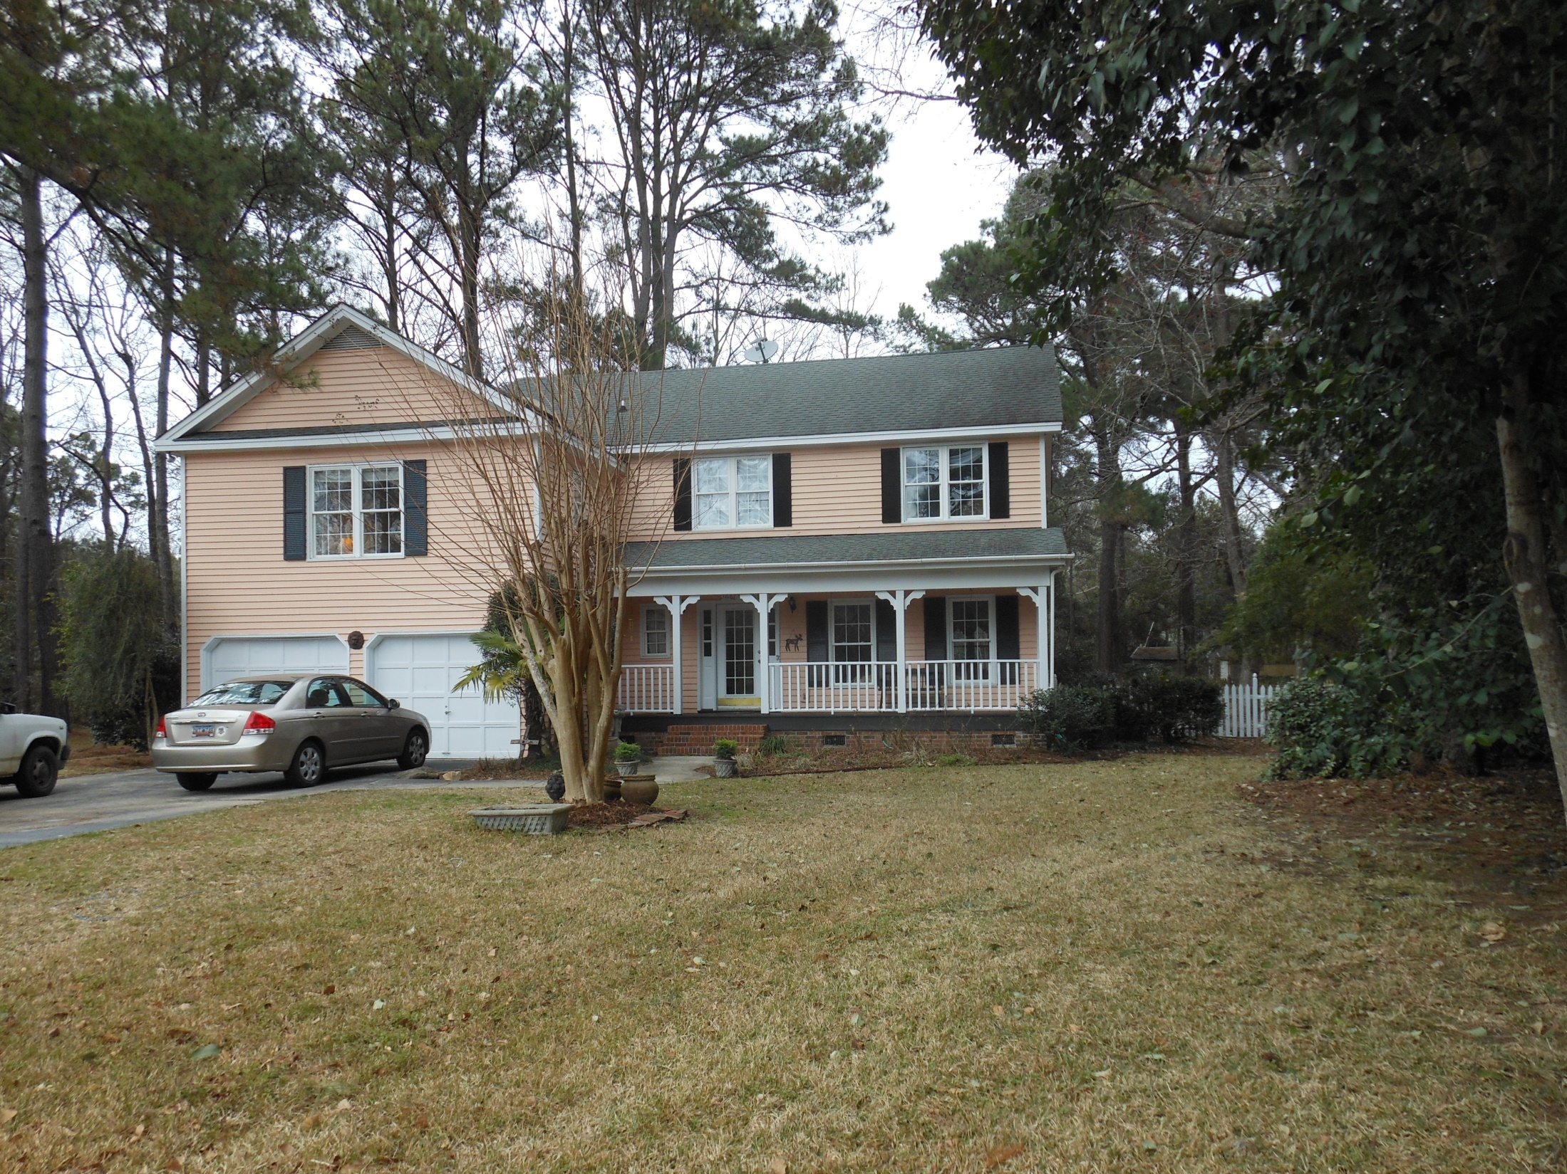
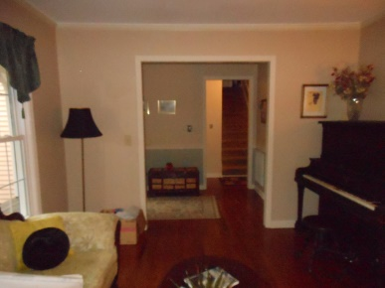
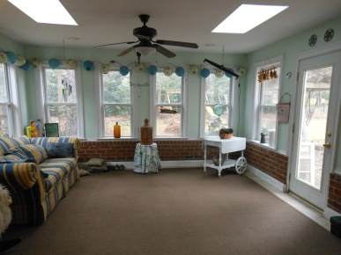
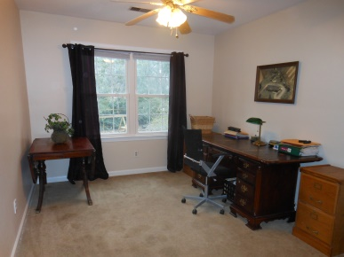


Open House! Sunday from 1-3
1149 Pegnail Corner
Snee Farm ~ Mount Pleasant ~ MLS# 15004701 ~ $418,000
5 Bedrooms ~ 3½ Baths
Mari Webb
(843) 708-5225 - mariwebbsells@gmail.com
www.mari.lifetreerealestate.com

