Slide 1
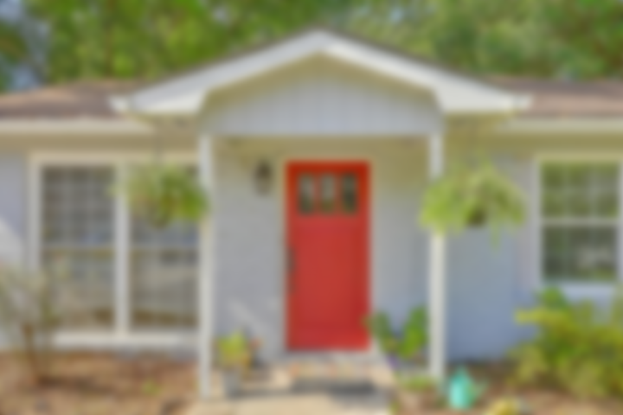
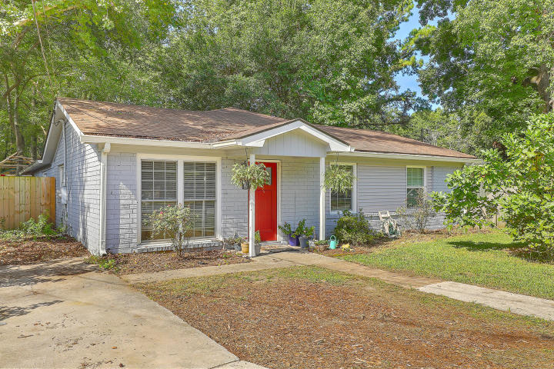
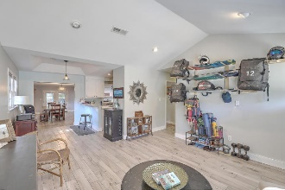
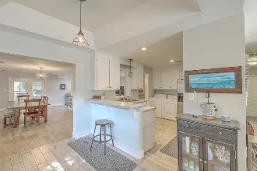
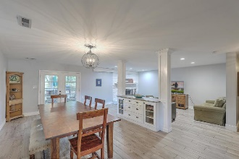
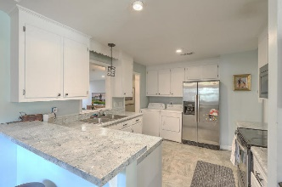
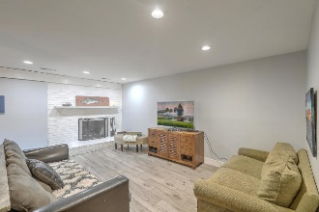
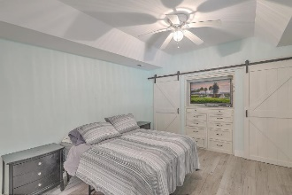
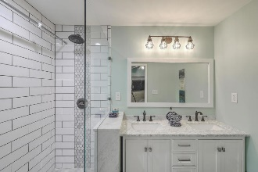
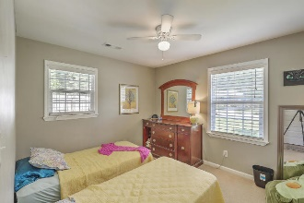
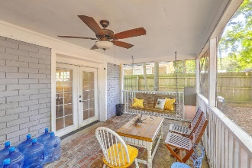
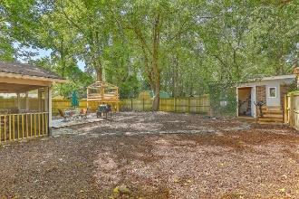

No HOA and X Flood Zone!
1149 Shadow Drive
Hickory Shadows
Mount Pleasant, SC 29464
MLS# 20022843
$399,999
4 Bed | 2 Bath | 2,010 SF
INCREDIBLE LOCATION in South Mount Pleasant!
Bring offers! This wonderful, updated home features 4 bedrooms, 2 full baths, and just over 2000 square feet. As you walk into the home, you'll notice the vaulted ceiling in the front room, and beautiful tile flooring throughout much of the home. The central kitchen opens up to a breakfast area with counter seating, a huge dining room, and a spacious living room with brick fireplace. The Master Bedroom and Bathroom were completely redone a few years ago and include a beautiful walk-in shower, vanity, and awesome barn-door storage closets! Out back, you'll find great outdoor space including a screened porch and comfortable backyard.

