Slide 1
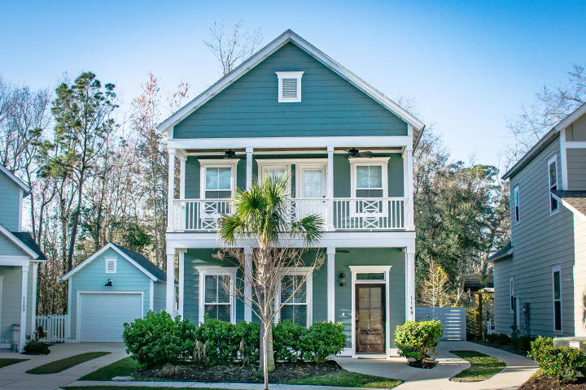
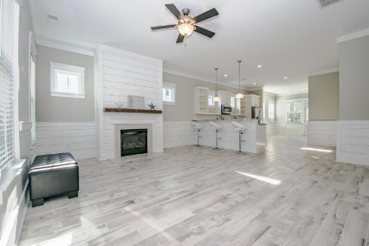
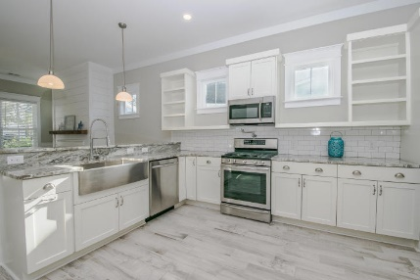
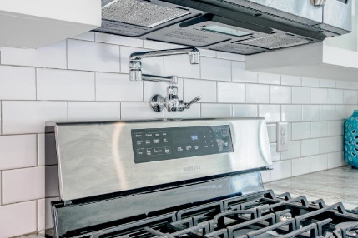
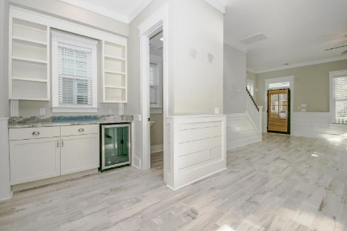
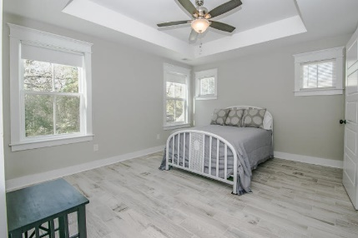
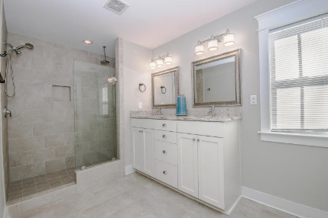
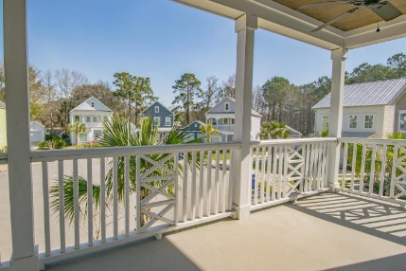
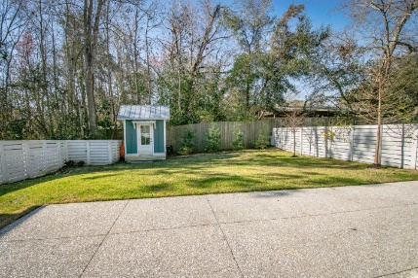


1149 Wexford Park
Wexford Park
Mount Pleasant, SC 29466
MLS# 18005342
$432,000
Shiplap…
Wine Fridge…
Pot Filler!
Located in a quiet cul-de-sac ~ this home is amazing! Gorgeous southern style home with solid craftmanship & an open floor plan all the details that will WOW you! Shiplap throughout the main level & custom trim around all windows & doors both upstairs & down, upgraded gorgeous wood look tile floors, stair riser tiles and double front porches! The home has a custom back patio & fenced yard with a 6x8 storage shed! Gourmet kitchen w/open cabinets, an apron front sink, sparkling granite, subway tile, bulter's pantry with wine fridge and a pot filler over the stove. The master suite has a large walk-in tile shower with rain head & shower head. It also has a double vanity with granite countertops. Flex space on main level could be a sitting/study or desk/office area. Perfect condition!
Lauren Zurilla (843) 991-9149
laurenismyrealtor@gmail.com
LaurenZurilla.com
AgentOwned Premiere Group
824 Johnnie Dodds Blvd
Mt Pleasant 29464

