Slide 1
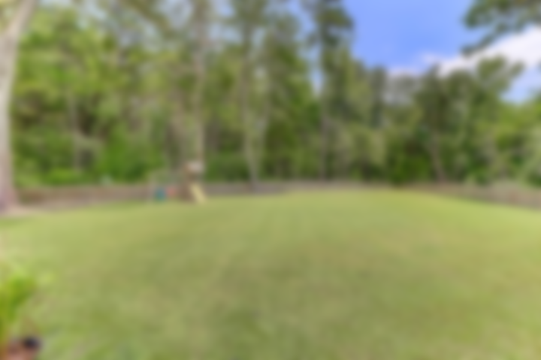
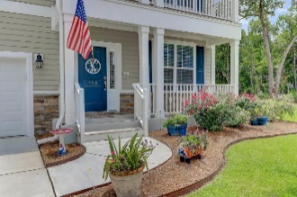
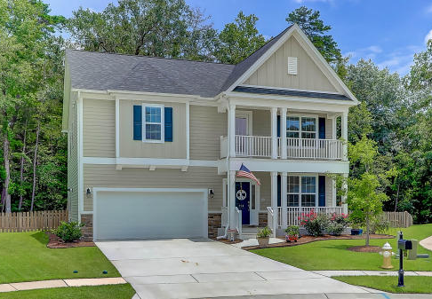
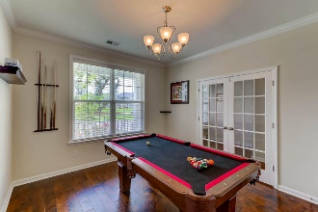
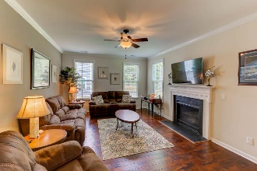
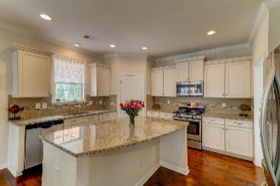
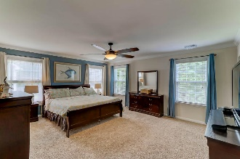
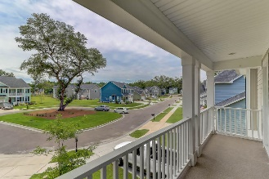
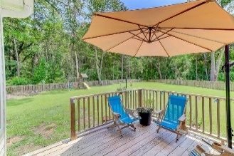
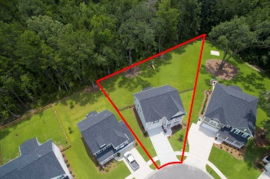
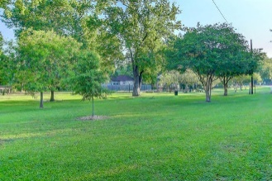
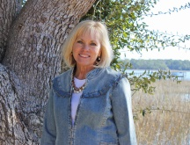

.39 Acre Wetlands Cul-de-sac Lot
Dorchester District II Schools
114 Daniels Ridge Drive
The Bluffs at Ashley River ~ Summerville ~ MLS# 17020468 ~ $368,000
This is a beautiful home on an awesome lot-almost .4 acres-Custom fenced back yard and backs up to wetlands-arguably one of the best home sites in the neighborhood! Built in 2015*Open concept floor plan (The Palmer) with double front piazza porches overlooking green space out front*Lovely popular Carolina Sunroom off the family room, fireplace in Family Room & Butler's Pantry between Kitchen & Dining Room with cabinets & granite counter tops*Absolutely beautiful open bright kitchen with island, granite & stainless*VERY spacious Master Suite along with 3 additional nice sized bedrooms*Carolina Sunroom opens onto great deck for relaxing or grilling-- all overlooking your great backyard! Neighborhood is in popular Dorchester II Schools and has great amenities-pool, clubhouse & playgrounds* Seller uses Dining Room as a pool/game room! Homesite backs up to wetlands per builder!
Sheila Romanosky
(843) 224-0242
sromanosky@carolinaone.com

