Slide 1
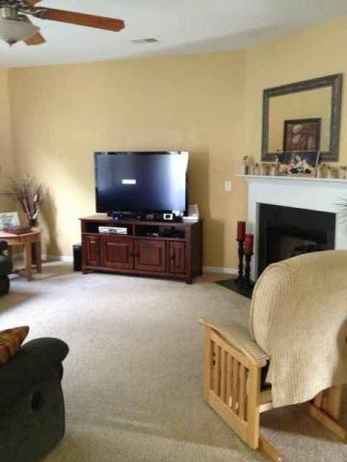
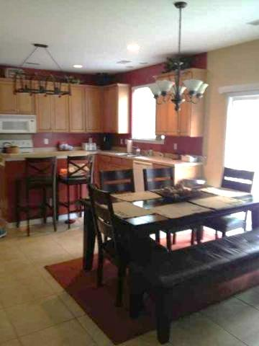
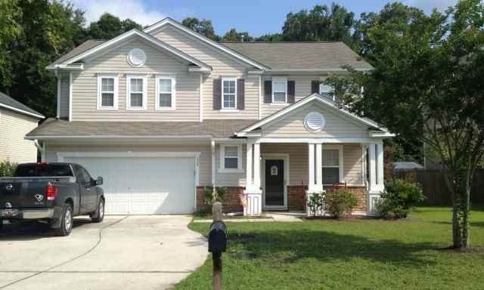
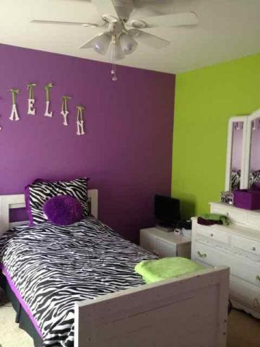
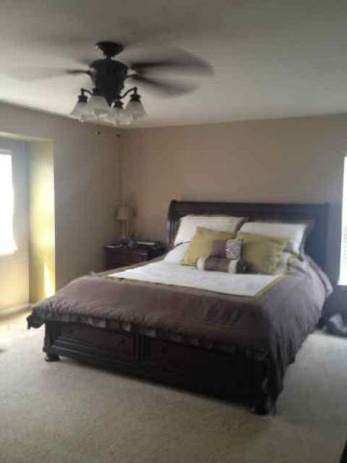
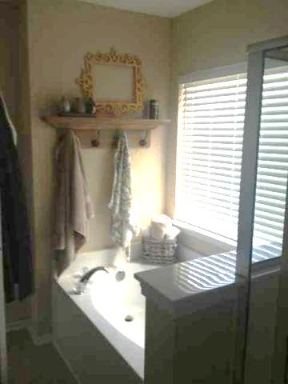


Open House Sunday from 10 to 4
114 Graduate Lane
Eagle Run ~ Ladson
MLS# 15013765 ~ $224,500
HOME WARRANTY AND PRE-INSPECTION PROVIDED!
Meticulously maintained, beautiful 4 bedroom on spacious fenced lot. This property backs up to wooded private bliss! Large master suite with garden/soaking tub and separate shower and a large walk-in closet. A large kitchen with island, open to dining and family room. Open floor plan is great for entertaining. A fully fenced and private backyard and patio are a great place to entertain and barbecue. The pond is fully maintained by the homeowners association for mosquito and algae prevention. Short commute to Air Force Base, Boeing and Airport. If square footage is important, measure.
Amy Lima
(843) 478-3009
lima.realtor@gmail.com
www.hornerealty.net
Horne Realty, LLC
133 East First North St,
Suite 5
Summerville, SC 29483

