Slide 1
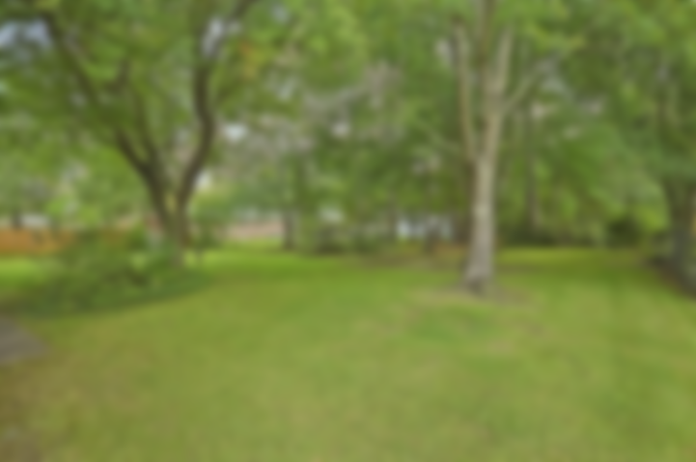
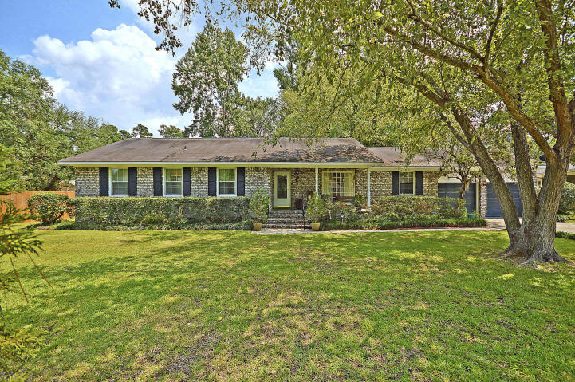
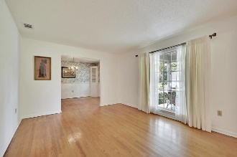
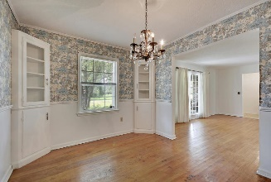
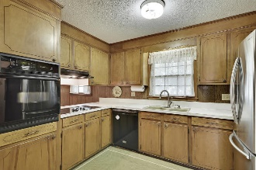
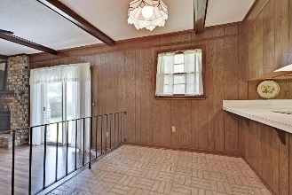
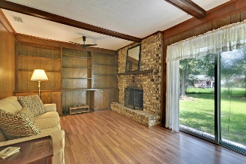
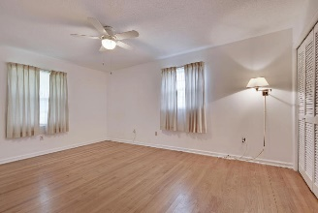
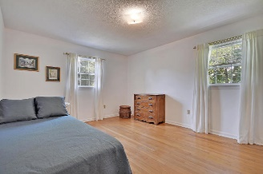
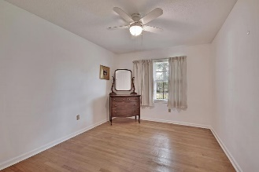
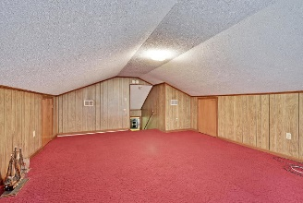
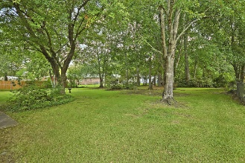


114 Middleton Drive
Oaks Estates | Goose Creek | MLS# 19022439 | $230,000
Great Ranch in Goose Creek
Asking $1,200,000
MLS# 17023051
3,692 SqFt
4 Bed/3½ Baths
Short Drive to Historic Downtown Charleston & Beaches
Wonderful ranch home in the much sought after Oaks Estates neighborhood. This location is close to the Naval Weapons Station as well as Volvo, Boeing, Google, Parks, Boating, Golf, Shopping and Schools. The fabulous .52 acre fenced yard allows plenty of room for cookouts, children's play and privacy. Home has 3 bedrooms and a FROG that could be the 4th bedroom. There is a laundry room off of the kitchen leading into the two car garage with a work bench. Enjoy family meals in the traditional dining room with fabulous chandelier from time gone by. Relax on the front porch with sweet tea & enjoy the quiet atmosphere of your new home. Hardwood floors run throughout most of this house with the exception of the kitchen and frog. A new Rinnai system & approx. nine year old A/C assures your comfort. No HOA!
Gay Slough
(843) 452-9708
gslough@carolinaone.com
Carolina One Real Estate • 195 W Coleman Blvd • Mount Pleasant, SC 29464
www.gayslough.com

