Slide 1


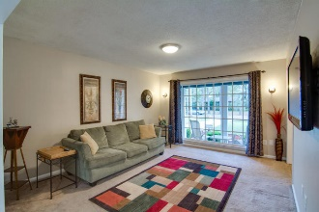
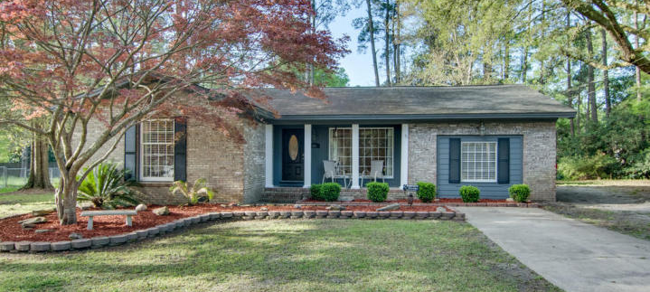
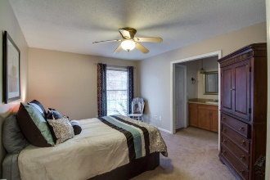
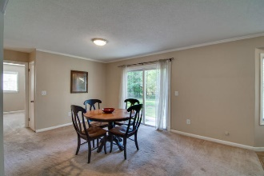
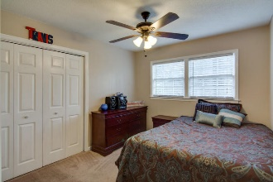
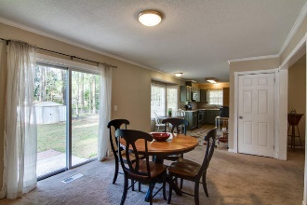
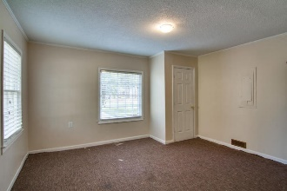
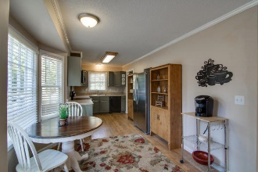
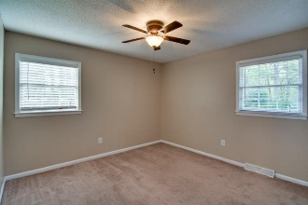
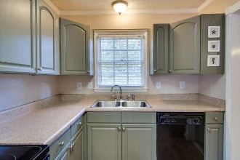
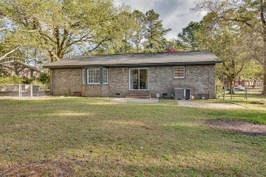
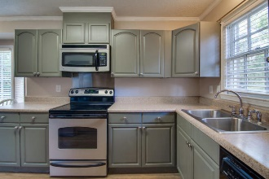
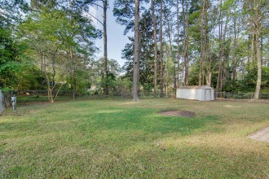

Great New Listing!!
114 Niblick Road
Corey Woods ~ Summerville
MLS# 16008522 ~ $157,900
Just Reduced!
Dorchester II schools, Large lot, Close to town, One story, Well maintained, No HOA, 1700 sq ft., just what you have been looking for in a home! Enter this well maintained home to the open foyer. To the right find a large family room with plate glass window for a light and welcoming living area. Continue to the formal dining room, which can easily accommodate large furniture for family gatherings. The patio is off the dining room, convenient for outdoor entertainment. Eat-in kitchen area with bay window is perfect for casual meals. Kitchen is complete with stainless stove, built-in microwave and refrigerator, shelving units to remain for additional storage and are a perfect addition to this functional kitchen. Dishwasher also included. Off the kitchen is the large laundry area and converted garage which can be used as the 4th bedroom or office, has partially finished closet. Bedrooms are located on other side of the house. Master is large enough for a king bed and armoire. The bathroom has been updated, and includes tiled shower/tub combo and walk-in closet. The secondary bedrooms are also spacious. Hall bath has been updated, and has plenty of room to move around. The yard is huge, approx. .4 acre lot! Call to schedule your appointment to view this beautiful home today!
Laurie A Loparo, ABR
laurieloparo@gmail.com
lauriesellscharleston.com
Golden Bear Realty | 654 Coleman Blvd, Suite 100 | Mt Pleasant , SC 29464
Cell (843) 442-1290 | Office (855) 352-9088 | Fax (561) 721-3311

