Slide 1
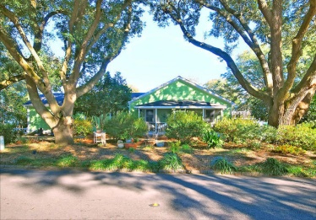
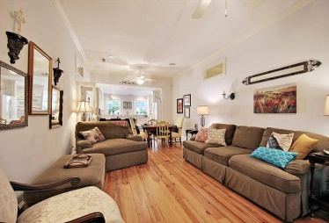
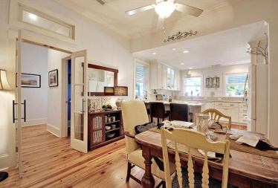
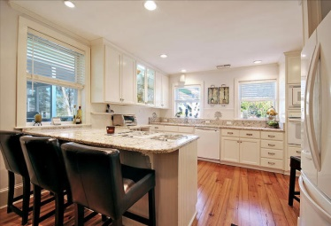
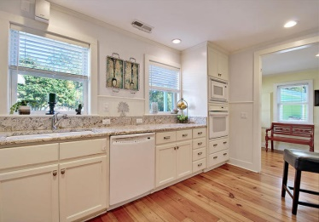
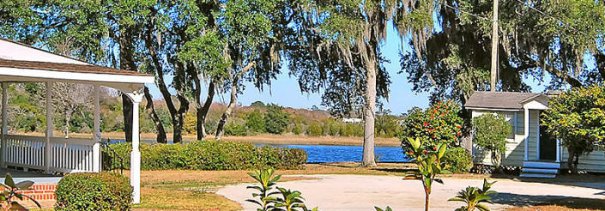
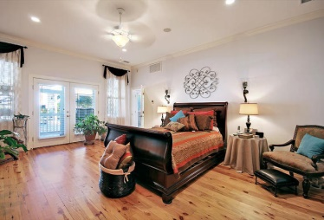
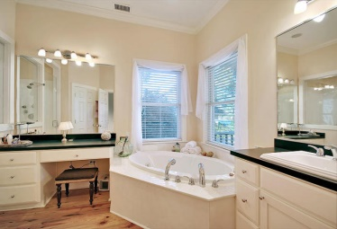
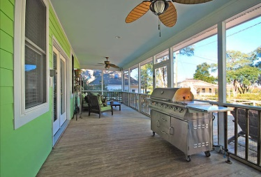
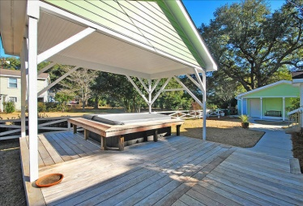
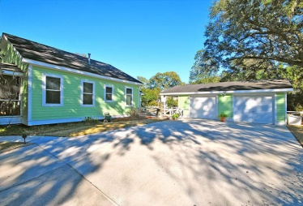


Riverland Terrace with River Views!
114 Old Point Drive
Riverland Terrace - Charleston - MLS# 15002806 - $659,000
Amazing renovated home in the heart of Riverland Terrace with unobstructed views of the river and amazing Grand Oaks! Don't miss this spectacular home! The owners have painstakingly maintained this home and added several luxurious features over the last several years. As you enter the home through the expansive front screened in porch you will note wide plank Heart of Pine floors throughout, along with 10 ft vaulted ceilings. The spacious living room features a built in entertainment center, recessed lights, surround sound throughout and flows beautifully into the Chef's kitchen. Perfect for entertaining guests and the family! The kitchen boasts granite counter tops, a gas built in range, custom cabinets, brand new refrigerator and views of the river from the kitchen sink! There are spacious bedrooms on the right side of the home, both with large closets and built-in speakers. They share an amazing bathroom with claw-foot tub, custom wainscoting, moldings and vanity. The expansive foyer separates the two bedrooms and is the perfect location for artwork and the like. The third bedroom also features built-in speakers, large closets and an amazing en suite bath. The grand master suite offers a marvelous space with tons of natural light, a palatial master bath with separate soaking tub, dual vanities and an incredible glassed in shower with multiple heads and a huge walk-in...amazing. The master suite flows directly into the custom hardwood deck screened in porch, which is enormous and offers views of the river. Porch has a gas grill tied directly into the gas line and ceiling fans. This then leads onto the custom IPE deck that was built custom to accommodate a jumbo private hot tub, encased in IPE decking and a structure built over top so you can enjoy it in all weather. The full laundry area with mud room can also lead you to the back deck area from the kitchen side. As you are walking around the outside under the oaks you will note a widened driveway that feeds to the newly expanded large two car garage with workshop and tons of storage. You will also note all new Hardie Board cement plank siding was added, all new windows and transom windows throughout. The list of upgrades also includes: two new Renai hot water heaters, Professional landscaping, a central vacuum system, large 10 inch baseboards, crown moldings, recessed lights, new fixtures, new HVAC in 2008, new gas furnace with a hybrid feature in 2013 as well, there is also a ton of room in the attic which may be convertible to bonus space. This home is just a block away from the Riverland Terrace boat launch, the Riverland Terrace play park, the Terrace shopping center and much more. Don't miss your chance to own this amazing home!! A one year AHS home warranty will convey with this home!!
Dan Lorentz, Realtor
ERA Agent of the Year
843-532-4653
dan@danlorentz.com
www.danlorentz.com
ERA Wilder Realty, 125-F Wappoo Creek Dr, Charleston, SC 29412

