Slide 1

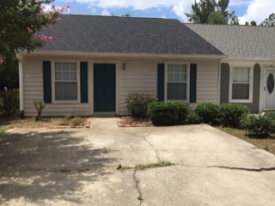

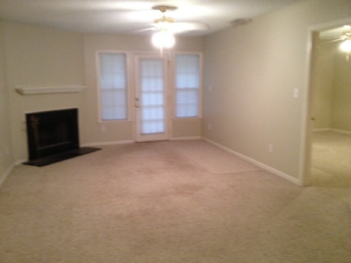
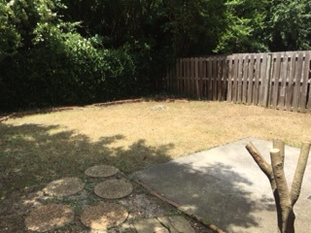
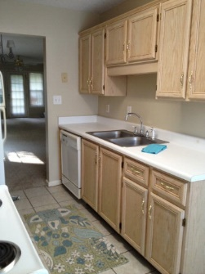
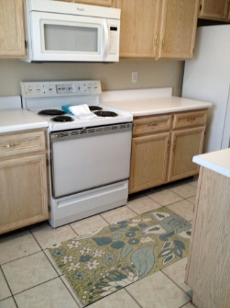
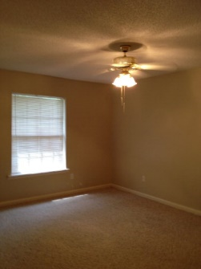
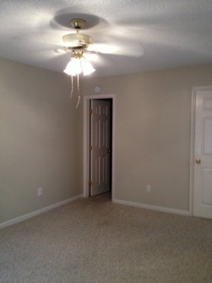
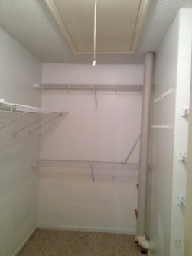
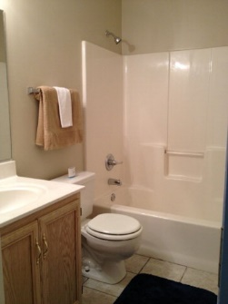


114 Raintree
Aiken, SC 29803
MLS# 89822 / $69,900
Well maintained two bedroom unit with private fenced backyard.
End unit with nice open floor plan. Great location, fresh paint with light and bright kitchen.
PRICE REDUCED owner wants it sold NOW!
Valli Catchpole
803.617.8540 / valli1@me.com
Property Consultants of the South, 1429 Lyon Dr SE, Aiken, SC 29801 / www.FineSouthernLiving.com

