Slide 1
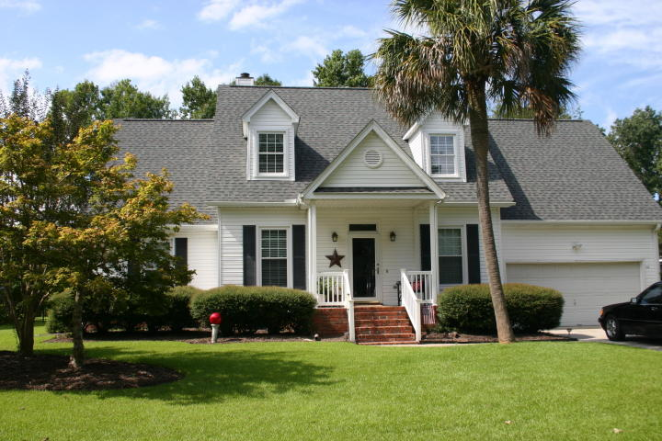
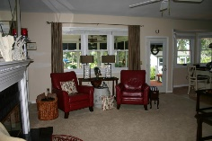
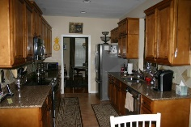
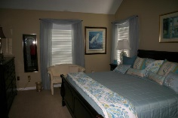
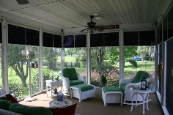
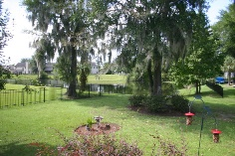


Shadowmoss Open House & Luncheon Friday, September 21st from 12:00 pm until 2:00
114 Shadowmoss Pkwy
MLS# 18024861
$380,000
Large screened/Eze-Breeze Sliding Windows back porch with beautiful view of pond stocked with wide mouth bass. Large deck with built-in seating and permanent acrylic finish. Lots of ceiling fans with individual remote controls. Kitchen cabinets replaced with quartz counter tops(better than granite), laminate flooring, and bay window. Living room has gas logs with remote and surround ceramic tile and hearth, new carpet. Master Bedroom bath cabinets replaced with quartz counter tops, frameless new shower door and garden tub, ceramic tile floor, new carpet and walk-in closet. Finished room over garage heat/air tied into upstairs unit. Upstairs Jack and Jill Bathroom completely refurbished with new cabinets, quartz counter top, beautiful modern lighting and mirror, enclosure for tub with hand held shower head that moves up and down, and ceramic tile floor. Lots of storage space. Laundry room has pedestal front loading w/d with storage underneath, coat rack, and shelf. Crawl space has Encapsulation System/Dehumidifier with inside digital moisture monitor. (No musty smell in this house) ADT Security. House has all the conveniences for a great serene lifestyle. GOLF COURSE COMMUNITY.. Square footage from appraisal, buyer to measure if desired.
Jean Gilmer
843-270-1666
jgilmergolfer@gmail.com
Agent Owned Realty
902 Savannah Hwy
Charleston, SC 29407

