Slide 1
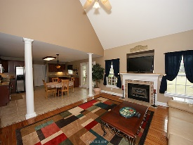
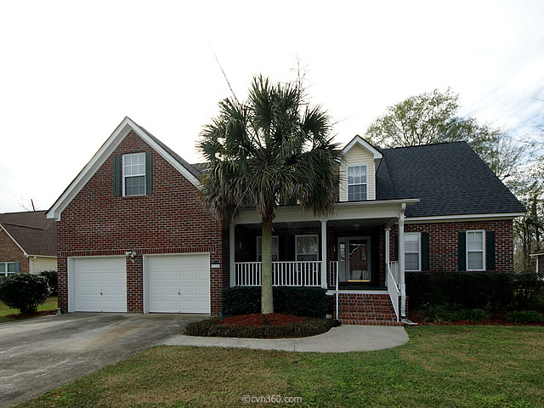
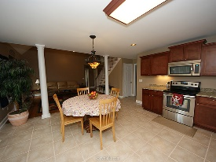
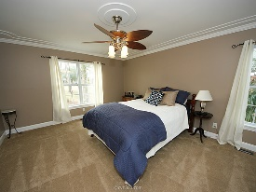
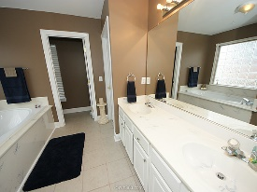
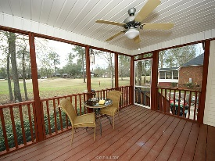
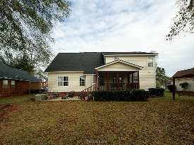
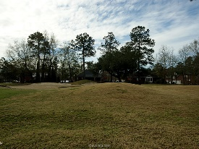


Open House Sunday ~ 12:30 to 3:30
114 Spalding Circle
Crowfield Plantation
Goose Creek, SC 29445
Open House Canceled!
Under Contract In 3 Days!
MLS# 16000514 | $299,000
4 Bed / 2½ Baths
Live on the 8th hole of the golf course in this gorgeous move in ready home! A welcoming foyer leads you into a spacious family room with gas fireplace, brilliant hard wood floors, a dining area & a bright, over-sized, eat-in kitchen with ceramic tile. Vaulted ceiling and open staircase add to the beauty! Sellers have installed an abundance of NEW cabinets, NEW granite counter tops, New stainless stove and New microwave! Appliances including refrigerator will convey with sale! Master bedroom is down stairs and 3 bedrooms are located up stairs PLUS a bonus room featuring hard wood floors! This home has been freshly painted and the sellers have installed a New roof and AC unit was replaced in 2013. Sellers pride shines throughout this home!
Connie White, Broker
C: 843-532-3356
conniesyouragent@gmail.com
Charleston Homes
111 Spring Hall Dr
Goose Creek, SC 29445

