Slide 1
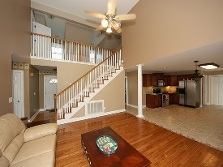
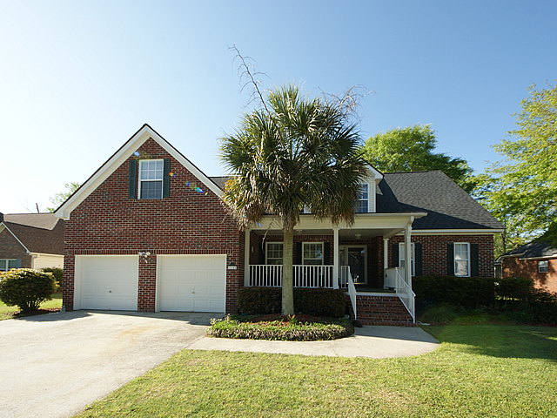
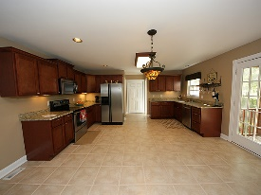
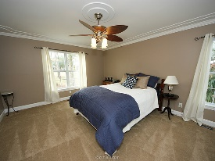
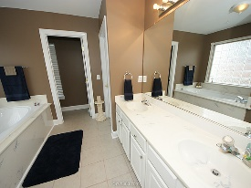
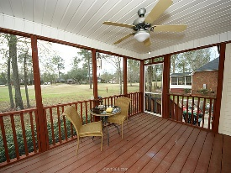
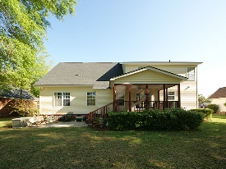
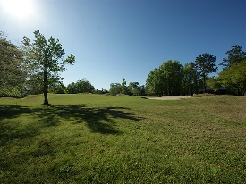


Sellers are motivated and ready for a buyer!
114 Spalding Circle
Crowfield Plantation
Goose Creek, SC 29445
Open House Canceled!
Under Contract In 3 Days!
MLS# 16000514 | $295,900
4 Bed / 2½ Baths
Elegant home on the golf course in Crowfield Plantation! This gorgeous home is move in ready! The floor plan is open featuring an oversized kitchen, eat in area and spacous family room. Vaulted ceiling and open staircase add to the beauty! Sellers have installed an abundance of NEW cabinets, NEW granite counter tops, New stainless stove and New microwave! Appliances including refrigerator will convey with sale! Master bedroom is down stairs and 3 bedrooms are located up stairs PLUS a bonus room featuring hard wood floors! This home has been freshly painted and the sellers have installed a New roof and AC unit was replaced in 2013.
Connie White, Broker
C: 843-532-3356
conniesyouragent@gmail.com
Charleston Homes
111 Spring Hall Dr
Goose Creek, SC 29445

