Slide 1
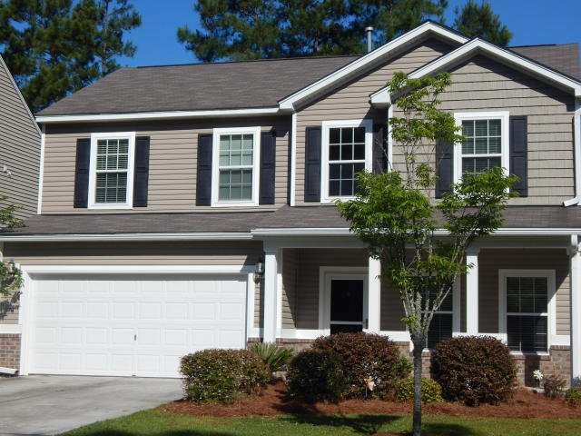
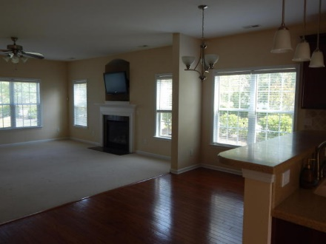
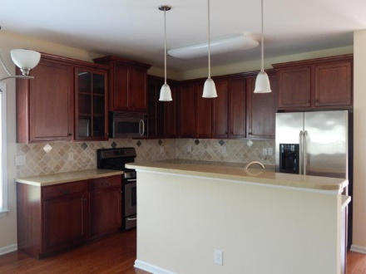
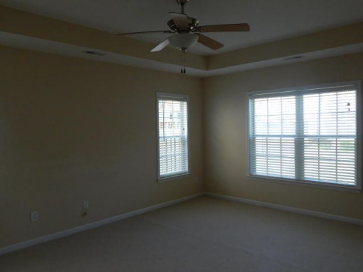
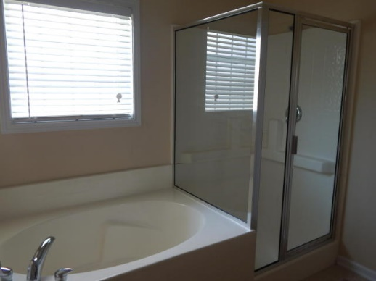
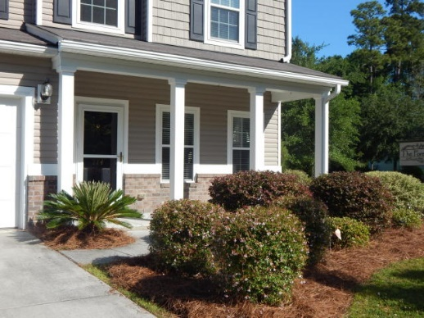
FABULOUS FAMILY-SIZED HOME IN DORCHESTER DIST 2!!!
114 Sweet Alyssum Dr
Summer Park
Ladson, SC 29456
MLS# 15012683
$259,900
4 Bedroom | 2½ Baths
Big beautiful home in swim community offers room for the whole family! Large 2-story foyer leads into light, open floor plan featuring formal dining room immediately to the right, with French doors; beautiful modern kitchen with solid surface counters, tile backsplash, upgraded cabinetry, & stainless appliances; huge great room with gas logs fireplace; & cozy sunroom on back with French doors to patio area. Lush master suite on main level offers designer tile floor & custom built-in for storage in bath, and large walk-in closet. Upstairs finds gigantic open living area -- could serve many uses. Three large BRs, all with walk-in closets & full bath with dual sinks complete 2nd floor area. Lots of storage access too! Extras include irrigation & security systems! Don't miss this one!! DORCHESTER DISTRICT 2 SCHOOLS!!
Darlene Bollettino
Real Estate Agent
Miler Properties
Office: 843-821-1111
Cell: 843-209-8955
dbollo84@yahoo.com
www.milerproperties.com

