Slide 1

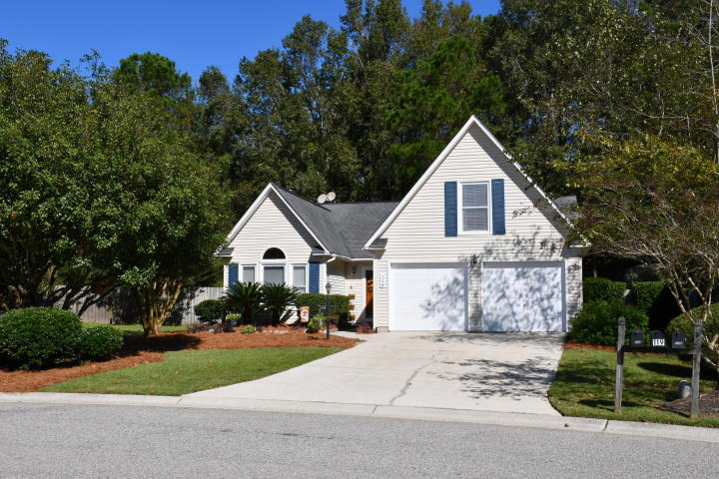
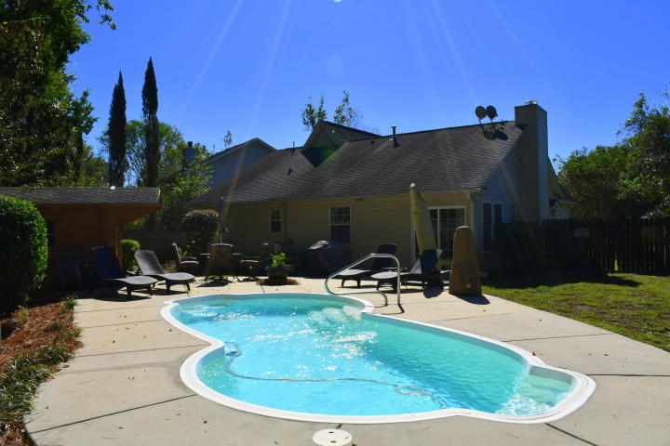
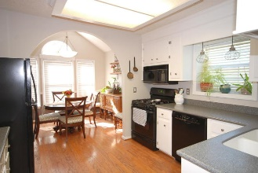
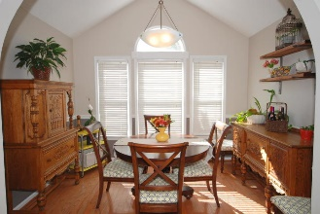
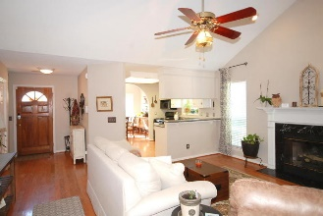
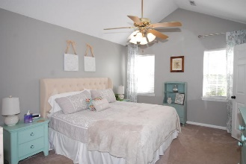
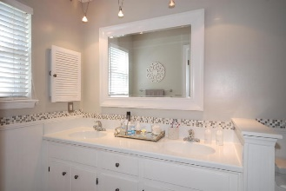

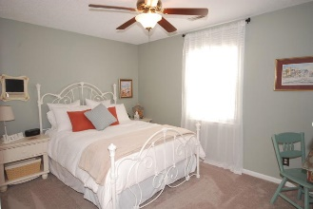
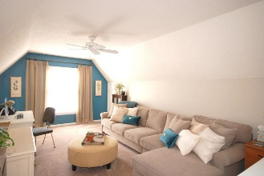
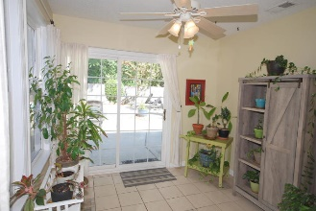
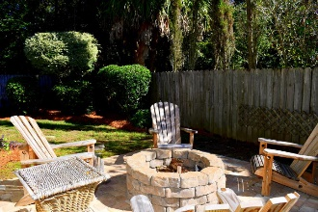
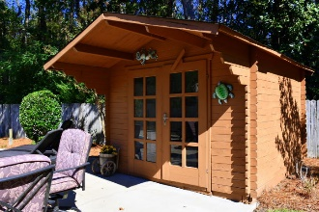
Debbie Cromer
ABR, RSPS, REALTOR, CRS
(843) 437-6342
debbie@debbiecromer.com
www.mylowcountryhomes.com
$1500 Agent Bonus
with close by 12/31/19
114 Toura Lane
Shadowmoss | Charleston, SC 29414 | MLS# 19030602 | $300,000
Beautiful home with IN-GROUND SALT WATER POOL and FIREPIT!
ALL BEDROOMS DOWNSTAIRS plus FROG upstairs and sunroom off the living room which featuring a vaulted ceiling. Master bedroom has a large walk in closet and attached bath. Other two bedrooms and full bath down the hall. Kitchen has solid surface countertops and newer appliances and leads to separate dining room . Sun room opens to the outdoor entertainment area with an in-ground salt water pool, expansive patio with pool house for storage and fire pit. Don't miss the cute barn doors to the laundry and FROG! Award winning Drayton Hall Elementary! Last time this home was on the market, it only lasted a couple of days.
Don't miss your opportunity to view this amazing property!
Century 21 Properties Plus | 1090 Park West Blvd; Ste 3 | Mount Pleasant, SC 29466

