Slide 1
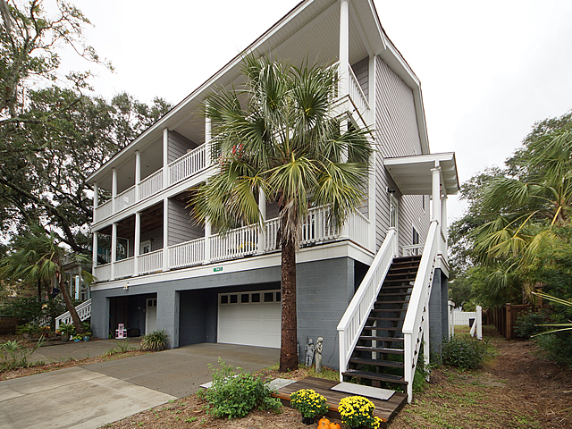
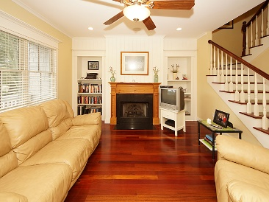
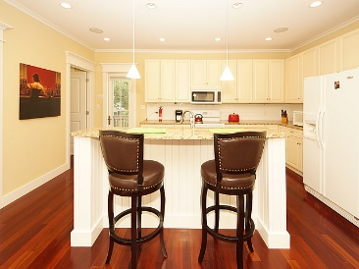
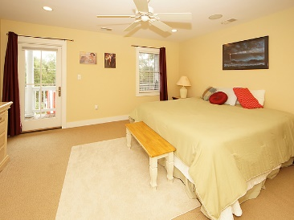
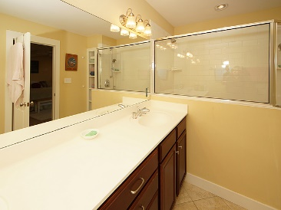
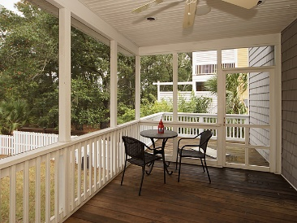
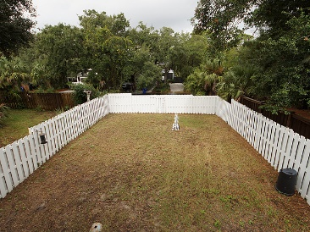

114 W Hudson A
Folly Beach, SC 29439
MLS# 17028794
$625,000
Open House
Sunday ~ 1-4pm
Reduced $32,000
Weekly Rentals are allowed One of a kind, immaculate home for sale by original owner located 1 block from downtown Folly, the bottom floor has a 2 car garage with a workshop area, pet doors from yard to garage and to the 1st floor which has a front deck, open living room, kitchen, 1/2 Bath, laundry room, and a back porch and deck. Off the garage is a private Oasis where you can soak away your trouble's in a slipper claw jetted tub in total privacy. The top floor has a spacious master with a walk in closet, and large bath in addition to the two other bedrooms and full bath. Home has all the extra's, crown molding, tank-less hot water heater. Don't miss out on your opportunity to "Live on the Edge". No Regime or HOA, Hazard/Flood is only 3,000 a year. Option to purchase furnished.
This property covers the entire lot from front street to rear street, the back portion has ample room for parking a boat, trailer etc. behind the fenced yard.
Gerri Sandford
(843) 817-8762
gsandford29455@gmail.com
Anchor Line Realty LLC
1619 Samuel Rd
Charleston, SC 29412

