Slide 1
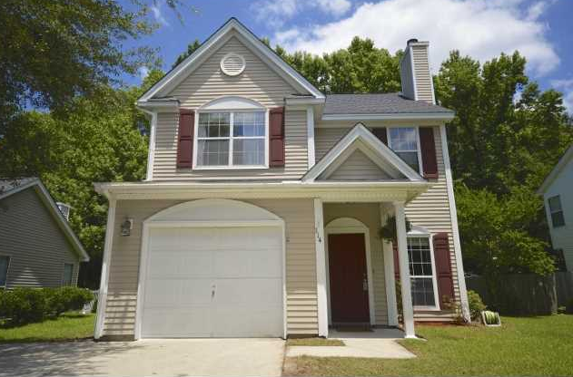
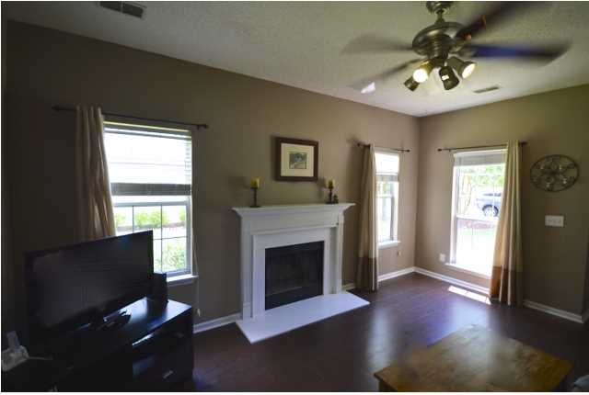
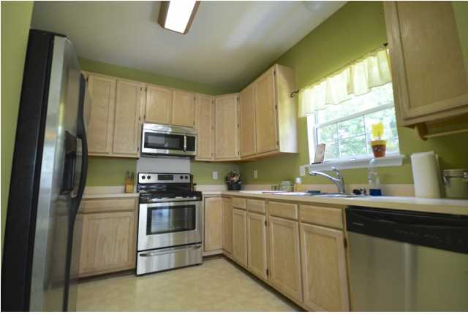
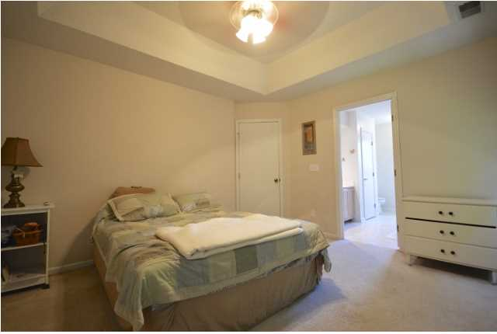
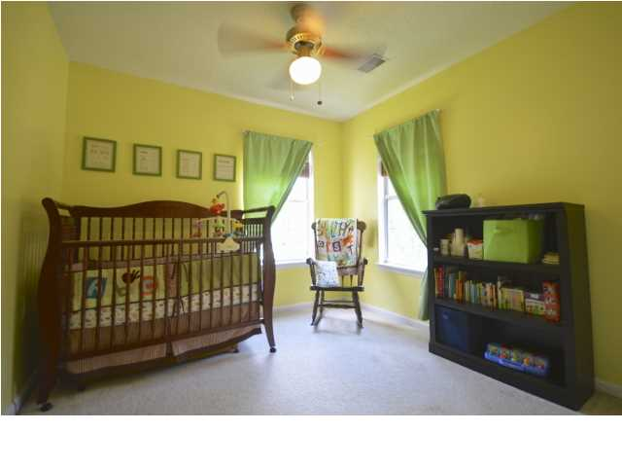
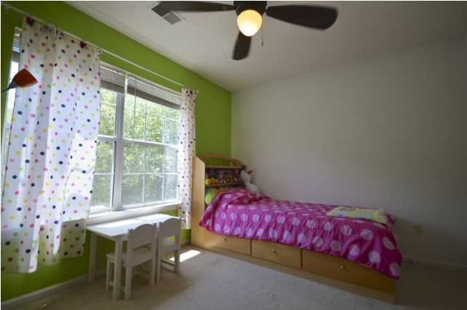


114 West Hartwick Ln
Views Of Intracoastal Waterway
Crowfield Plantation ~ Goose Creek, SC ~ MLS# 1416285 ~ $148,500
Bring your clients to see this adorable home. Living area has a nice wood burning fireplace. Kitchen has stainless steel appliances and the refrigerator conveys! Upstairs you will find the laundry area 3 bedrooms and two full baths. This home also has a great back yard with a wooded area for privacy. This is a great neighborhood with walking trails, sidewalks and other amenities. Zoned for Westview elementary/middle and Stratford High. It is the buyers responsibility to confirm square footage, schools, HOA fees and any other information deemed important.
Chuck & Edy Mimms
Cell 843-224-9507
Office 843-530-8100
www.sanddollarsc.com
www.facebook.com/Sanddollarsc
Sand Dollar Real Estate Group | 2205 Middle Street | Suite 203, Mailbox 2 | Sullivans Island, SC 29482

