Slide 1

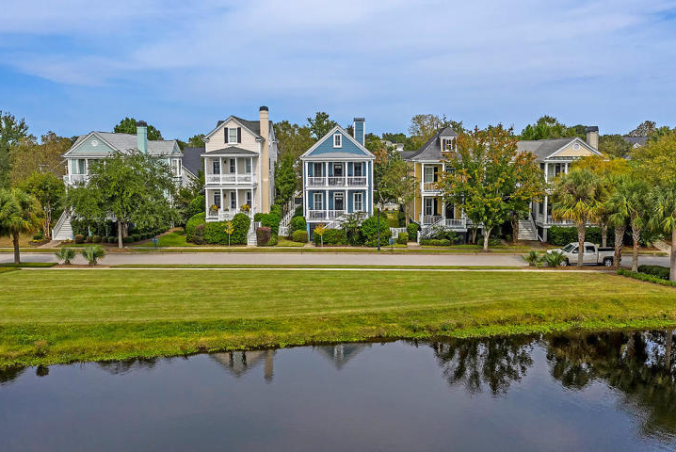
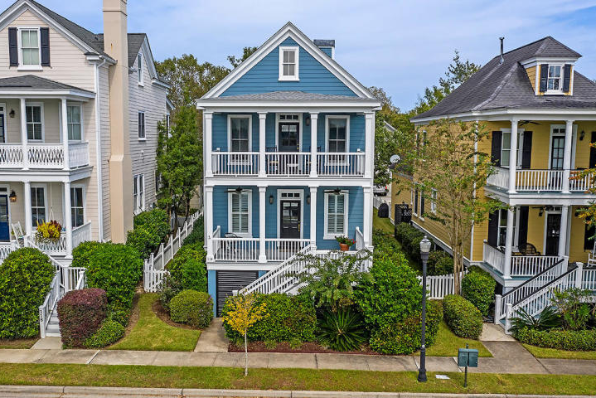
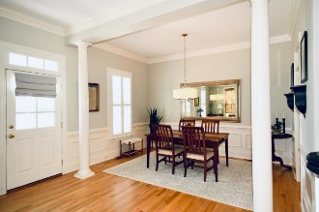
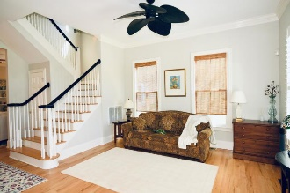
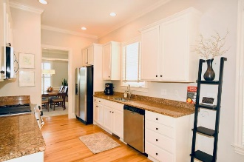
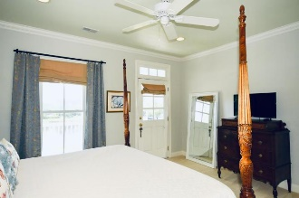
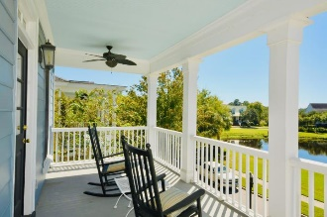

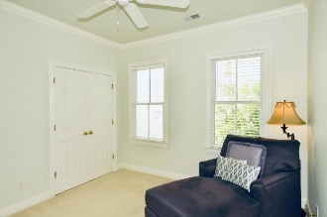
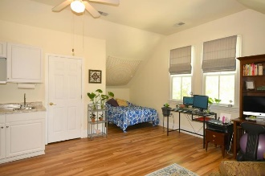
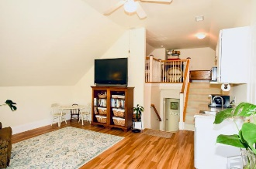
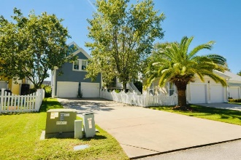
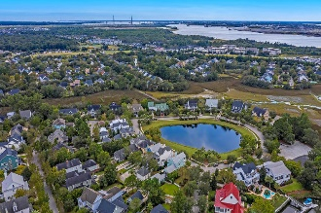
Stunning Custom DI Home
with Beautiful Sunset Views
Debbie Cromer
ABR, RSPS, REALTOR, CRS
(843) 437-6342
debbie@debbiecromer.com
www.mylowcountryhomes.com
114 Currier Street
Daniel Island | Charleston, SC 29492 | MLS# 20027144 | $775,000
Stunning Custom built Charleston single-style home facing Beresford Creek Park with gorgeous lake views. The double front porches are perfect for watching wildlife and the beautiful sunsets. The main floor features spacious living spaces with beautiful hardwood floors and 10 ft ceilings. Upstairs you find the large master with updated luxury bath as well as two additional bedrooms and full hall bath. Over the attached garage is the mother in law suite/ attached FROG that includes a full bath, kitchenette and large living and sleeping areas that can be accessed from both inside and outside the main house and has been rented in the past for $1000/mo. New roof, new tankless water heater and spray foam insulation beneath the house. Steps from the boat ramp.
Video Tour: http://114currierstreet.eproptour.com/
Century 21 Properties Plus | 1090 Park West Blvd; Ste 3 | Mount Pleasant, SC 29466

