Slide 1
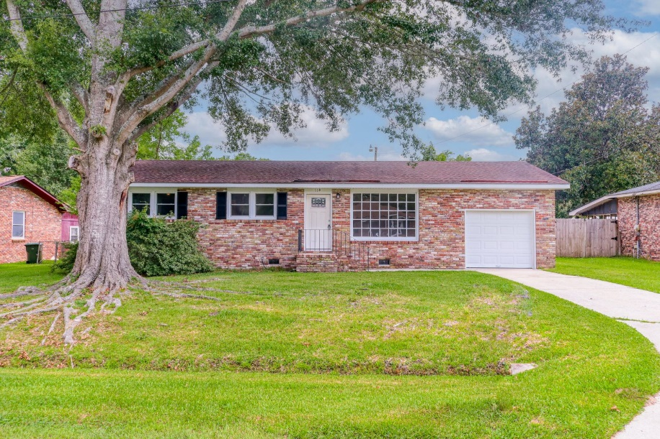
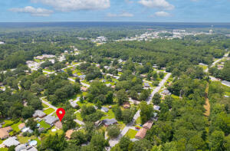
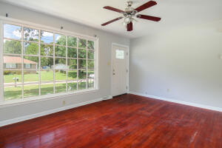
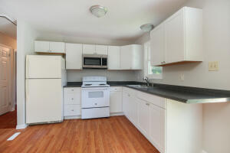
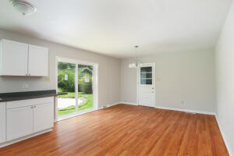
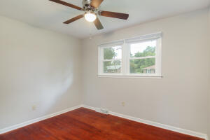
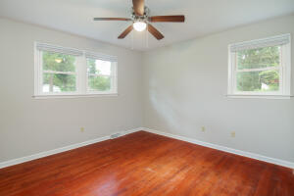
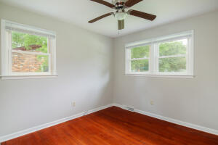
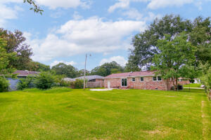
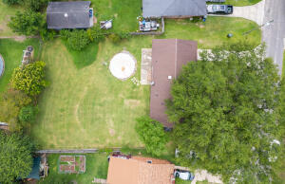



114 Edmund Road Greenview ~ Goose Creek, SC 29445 MLS# 22019486 ~ $235,000
THIS WILL GO FAST ~ EXCELLENT LOCATION
YOUR CHANCE TO LIVE IN A NICE NEIGHBORHOOD WITH NICE NEIGHBORS IN A NEWLY RENOVATED 3 BEDROOM 1 FULL BATH HOME! PERFECT LOCATION TOO! Easy access to 26, a walk to Goose Creek High School, and close to US Naval Station. New kitchen appliances,,new A/C system, new bathroom, refinished wood floors, new paint and more!
Susan Stanley
832-323-5573
susancstanley@gmail.com
Brand Name Real Estate
4 Carriage Lane Suite 106
Charleston, SC 29407

