Slide 1

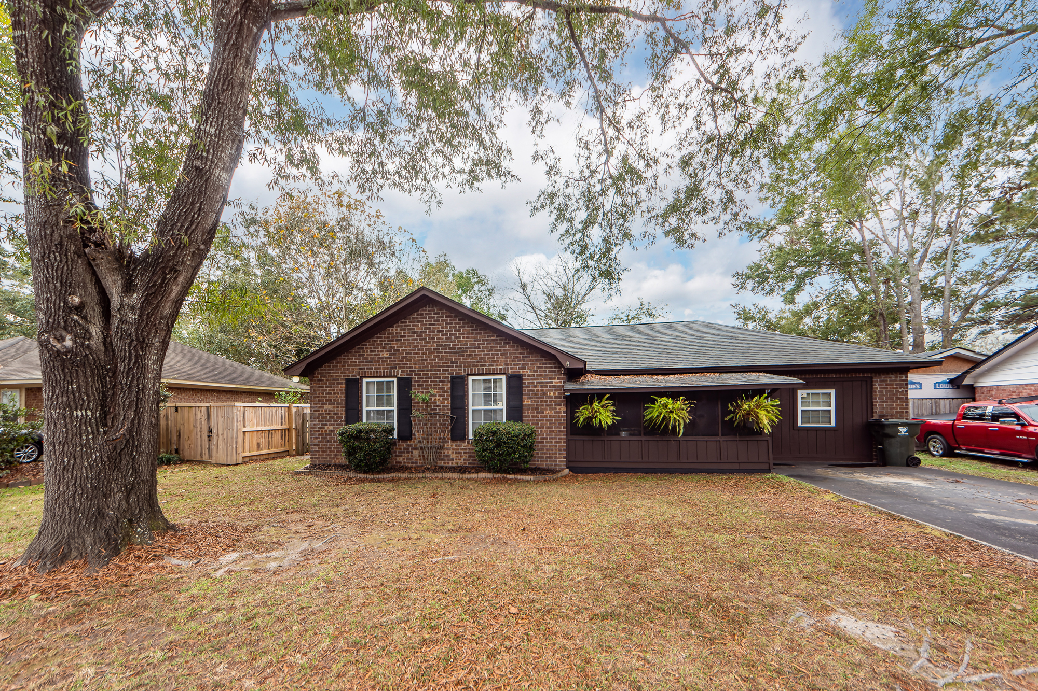
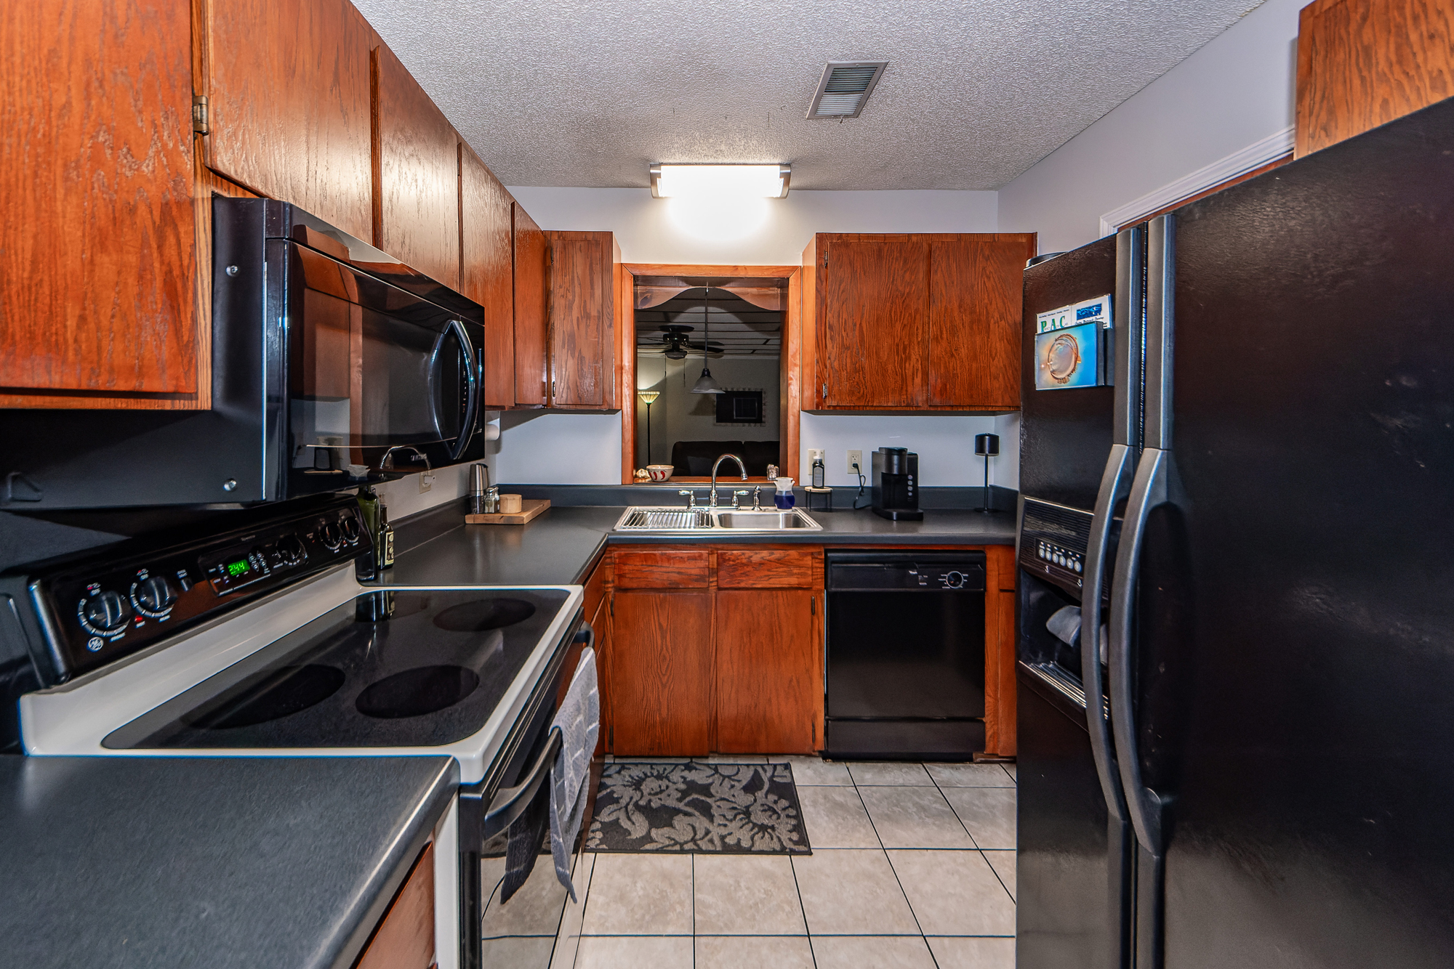
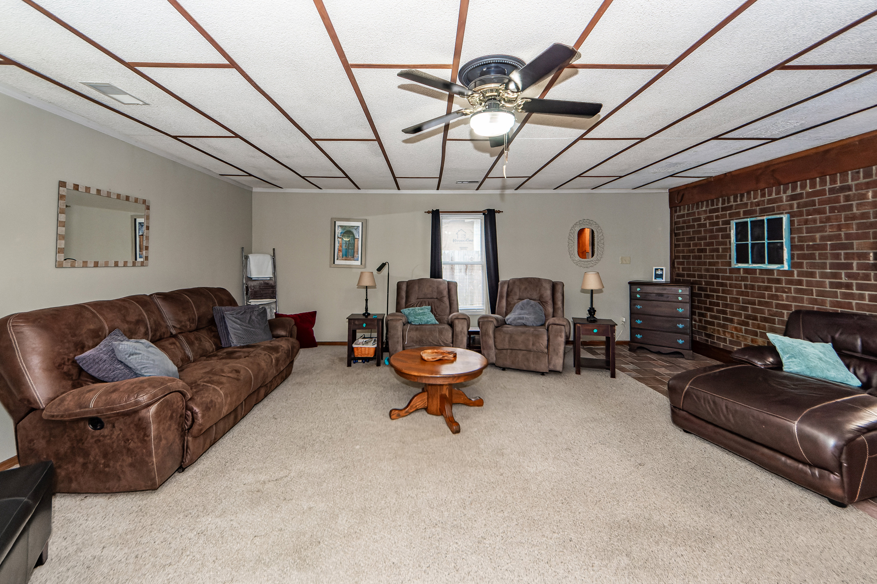
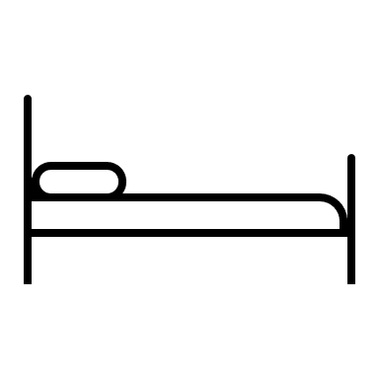

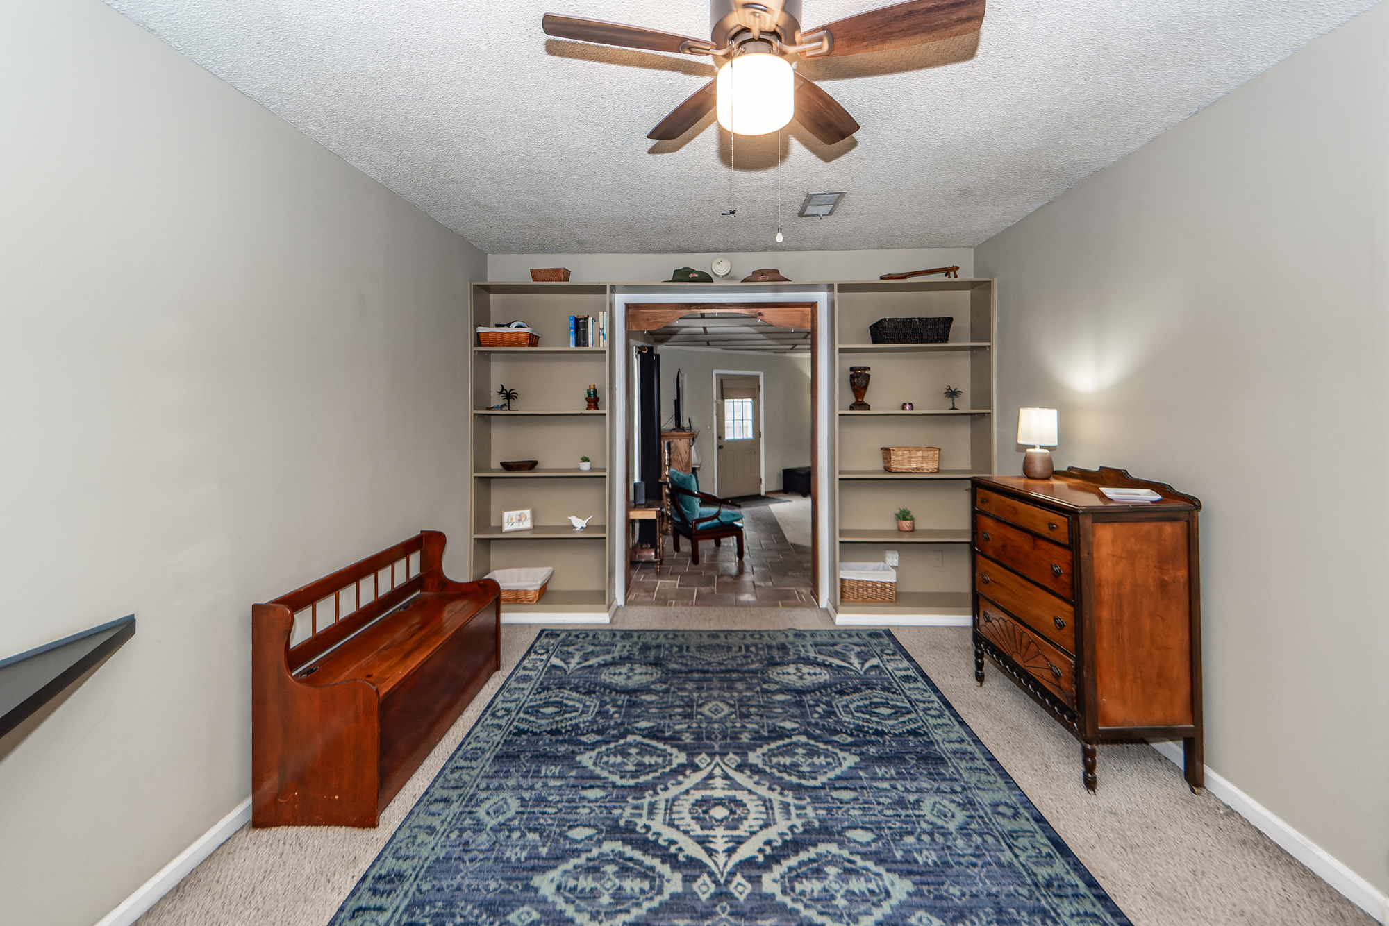
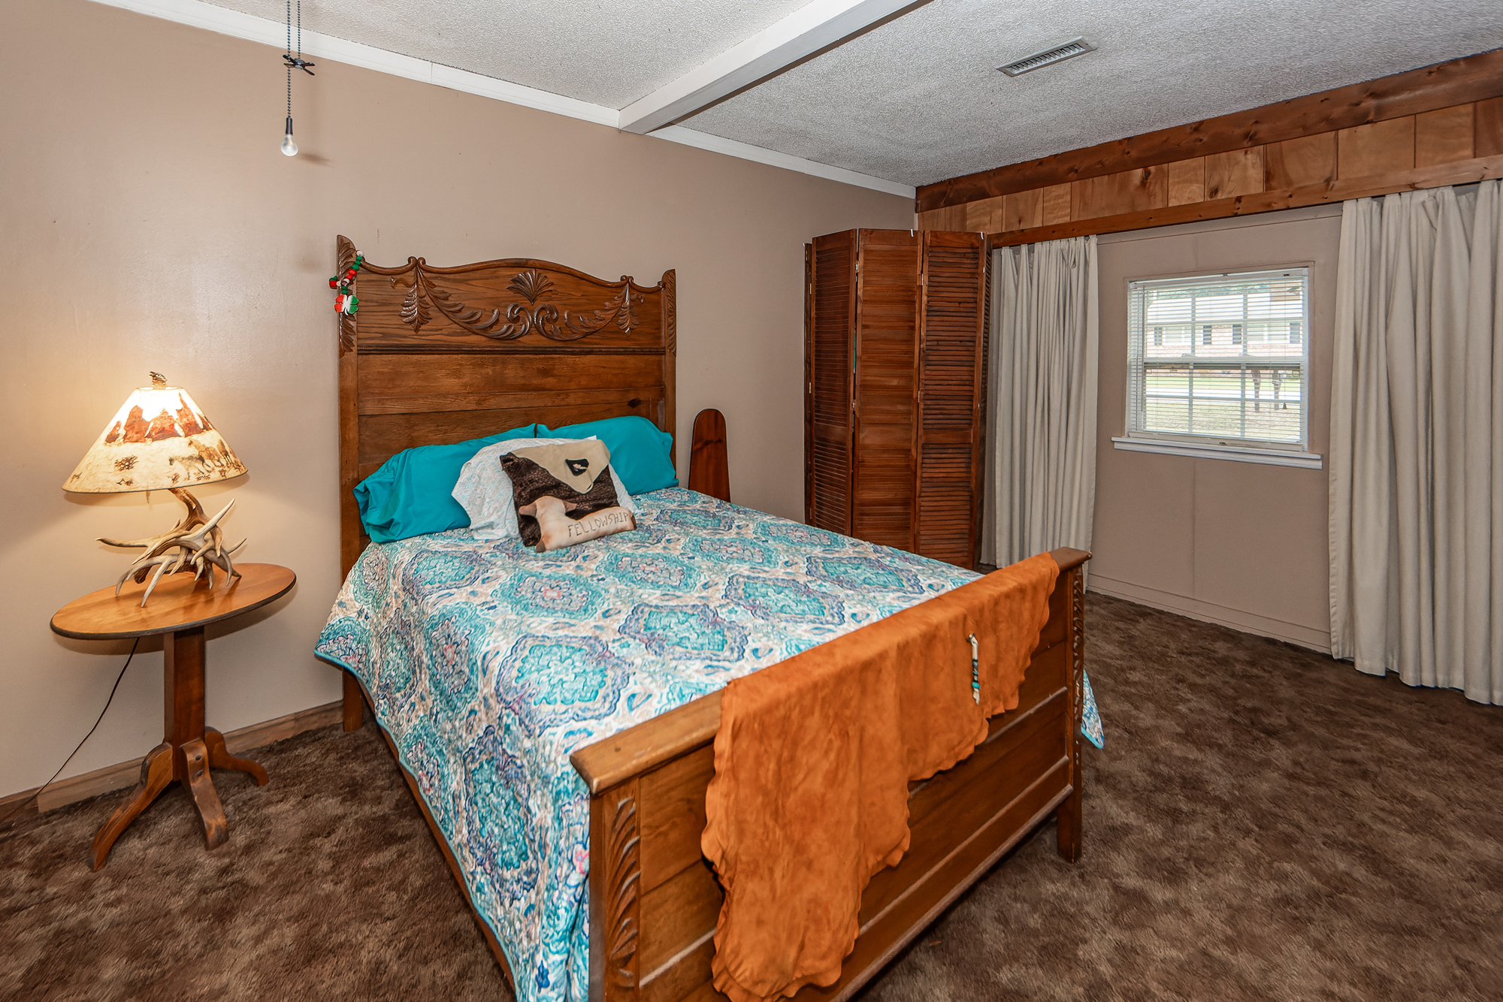



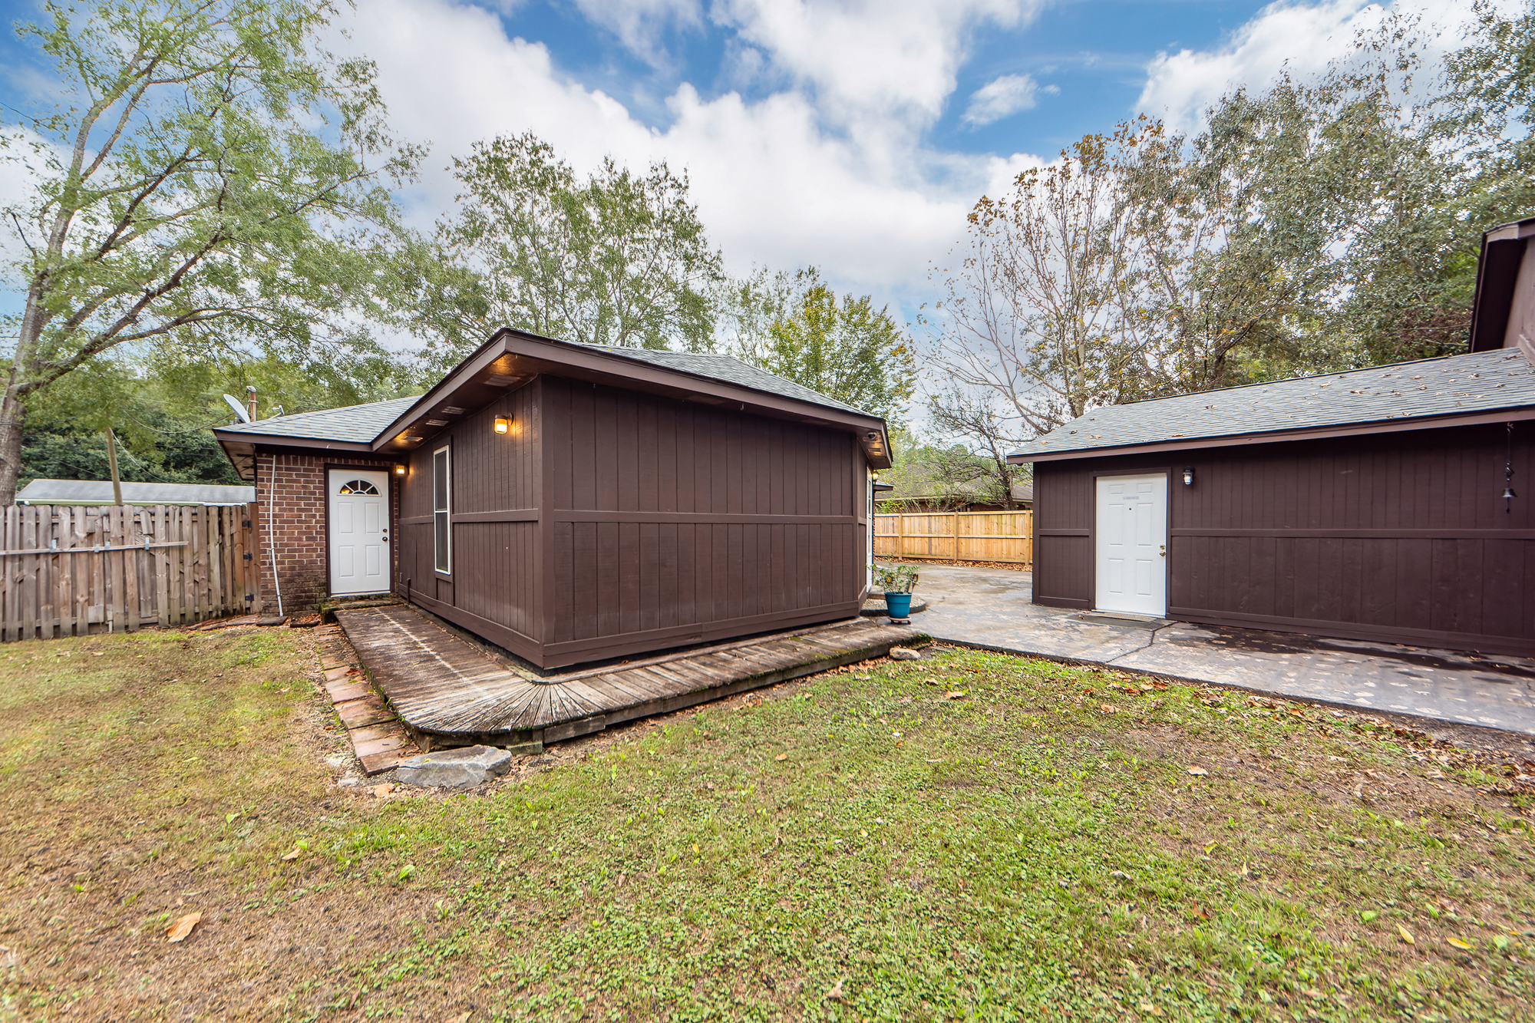
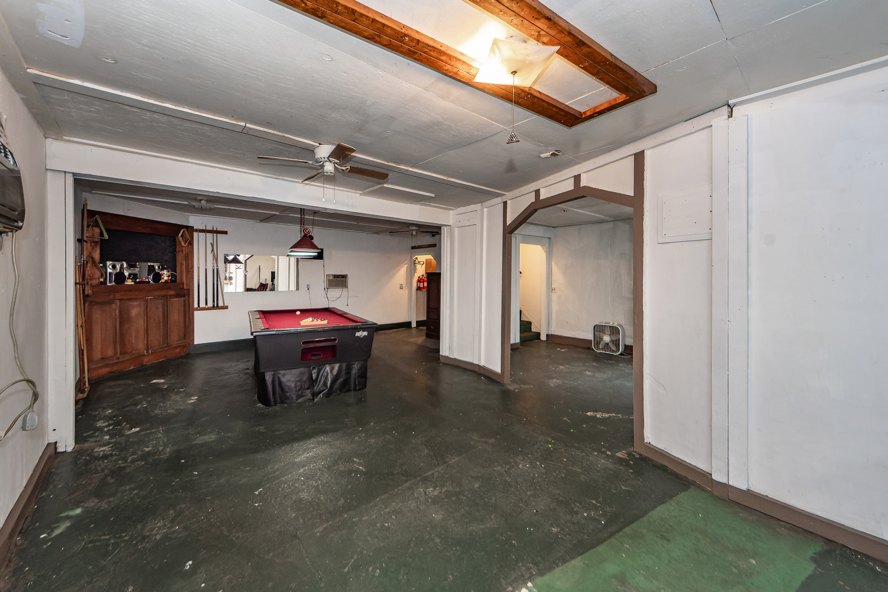

Closing
Assistance Available
114 Gator Drive
Forest Lawn | Goose Creek, SC 29445 | MLS# 24029340 | $325,000
Amazing! Seller is original owner from 1987! Well maintained, New Roof 2020, New HVAC 2024 and fresh paint. Oversized family room was added many years ago which changed the use of living and dining room. This brick home is cozy and the sellers pride and care show throughout. Main garage attached to house was tastefully enclosed and currently used as a bedroom. Two story garage in back yard has been used as garage, entertainment area, man cave and pool table will convey with the sale. Separate storage shed in back was used as a luxury dog house. This home is a must see and must own!
We are offering up to $10,000 in down payment assistance and up to $7,500 in closing cost assistance. Buyers do not need to be first-time home buyers although we do require the home to be a primary residence. These are not traditional grant programs and do not need to be re-paid. Robert Vinton Bank of America 843-882-4191
3 Bedroom
1½ Bath
2,443 sf
Virtual Tour
Connie White, Broker
843-532-3356
connie@conniewhiteteam.com
conniewhiterealestate.com
Connie White Real Estate & Design, LLC
102 Six Point Court
Goose Creek, SC 29445

