Slide 1
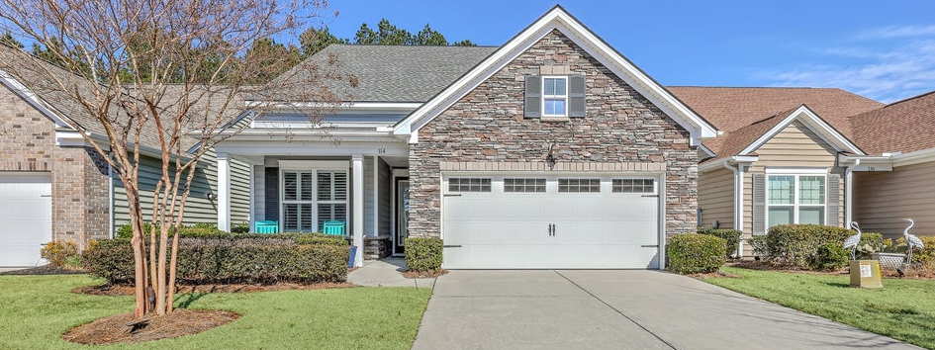
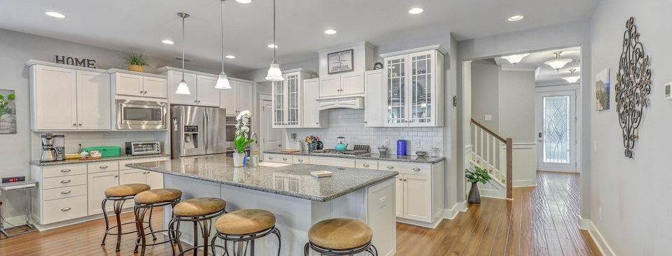
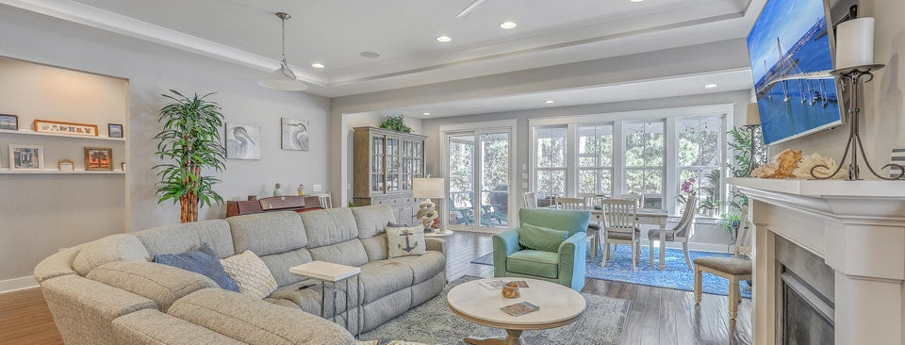

New 55+ Community Listing with Exceptional Amenities
JUS
9714 ROSEBERRY STREE
MOTIVATED SELLER!
/
7
1/
ii
This thoughtfully designed home features 3 spacious bedrooms plus a loft, 3 full bathrooms, and a dedicated office, offering flexible space for guests, hobbies, or working from home.
114 Harbor Trace Lane
Cane Bay Plantation | Summerville, SC 29486 | MLS# 26005716
�
$599,900
3 BED
3 BATH
2,519 SQ FT
0.13 ACRES
As you enter through the front door, you're welcomed by a bedroom and private office to your left, perfect for visiting family or a quiet workspace. Upstairs, you'll find a massive loft ideal for a media room, game space, or additional living area, along with a full bathroom and private bedroom that creates the perfect guest retreat. The main level showcases wood flooring throughout and tile in wet areas, blending warmth with timeless style. The open-concept layout flows effortlessly into the upgraded gourmet kitchen with large island and stainless steel appliances featuring a gas cooktop and double wall ovens and ample cabinetry, perfect for entertaining or everyday living. The spacious living room, anchored by a cozy fireplace, creates an inviting atmosphere for relaxing or gathering with friends. The primary suite is conveniently located downstairs, offering comfort and privacy. Step outside to your peaceful wooded lot and enjoy the screened porch and patio with sun shades--ideal for morning coffee, evening cocktails, or grilling out with friends and family. This home truly shines when hosting, with spaces designed to bring people together.
Additional premium features include:
■ Whole-house generator ■ Whole-home UV air purifier (installed 2021)
■ Extended garage with built-in storage ■ Beautiful natural light throughout
Located in a vibrant 55+ community with exceptional amenities, this home offers not just a residence--but a lifestyle designed for comfort, connection, and enjoyment.
THE SCOTT BASKIN TEAM
Scott Baskin
843-324-4139
scott@explorecharlestonrealestate.com
Katie Mootz
katie@explorecharlestonrealestate.com
SCOTT BASKIN TEAM

