Slide 1
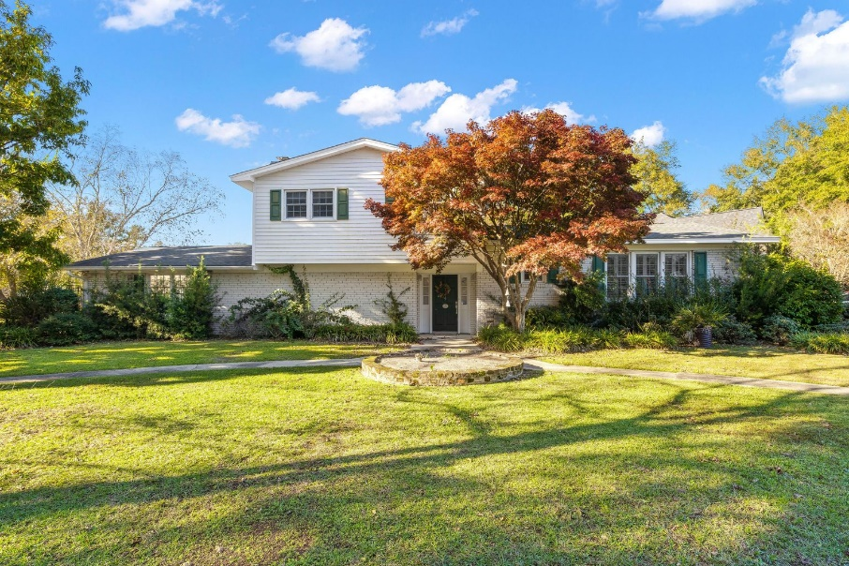
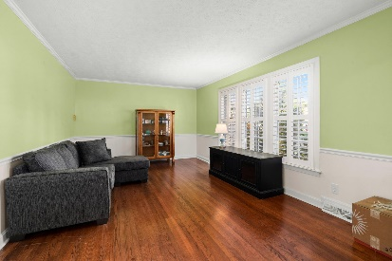
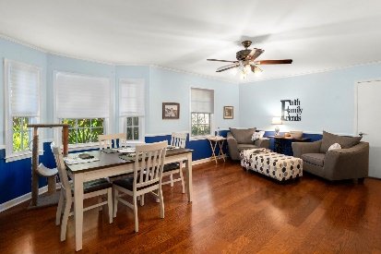
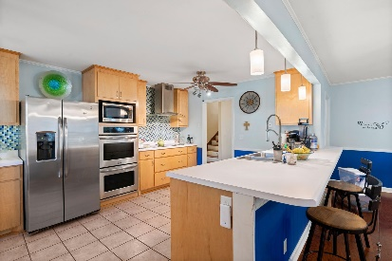
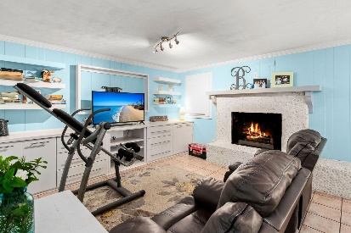
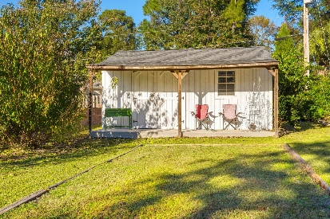
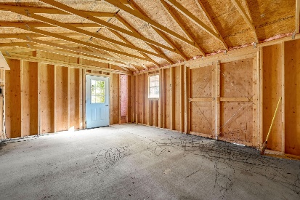
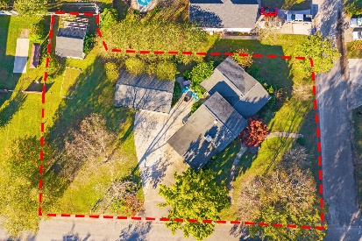
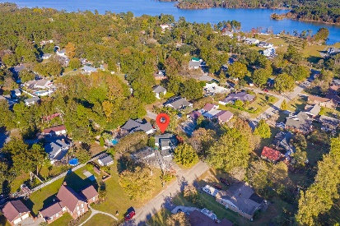



Gorgeous Home in Land O Pines
114 Land-O-Pines Cir Land-O-Pines
Moncks Corner, SC 29461
MLS# 21030226
$445,000
3 Bed | 2½ Bath | 2,307sf
Welcome home to this gorgeous and meticulously maintained home in the established Land O Pines neighborhood. No HOA and a short walk to Lake Moultrie! This home has amenities galore. 2 Car carport, 2 car garage, huge shop with electric, separate shed with electric and awning, garden area, paved fire pit area, half acre of land on a corner lot and that's all before getting inside the house! The owner just recently replaced the roof in 2014 and HVAC 6 months ago. The home also has a termite bond on both the home itself and the garage. Upon entering the home, you are greeted by wonderful hardwood floors in the foyer. The kitchen has tons of cabinetry and counter space, a 5 burner electric stovetop, 2 wall ovens and 2 pantries. One pantry is enormous; you'll never run out of room for food! Off to the side is a wet bar, great for storing your favorite drinks or creating your preferred cocktails. The family room boasts a large brick gas fireplace along with access to the carport. Upstairs you'll find all 3 bedrooms which are plenty big! The master bedroom offers a creative bathroom for its size offering an inviting tile shower. Just around the corner you have the boat ramp to Lake Moultrie. This entire neighborhood is quiet but is also a very family-oriented community. You truly have to come see this home to appreciate everything it has to offer!
Nick Mazzilli (843) 640-5575
nick@nickmcharleston.com www.mavenrealtysc.com
Maven Realty
2180 McMillan Ave
#71672
Charleston, SC 29405

