Slide 1
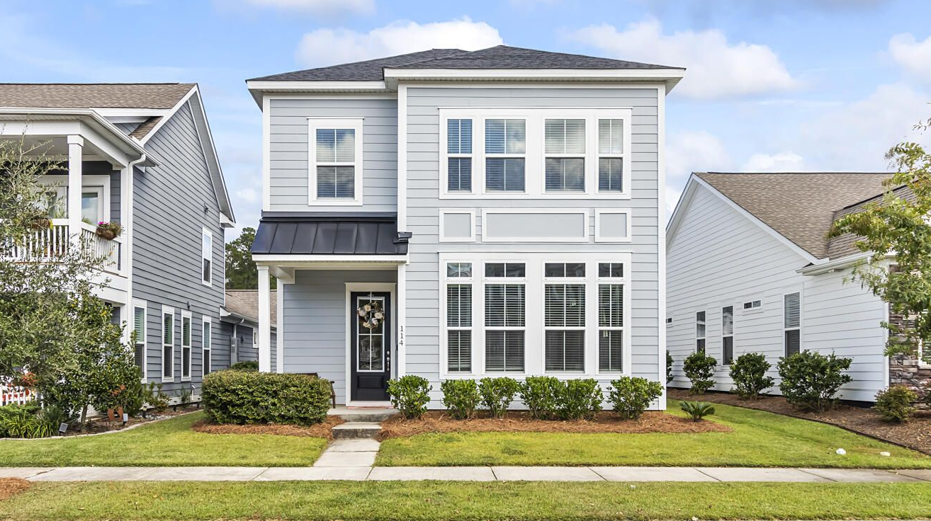
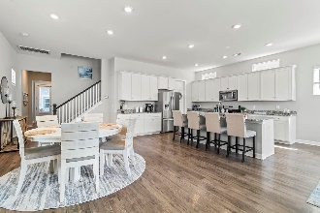
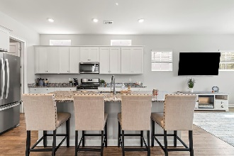
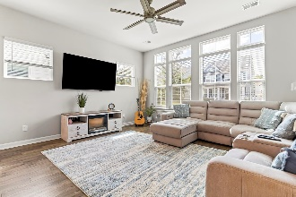
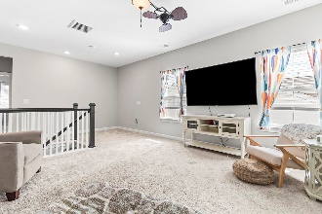
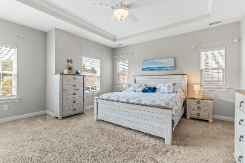
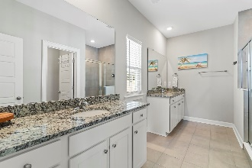
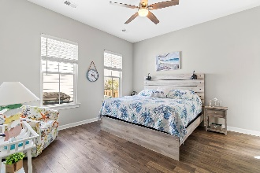
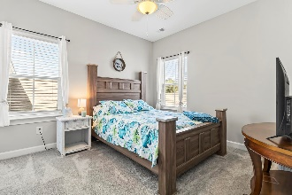
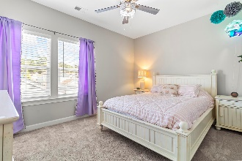
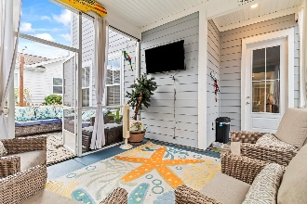
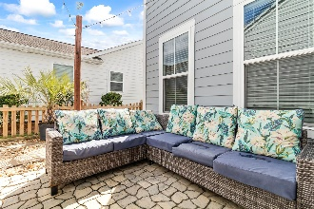
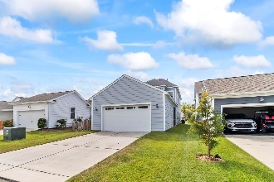


114 Starling Street The Ponds Summerville, SC 29483 MLS# 23022610 $465,000
Open House
Wednesday, 7/20
3-5PM
Price Improvement
Welcome to this beautiful home in The Ponds. When you walk in the front door you are greeted by 10' ceilings with 8' doors that leads to an open concept living. Your spacious family room next to the kitchen with a large island and a huge walk-in pantry. The mother-in-law suite on the first floor with a walk in closet and bathroom. There is a loft space at the top of the stairs. The master has a tray ceiling and walk in closet. There are 2 more bedrooms on the second floor with walk in closets. Leaving through the back door is a screened in porch that leads to the garage and a side yard. There is a nice green space around the street from the back yard for kids to play and dogs to run. The Ponds community has walking trails, dog park, pool, fishing ponds, YMCA and a fire station.
Your spacious family room next to the kitchen with a large island and a huge walk-in pantry. The mother-in-law suite is in the back on the first floor. There is a nice loft space at the tip of the stairs that leads to the bedrooms. The master has a tray ceiling and walk in closet. There are 2 more bedrooms on the second floor. Leaving through the back door is a screened in porch that leads to the garage and a side yard. The Ponds community has walking trails, dog park, pool, fishing ponds, YMCA and a fire station.
Take a virtual tour!
Carol Torres
843-810-7726
carol.torres@carolinaone.com
www.carolinaone.com
Carolina One Real Estate
900 N Main St
Summerville, SC 29483

