Slide 1
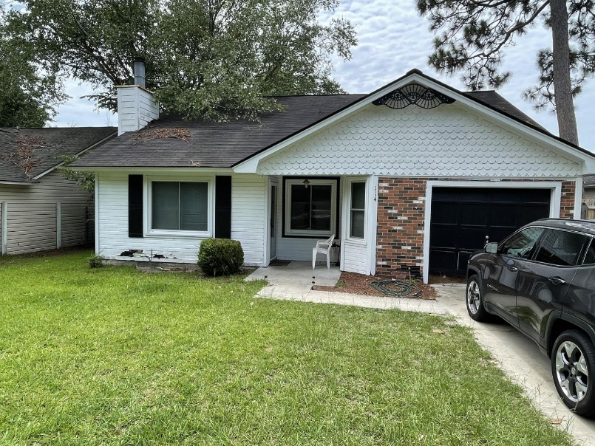
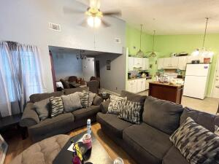
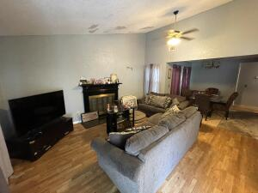
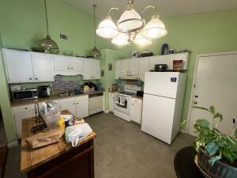
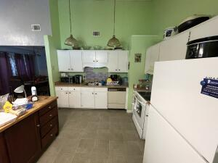
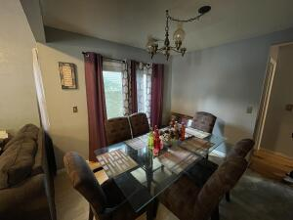
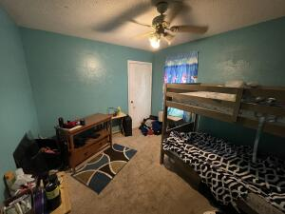
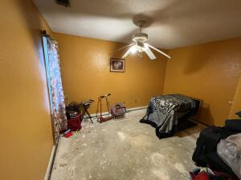
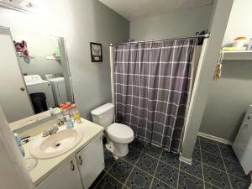



SINGLE STORY HOME IN SUMMERVILLE!
114 Tennyson Way Sangaree
Summerville, SC 29486
MLS# 22018282
$225,000
3 Bed | 2 Bath | 1,232 sf
Wonderful single story 3 bedroom and 2 bathroom home in the Sangaree neighborhood (NO HOA FEE), just minutes to restaurants, shopping, grocery stores, you name it! This home does need TLC and handyman work, but luckily a $10,000 repair credit is being given to the lucky buyer. This home has large ceilings, an open living and large kitchen area with plenty of cabinet and countertop space, The primary bedroom has an en-suite and the guest bedrooms share a full bathroom. Home also has a 1 car garage. The roof is approximately 7-8 years old and the HVAC is approximately 10 years old. Dishwasher does not work. All appliances and home convey in ''as-is'' condition.
Nick Mazzilli (843) 640-5575
nick@nickmcharleston.com www.mavenrealtysc.com
Maven Realty
2180 McMillan Ave
#71672
Charleston, SC 29405

