Slide 1
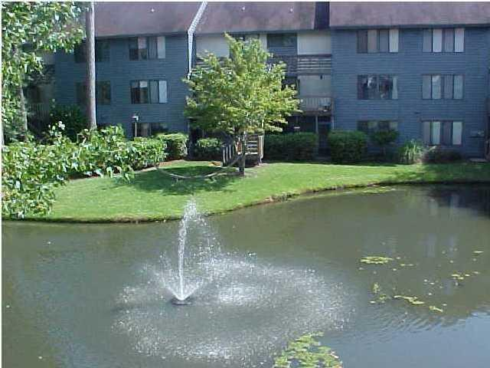
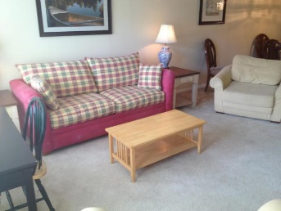
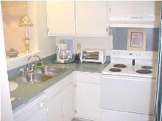
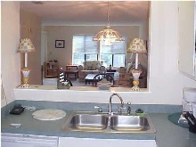
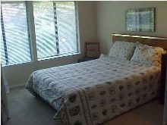


Furnished Short-Term Rental
1151-C Shadow Lake Circle C
Snee Farm Lakes
Mount Pleasant, SC 29464
MLS# 17013183
$1,695
Short-term furnished rental. For people temporarily ''between homes'', waiting for a house elsewhere to sell, here on business for a few months, getting used to the area, etc. Landlord pays all utilities, including basic cable TV & internet. Turn-key/fully equipped & furnished. Front entrance is up one flight of stairs: interior is 2-stories, bedrooms upstairs. 3-month minimum rental
John Crowley
843-819-4951
john.crowley@agentowned.com
AgentOwned Preferred Group | 1400-G Palm Blvd | Isle Of Palms, SC 29451

