Slide 1
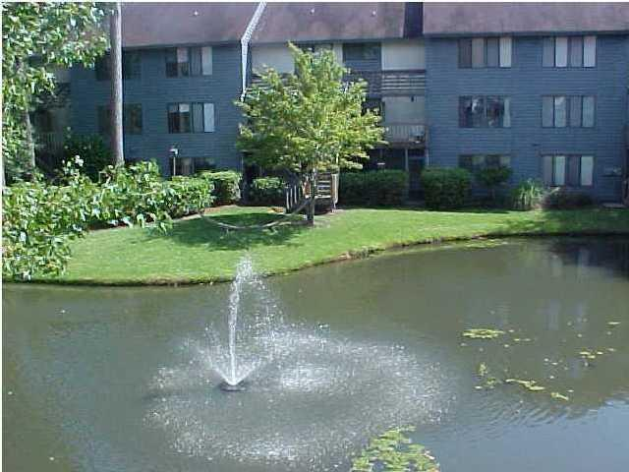
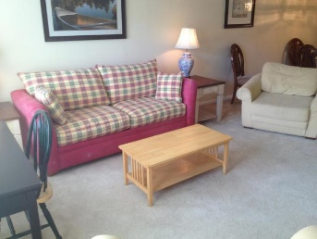
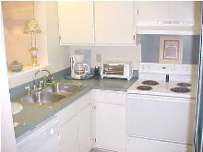
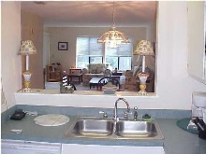
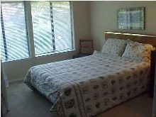


Furnished Short-Term Rental
1151-C Shadow Lake Circle C
Snee Farm Lakes
Mount Pleasant, SC 29464
MLS# 19028781
$1,800
SHORT-TERM FURNISHED RENTAL. FOR PEOPLE TEMPORARILY ''BETWEEN HOMES'', WAITING FOR A HOUSE ELSEWHERE TO SELL, HERE ON BUSINESS FOR A FEW MONTHS, GETTING USED TO THE AREA, ETC. LANDLORD PAYS ALL UTILITIES, INCLUDING BASIC CABLE TV & INTERNET. TURN-KEY/FULLY EQUIPPED & FURNISHED. FRONT ENTRANCE IS UP ONE FLIGHT OF STAIRS: INTERIOR IS 2-STORIES, BEDROOMS UPSTAIRS. 3-MONTH MINIMUM RENTAL.
Owner is a Licensed Real Estate Agent. Three month minimum rental.
John Crowley
843-819-4951
john.crowley@agentowned.com
AgentOwned Preferred Group | 1400-G Palm Blvd | Isle Of Palms, SC 29451

