Slide 1
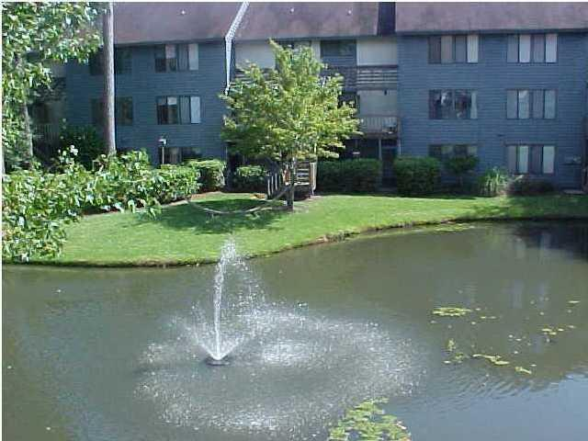
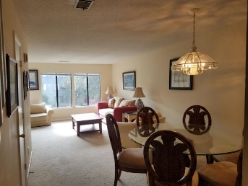
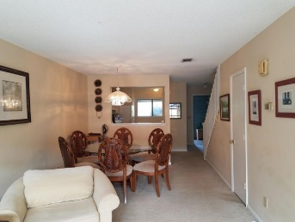
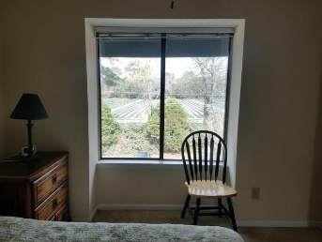
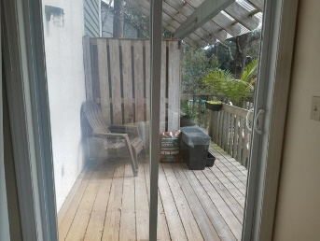


Mt Pleasant Snee Farm 2BR Condo For Rent
1151-C Shadow Lake Circle
Snee Farm Lakes
Mount Pleasant, SC 29464
MLS# 20029342
$1,395
You cannot beat this location! New LVT flooring downstairs in this bright and cheerful condominium overlooking a pond with a calming accompanying fountain adding to the serenity. Semi-private deck with stairway down to the park-like pond area and a close walk to 1 of 4 swimming pools in the complex. Owner would consider a 6-month lease application. Public schools (all very desirable) are all nearby. Towne Centre shopping with lots of restaurants, salons, a 16-screen movie theater, are all within a 5-minute drive as well as three, count 'em, 3 Harris Teeter grocery stores. Beach (15 mins), Downtown Charleston (20 +/- mins), & CHS Airport (20-25 mins) . Both bedrooms are masters with en-suite baths. Note that owner is a Licensed Real Estate Broker and is the listing agent.
John Crowley
843-819-4951
john.crowley@agentowned.com
AgentOwned Preferred Group | 1400-G Palm Blvd | Isle Of Palms, SC 29451

