Slide 1
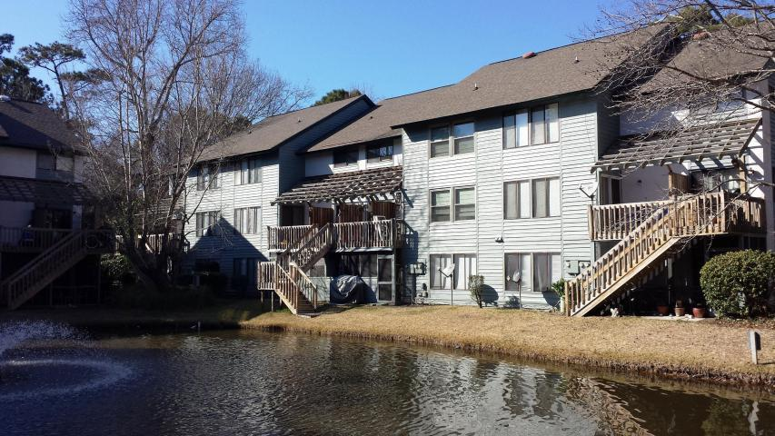
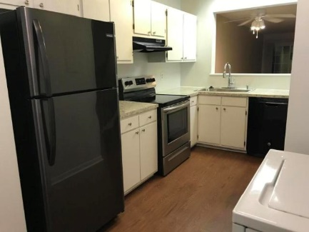
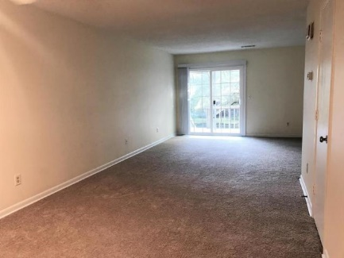
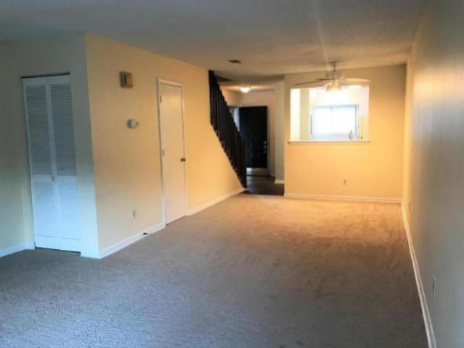
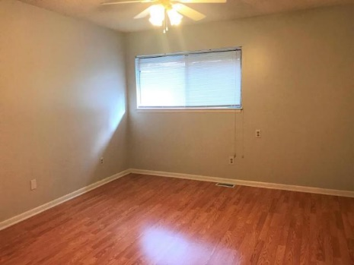
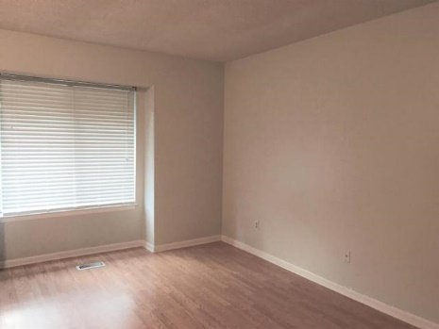
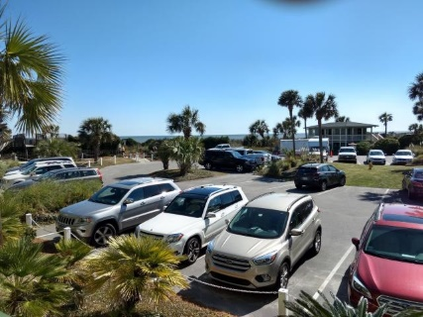
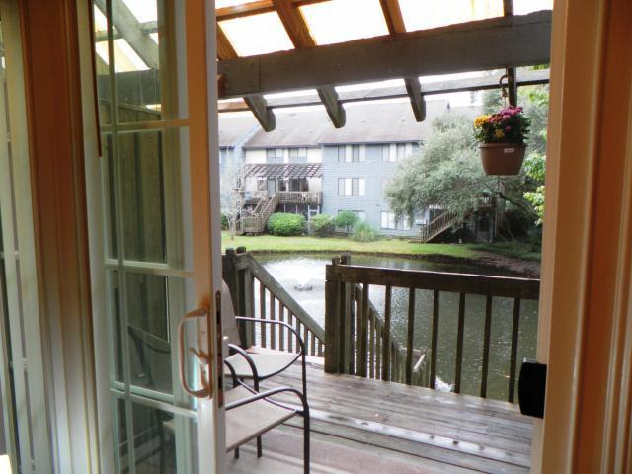
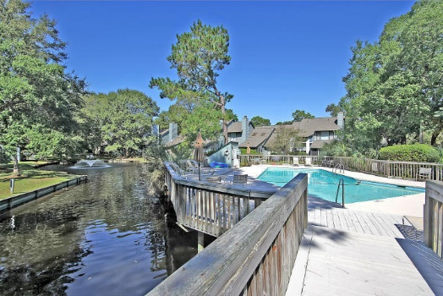


Great Snee Farm Lakes Location Priced Right ~ Easy to Show
Roomy condo in conveniently located Snee Farm Lakes. Enjoy Town Center shopping and restaurants, and be just 10 minutes to the Beach at the Isle of Palms...Then just 20 minutes to Downtown Charleston. There is a Large Living Room/Dining Room combination; where off the deck are views of the Pond. The Kitchen has newer appliances: Refrigerator, Stove with Hood Vent. Sink and Faucet. 1st Floor Half Bath. There are dual Master Bedrooms, each with two closets and full bath. Large closet is in the hallway joining both bedrooms. Regime fee covers all exterior insurances, water/sewer, exterior maintenance, Pools, Trash Pick Up, and Property Management.
1151-H Shadow Lake Circle
Mount Pleasant, SC 29464 ~ MLS# 20005894 ~ $185,000
2 Bedroom | 2½ Bath | 1,300sf
Frank Rutigliano
843-813-4961
frutigliano@kwchs.com

