Slide 1
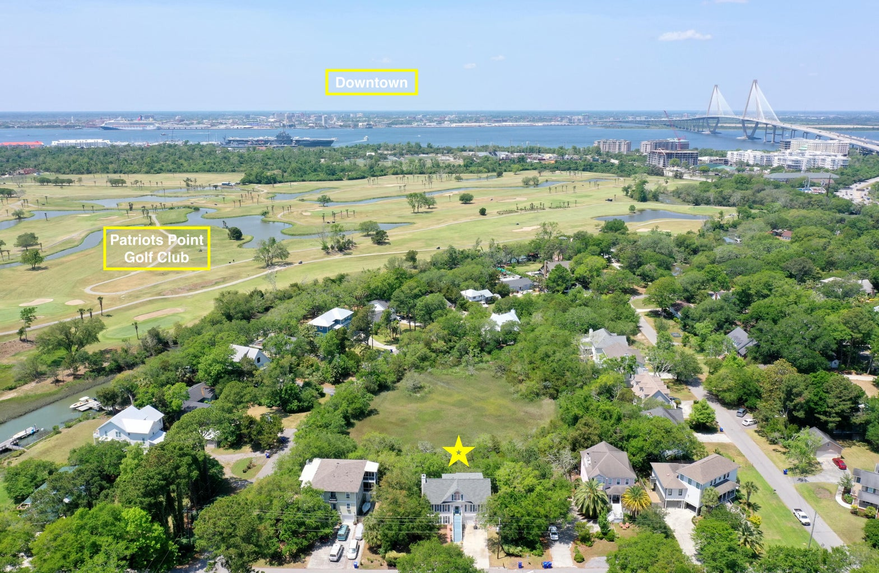

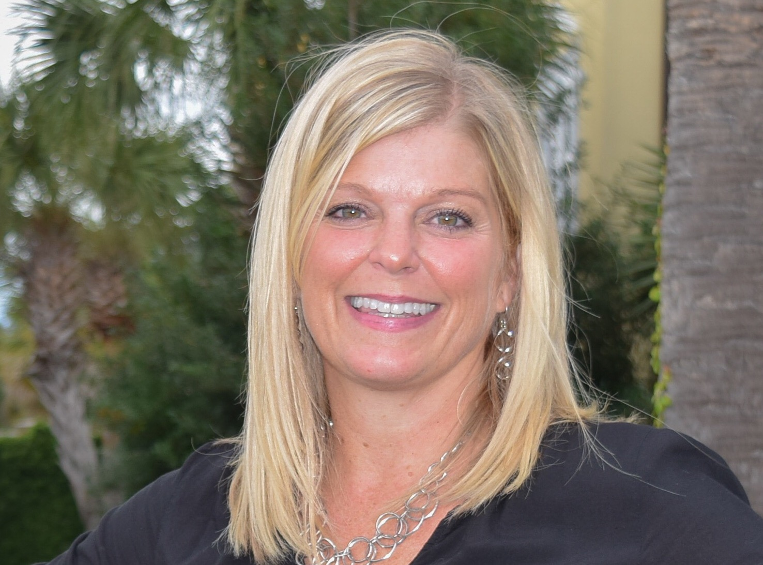
South Mt. Pleasant at Shem Creek
Neighborhood Boat Ramp!
1152 Garland Road
Bayview Acres | Mount Pleasant, SC 29464
MLS# 23001753 | $1,300,000
Welcome to 1152 Garland Rd located in Mt. Pleasant's Bayview Acres! This wonderful community is located at the foot of the Ravenel Bridge off Coleman Blvd offering easy access to downtown and Shem Creek and has a neighborhood boat ramp that feeds into Shem Creek, tennis courts, play park and NO HOA allowing boat storage at your home. This beautiful home has a newly updated kitchen complete with new cabinets, lighting, farm sink and quartz counters and is open to the dining area that features custom built-in cabinets with quartz counters, open shelving and wine refrigerator perfect for entertaining. The living room is flooded with natural light, has a vaulted ceiling, newly added shiplap accent wall, fireplace and marsh views. NEW thermal windows were just installed throughout!
The master suite is located on the main level and features a large walk in closet and refreshed bath with shiplap, quartz counters and garden tub overlooking the marsh. Upstairs you will find two guest rooms, one with a porch overlooking the marsh, refreshed bath with dual vanity and an additional room that can serve as an office or flex space.
On the ground level you will find an additional 535 square feet of conditioned space that can be used as a MIL suite, teen suite, home office with extra guest room or as a short term rental (STR - area is in compliance but new owners will need to apply for a permit). This area features a private full bath, living room and bedroom with walk in closet and private back entrance. A parking pad was added to fulfill the STR parking requirement. This space is currently included in the insurance policy. A 2 car garage and boat storage offers plenty of room for cars, toys and your boat!
Tiffany Senden | 843-560-4757 | tiffany@theblvdcompany.com

Slide 2
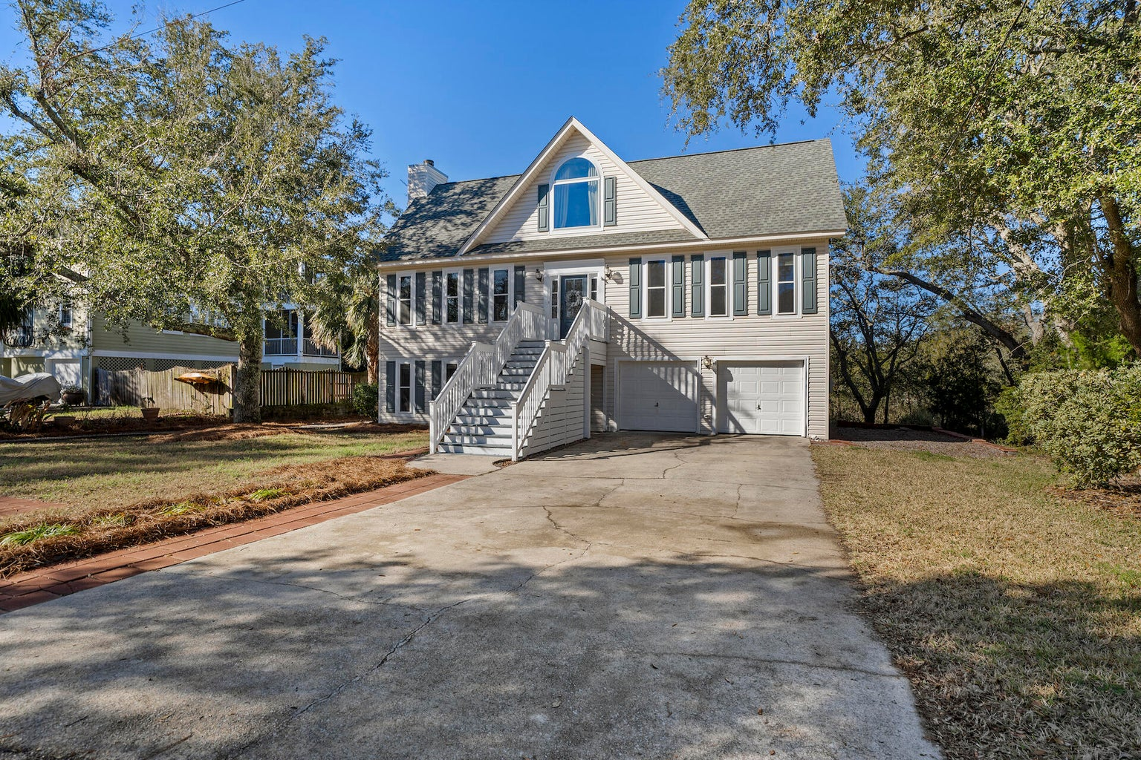
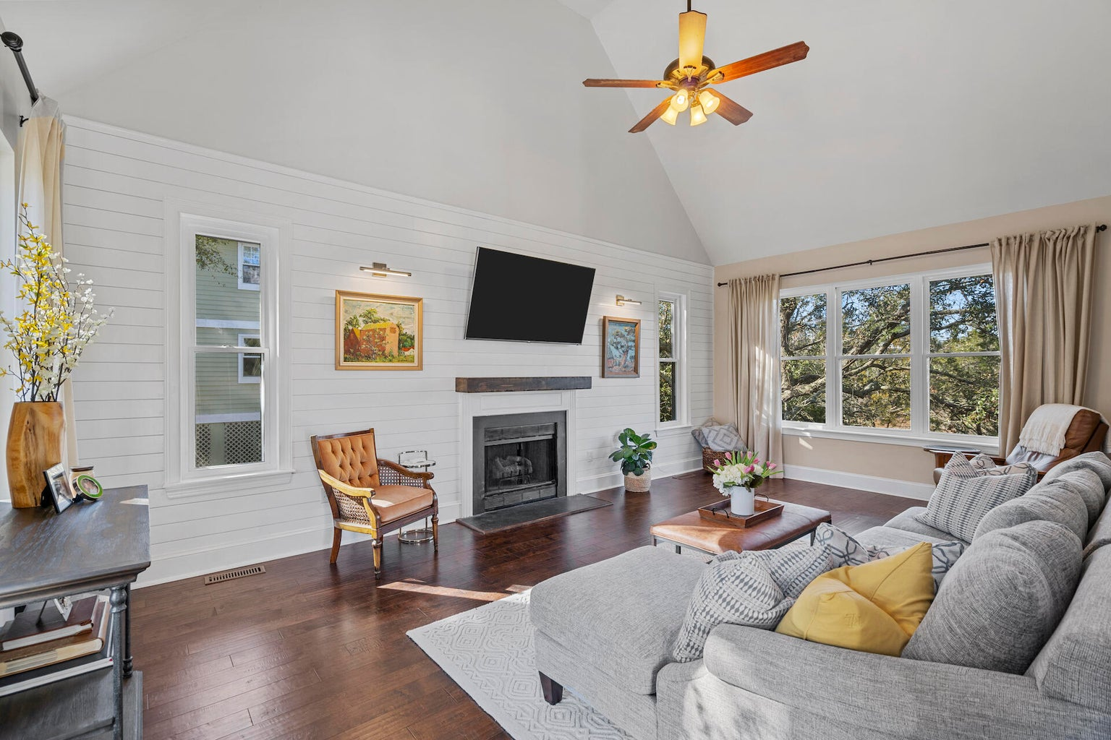
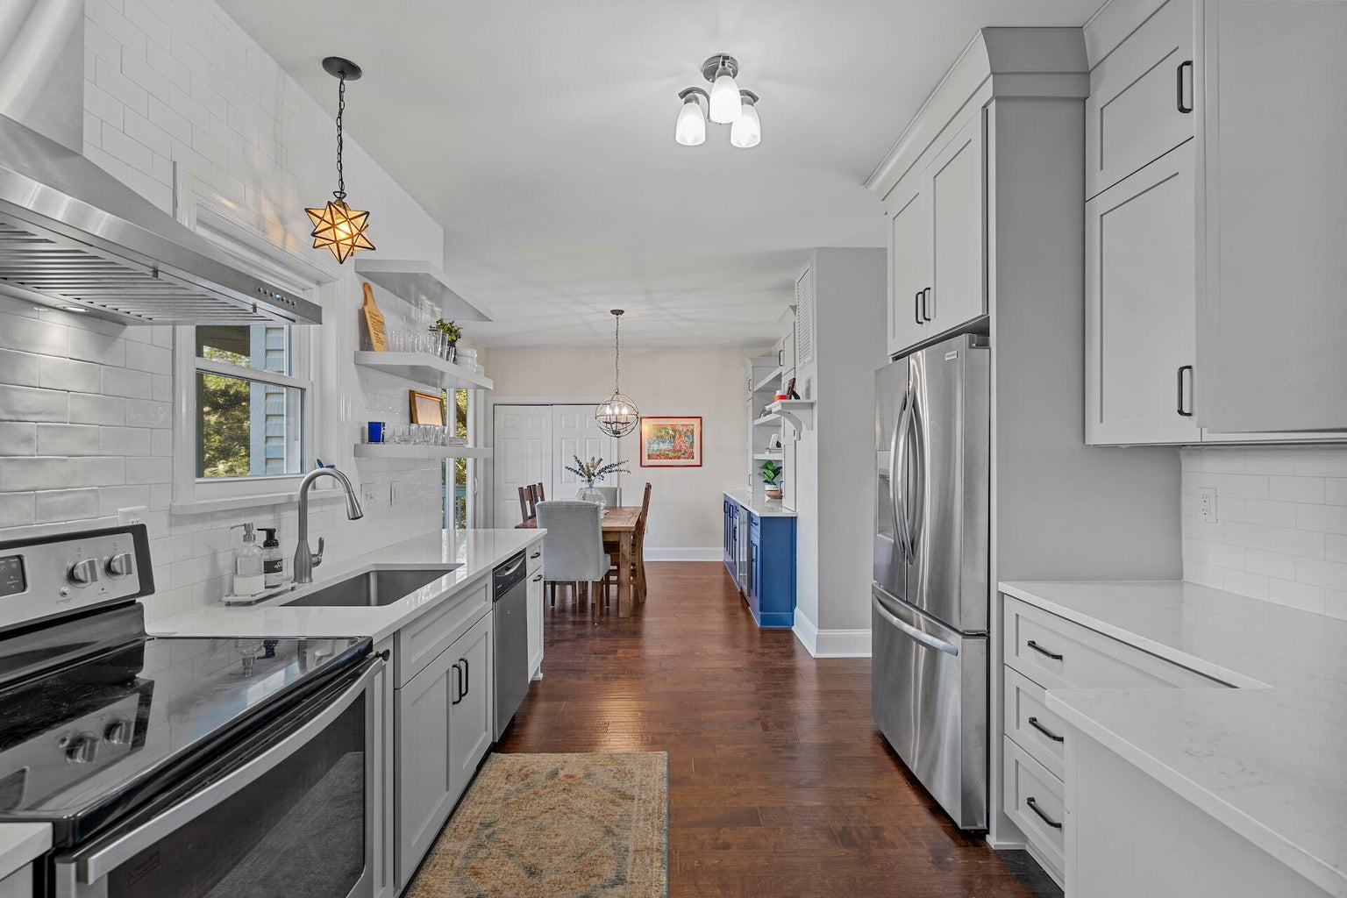
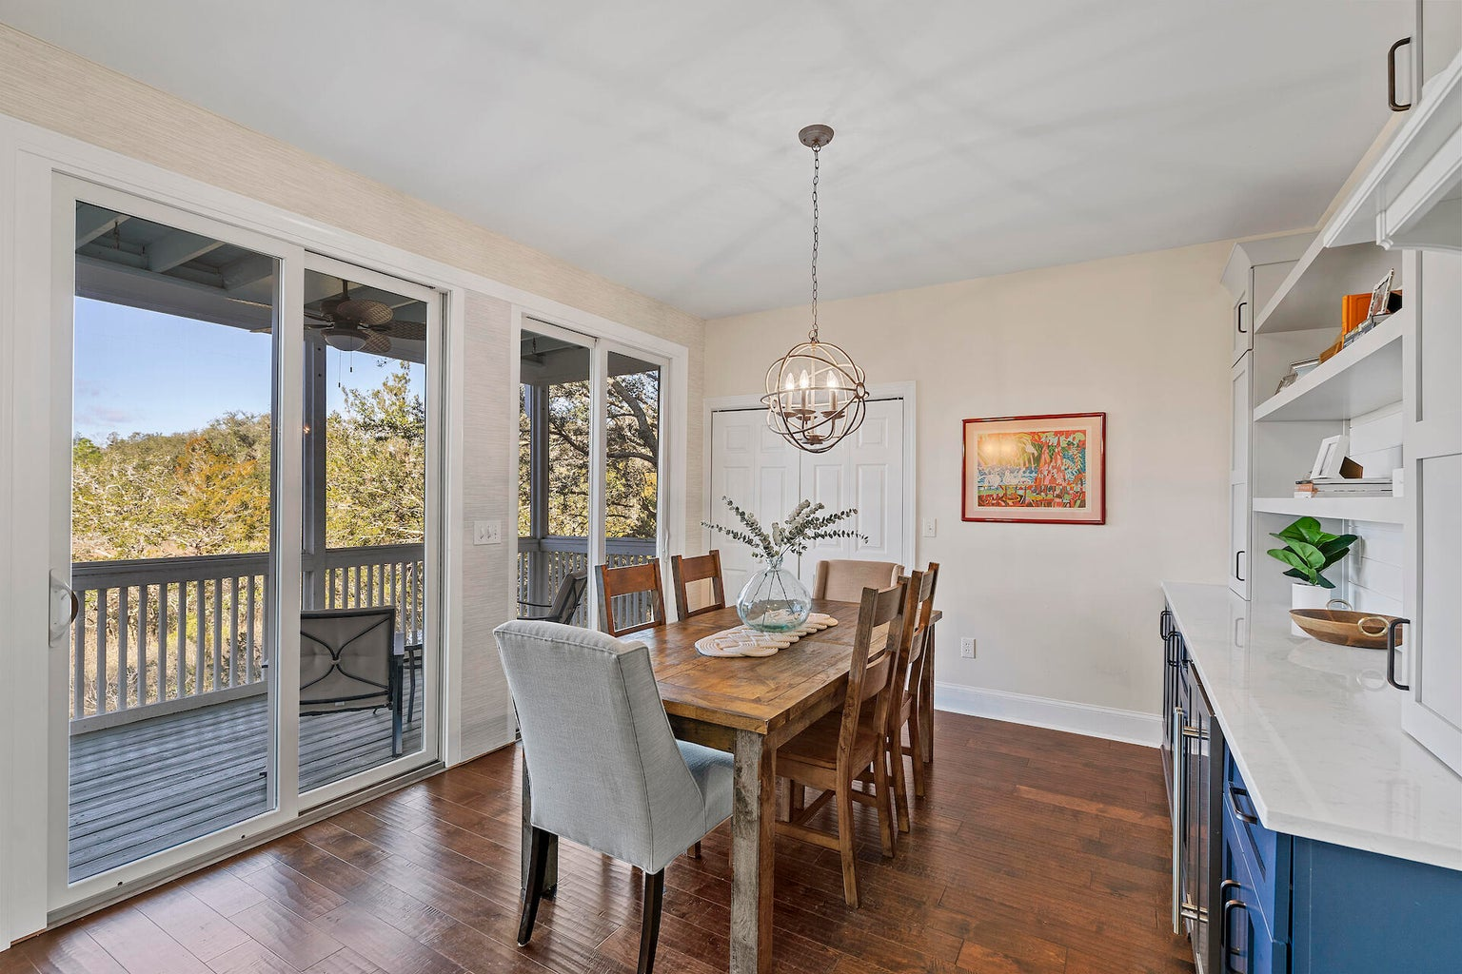
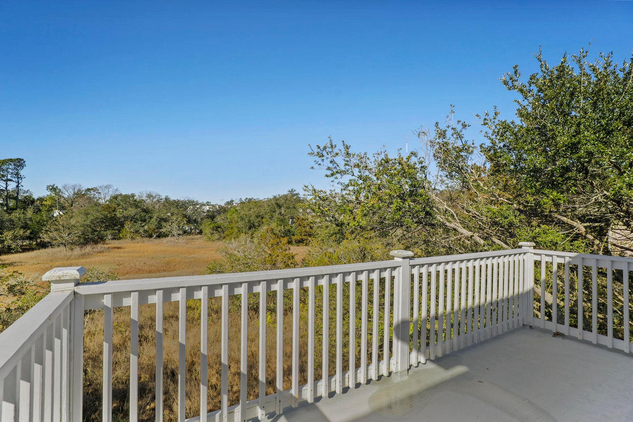
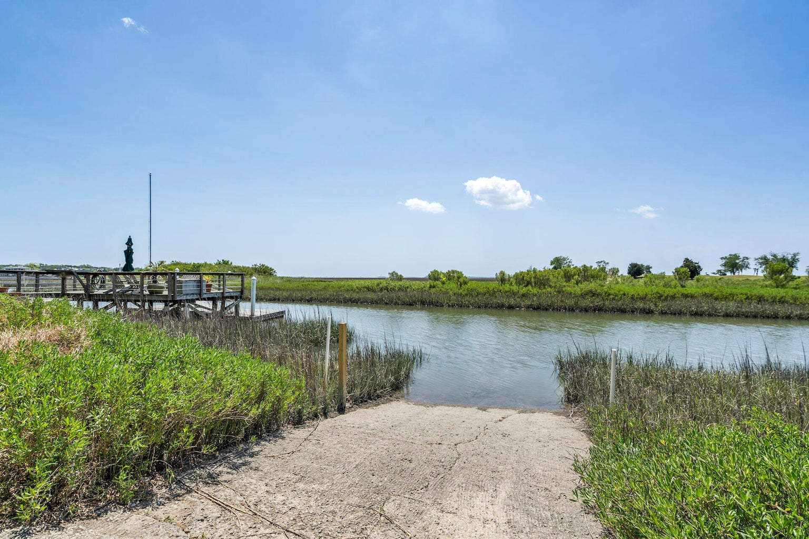
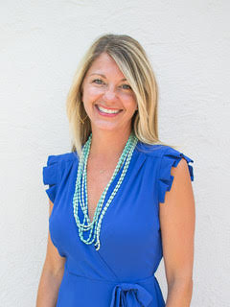

Tiffany Senden
843-560-4757
tiffany@theblvdcompany.com
The Boulevard Company 806 Johnnie Dodds Blvd | Mount Pleasant, SC

