Slide 1
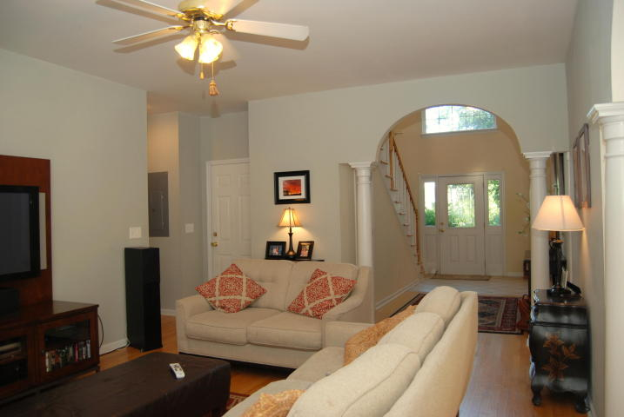
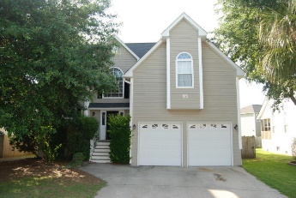
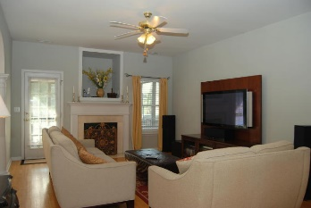
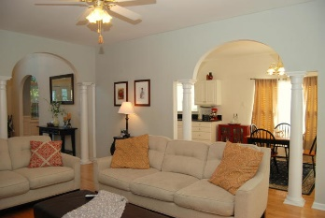
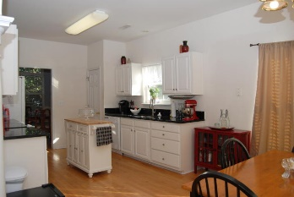
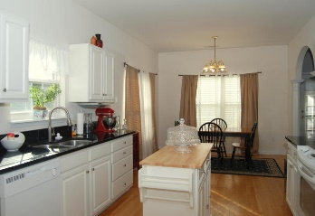
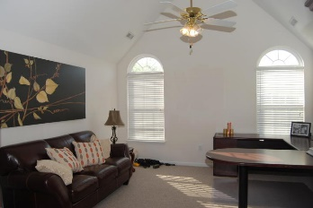
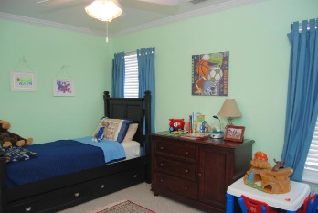
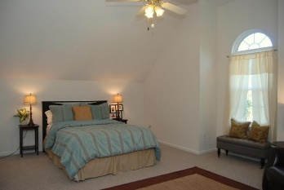
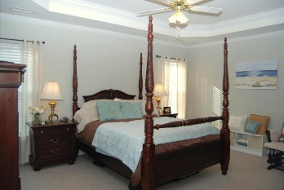
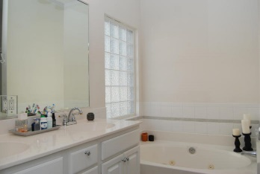
Ocean Neighbors Charmer
1153 Clearspring Drive
Ocean Neighbors | Charleston | MLS# 15016375 | $369,900
Welcome to 1153 Clearspring- This beautiful family home is bright and open featuring elegant moldings, tray ceilings, graceful archways, hardwoods downstairs and classic architecture. A spacious entry leads to the cozy light filled family room that boasts a gas fireplace. The spacious kitchen features an eat in area and brand new granite countertops. There is an elegant separate dining room that boasts classic molding. Master down with walk in closet and spacious bath with whirlpool tub and separate shower. 4 bedrooms up and a large FROG that features 2 large closets. In addition to all of these rooms, there is another great space at top of stairs that can me used in various ways- playroom, office, etc. This is a must -see! A perfect location- close to downtown and beaches!
Angel French
843-367-5333 | angelfrench4@gmail.com
Brand Name Real Estate | 4 Carriage Lane Suite 106 | Charleston, SC 29407

