Slide 1
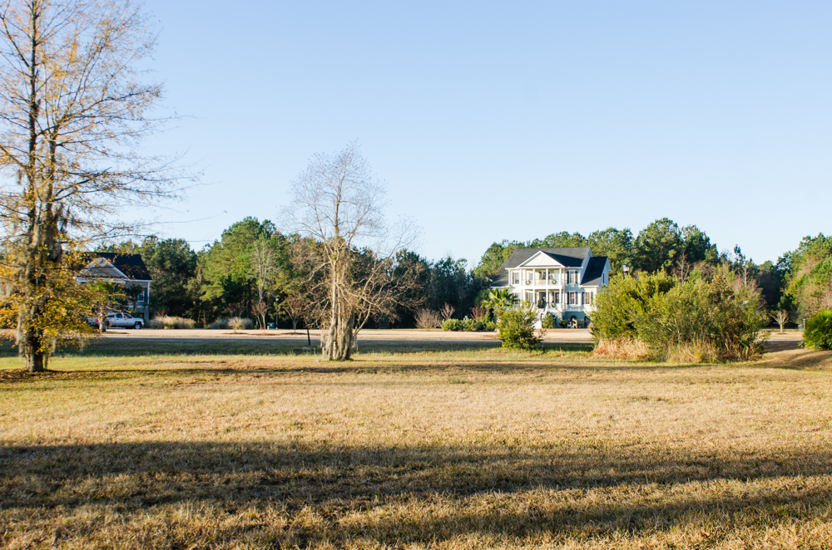
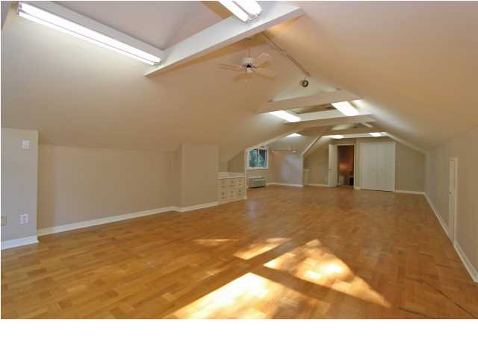
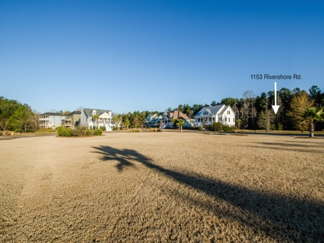
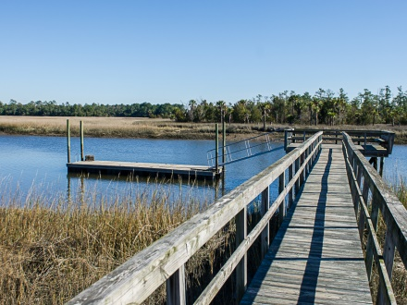
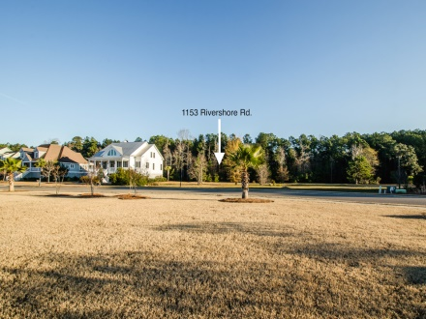
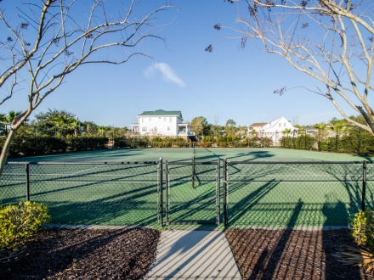
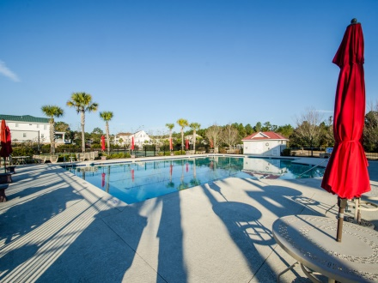
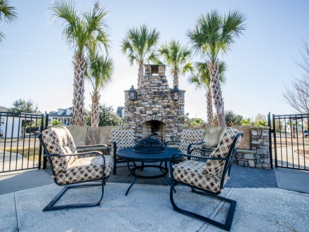


1153 Rivershore Road
Beresford Creek Landing ~ Charleston, SC 29492
MLS# 14031405 ~ $145,000
Looking for a lot to build your dream house
in Beresford Creek Landing?
See more at www.2161shellring.com
The lot is 1/2 acre and located in Beresford Creek Landing. Private lot backing up to a wooded area with a common area across the street. Neighborhood amenities include club house, swimming pool, tennis court, community dock, and boat storage area. Close to Daniel Island, Mt Pleasant, North Charleston, shopping and beaches
Charla McDonald
Office - (843) 884-1622
Cell - (843) 343-1456
Fax - (843) 746-4845
cmcdonald@carolinaone.com
charlamcdonaldproperties.com
Carolina One Real Estate
628 Long Point Rd
Mt Pleasant, SC 29464

