Slide 1
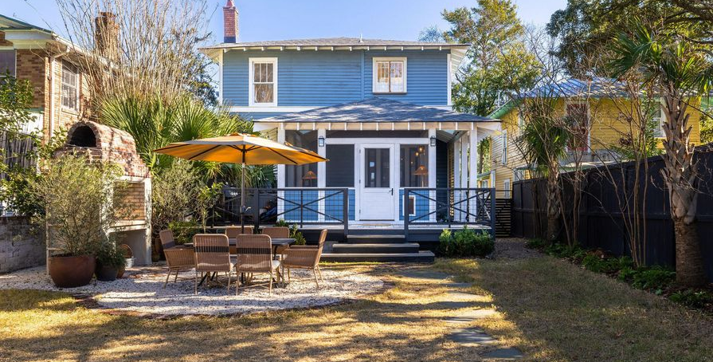
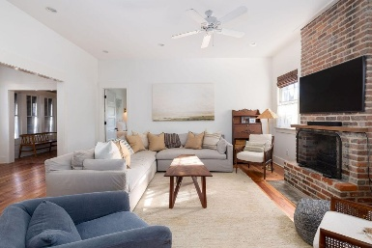
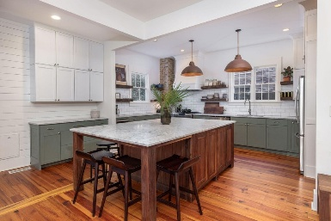
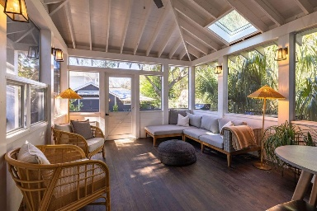

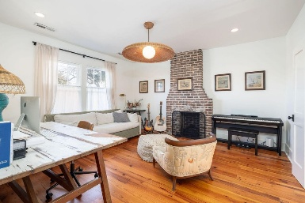
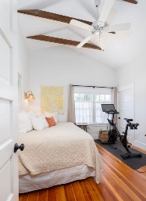

New Beautifully Renovated North Central Listing
1153 King Street
North Central | Charleston, SC 29403 | MLS# 25011960 | $1,499,000
4 Bed/3.5 Bath
2,549 Square Feet
Built In 1938
Detached 450 Square Foot Workshop
One Block From Lowline Development
Screened-in Porch
Greg Gelber
843-494-2354
greg.gelber@agentownedrealty.com
Kristin Hamilton
843-693-6280
kristin.hamilton@agentownedrealty.com
AgentOwned Charleston Group | 902 Savannah Hwy | Charleston, SC 29407-7802

