Slide 1
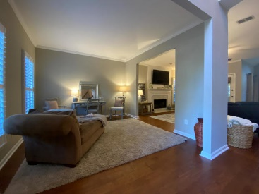
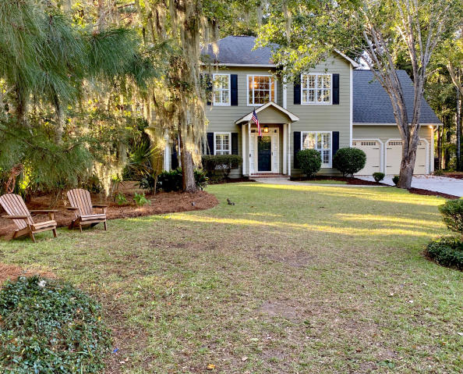
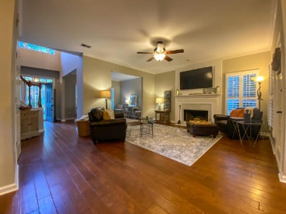
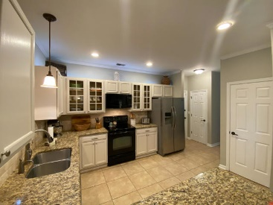
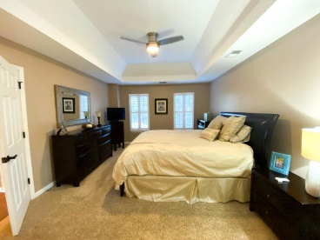
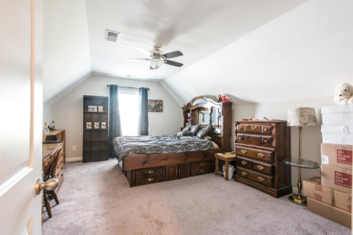
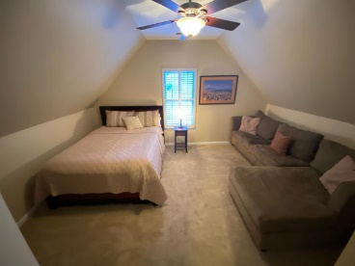
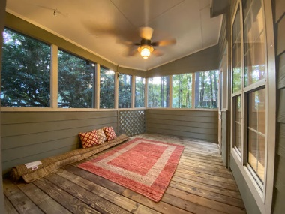
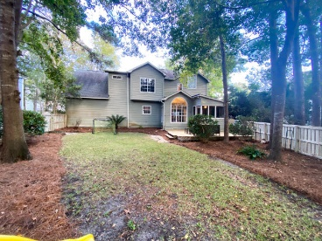


1155 Clover Place Brickyard Plantation · Mt Pleasant MLS# 20030255 · $520,000
New Price
Fabulous In Foxbank...
Sellers Say Sell!
This precious home is ready for it's new owners. Gorgeous on the inside and out! Located on a cul de sac in the highly sought after Brickyard Plantation. This home boasts 4 bedrooms with 2 and half baths. There is a formal dining room and a formal living room that could be used as a flex space as well. Through the formal living room you enter into the spacious family room with a fireplace. The kitchen is open to the family room and has granite countertops and freshly painted cabinets. There is a large screened in porch and a huge deck that opens up into the sizeable backyard. Upstairs you will find 4 bedrooms including the master bedroom that is a really nice size. The en suite master bath boasts double sinks, a walk in shower and a garden tub with a walk in closet.
The other two bedrooms are located just down the hall from the master and at the other end of the hall is the Frog which has a closet and so it can also be considered the fourth bedroom. The laundry room is upstairs which makes doing laundry convenient as it is located near all of the bedrooms. There are plantation shutters just to add to the charm of this property. Brickyard is a great neighborhood with amazing amenities including a boat ramp, boat storage, two community swimming pool, a lovely club house, tennis courts and really lovely walking trails.
Carey Nikonchuk
(843) 276-1701 M
cnikonchuk@gmail.com
www.palmettoproperty.net

