Slide 1
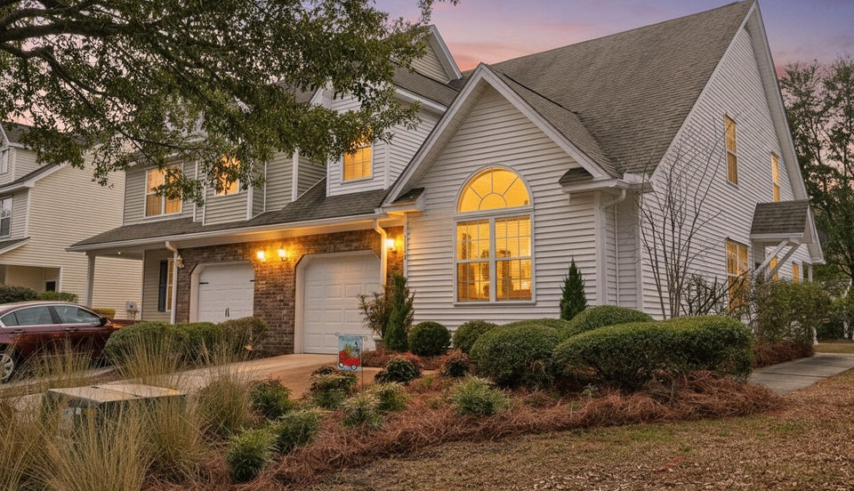

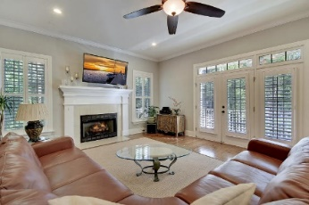
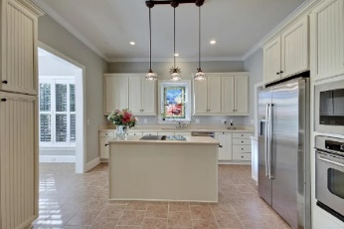
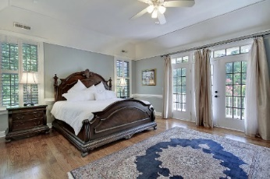
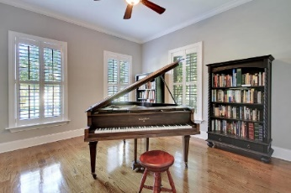
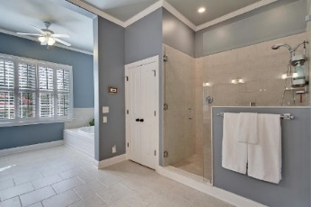
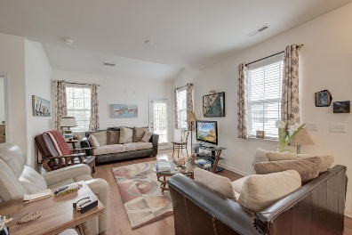
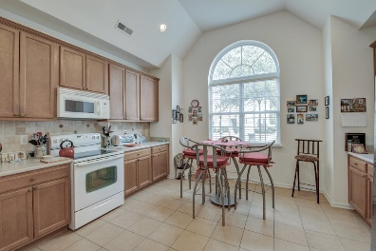
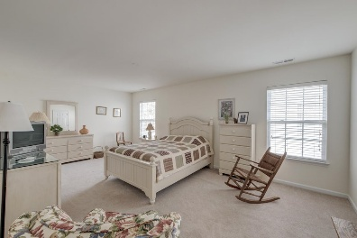
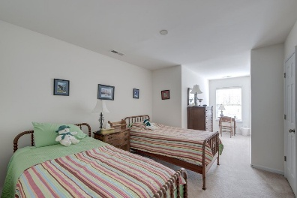
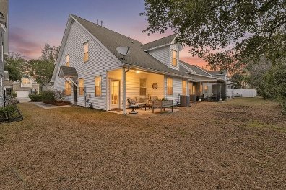
Price Reduced!
Price Improvement
Happy Hour Broker Open House Friday, Nov 22 from 3-5
$100 Gift Card Giveaway
1155 Saint Pauls Parrish Lane
The Gates of Fenwick Plantation | Johns Island, SC 29455 | MLS# 26002384 | $429,000
***Ask about the possibility of receiving 1% reduction in interest rate and free refi.*** Located in The Gates of Fenwick Plantation, this beautifully maintained end-unit townhouse offers a bright, functional floor plan in a highly convenient location. From the moment you arrive, you'll appreciate the pristine landscaping, the tall, shady tree out front, and the charming exterior that sets the tone for what's inside. Step through the door to find attractive oak wood flooring, an open layout, and wonderful natural light throughout the main living areas. The kitchen is both inviting and practical, featuring vaulted ceilings, a Palladian window, a full tile backsplash, a new stainless refrigerator, abundant cabinetry and countertop space, a pantry, and room for a dining table.
The adjacent dining area flows seamlessly into the living room, which opens to the patio and backyard beyond; perfect for everyday living and entertaining alike.
The main-level primary bedroom serves as a relaxing retreat with an en suite bathroom that includes a dual sink vanity, a large renovated step-in shower, and a walk-in closet. A convenient powder room completes the first floor.
Upstairs, you'll find a versatile loft ideal for a reading nook, office, or flex space to suit your needs. Two generously sized bedrooms complete the second level, including one that can function as a second primary bedroom with in-room access to the shared hall bath.
Additional highlights include an updated gas tankless water heater (2023), updated HVAC (2022), and new carpet on the second level. The community offers a swimming pool, and the home is located within three miles of popular dining spots and breweries such as Wild Olive, The Royal Tern, Kiss Cafe, Estuary Beans and Barley, and Low Tide Brewery. Just over seven miles from downtown Charleston, this home truly has so much to love. Schedule your showing today and see it for yourself.
Kellen Smith ksmith@mattoneillteam.com 843-801-2630

