Slide 1
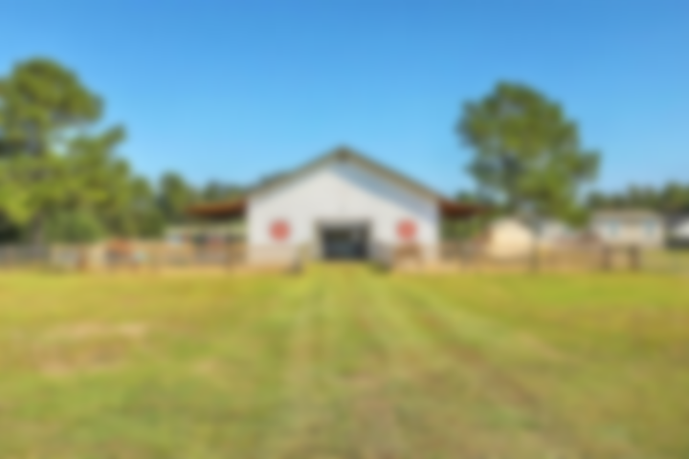
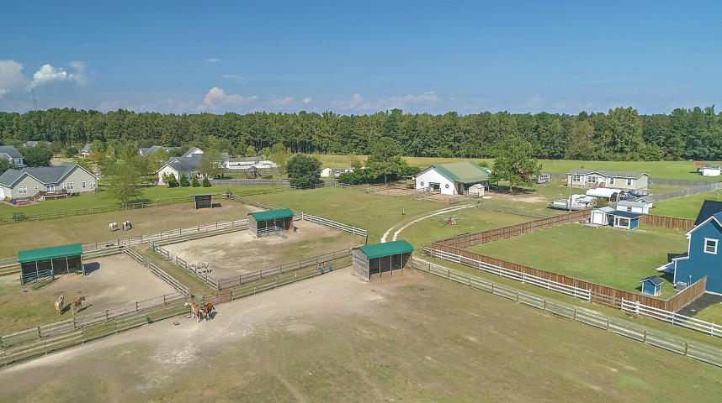
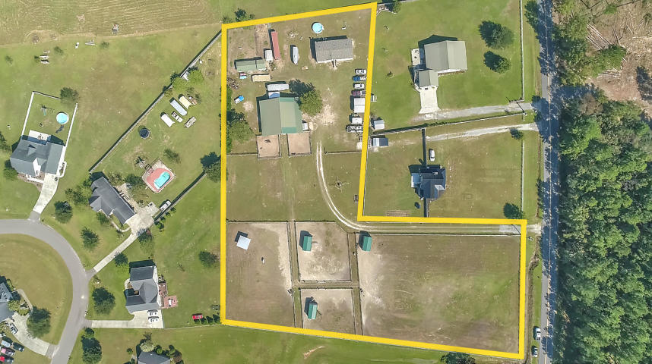
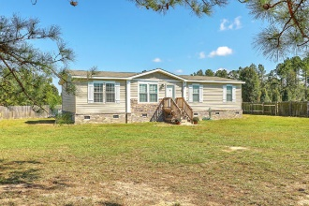
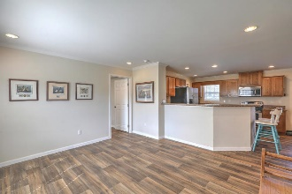
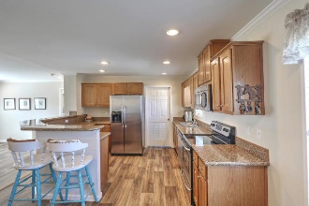
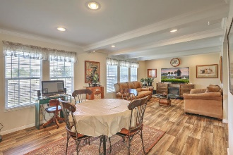
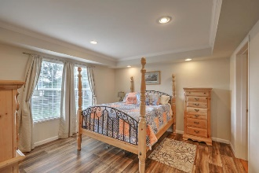
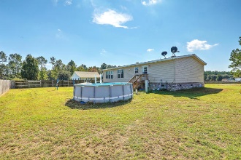
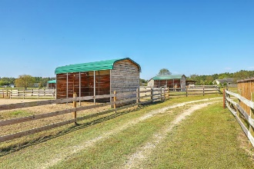

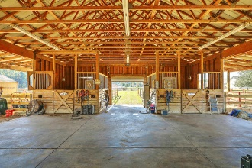
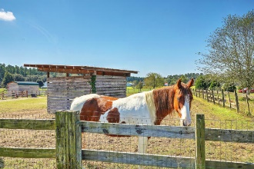

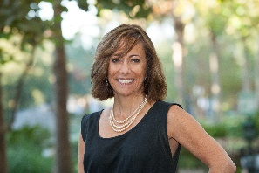
Horse Lovers: Join Us on the Farm!
Sunday, November 18th from 12-2PM
1156 Old Cherry Hill
Moncks Corner, SC 29461 | MLS# 18028688 | Reduced to $399,775
Horse lovers & gentlemen farmers look no further! Just across the street from the Santee Cooper owned forest where you can ride your horses, this lovely property, located on a quiet country road, features a 2-stall 48'x48' +/- horse barn with wash-down area, large open area and apartment/lounge/tack room with brand new tankless water heater, offering lots of potential. Multiple fenced pastures with run-in sheds make this a perfect opportunity for boarding! The 1456 sq ft 3BR/2B main residence, built in 2017, features an open concept floorplan, smooth 9' ceilings with recessed lights, master ensuite with tray ceiling, quality laminate flooring and crown molding throughout. Enjoy summer nights in your above-ground pool. The smaller barn, perfect for chickens, goats, or extra storage, can hold 125 bales of hay and the container will hold an additional 300 bales of hay. This turn-key farm includes a new septic system, Hot Walker, zero turn lawn mower and a John Deere Gator - all you have to do is bring your personal belongings and horses and move right in! 30 minute drive to the new Volvo Plant, Boeing, this country home is close to shopping, beaches, boating and all that CHARLESTON, SUMMERVILLE, MONCKS CORNER, and the rest of the LOWCOUNTRY has to offer!
Desiree Maurer
Office - (843) 416-2000
Mobile - (843) 327-9010
desiree.maurer1@gmail.com
www.yourcharlestonhousesearch.com
Keller Williams Realty
496 Bramson Ct Ste 200
Mt. Pleasant, SC 29464

