Slide 1
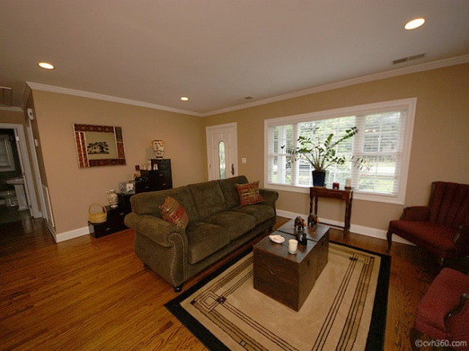
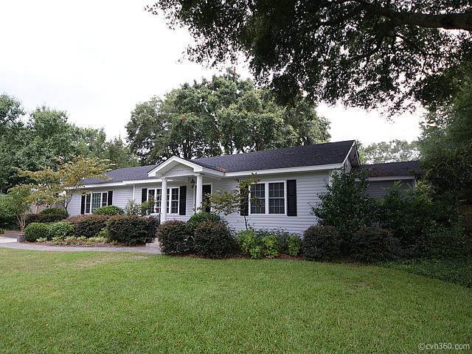
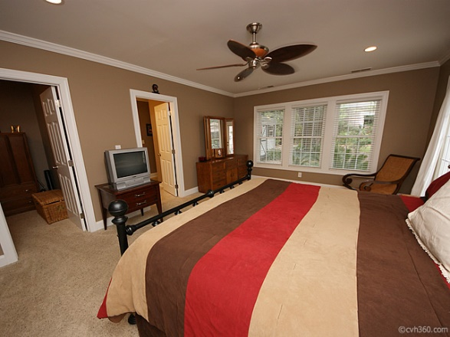
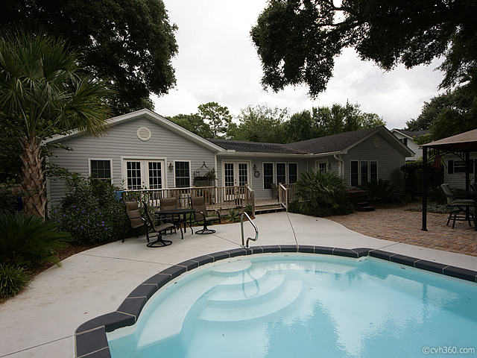
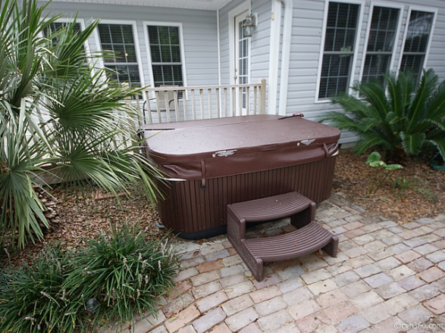



1159 Camellia Dr, Shemwood, Mt Pleasant
Completely renovated to the studs, this is your opportunity to own a spacious gem in the Heart of Mt. Pleasant, just off of Coleman Blvd.
Open the front door and you will step into an open Family Room and Kitchen combination, with a separate Dining Room off to the right. There is a granite counter with bar chairs for family dining separating the Family Room and Kitchen. Gorgeous wood cabinets and stainless appliances make this flow-through Kitchen easy to cook and entertain in.
Asking $545,000
MLS# 1321264
2,614 SqFt
3 Bed/3 Baths
Come and see! You will be pleased with this gem of a home on its double lot.
Don Dawson
3040 Highway 17 North • Mount Pleasant, SC 29466 843-514-0452 • ddawson@carolinaone.com
www.TeamDawsonSC.com

