Slide 1
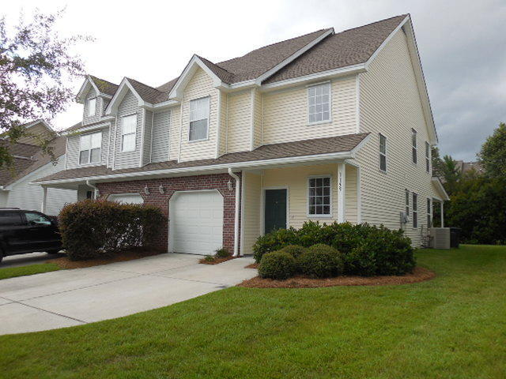
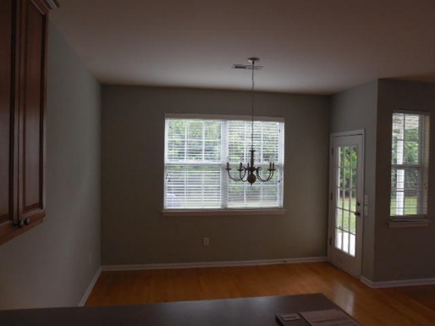
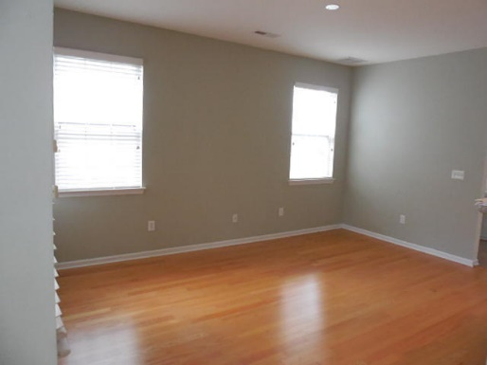
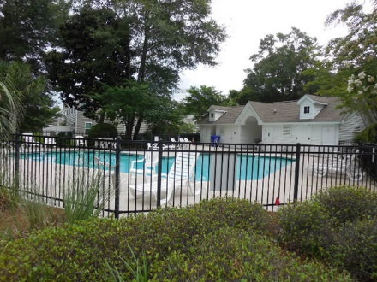
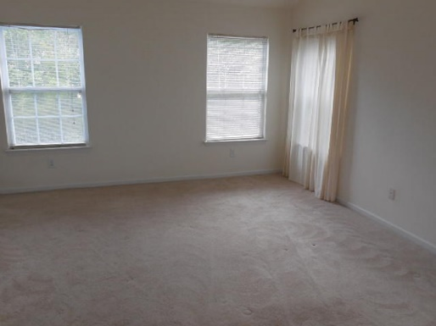
William S. Smith, Broker
Hartnett Realty Co., Inc.
134 Meeting St, Chas, SC 29401 wssmith@hartnettrealty.com
(843) 723-7222
New listing!
1159 St. Pauls Parrish Lane
Fenwick Commons - Johns Island - MLS# 15017992 - $197,500
Elegant townhouse, featuring multiple upgrades, in move-in condition. The Commons at Fenwick Hall is ten minutes to downtown Charleston and offers mature landscaping and a very well-manicured neighborhood. Stainless appliances, garden tubs. Two master bedroom suites on the second floor. One car garage plus driveway is flagged for side-by-side parking. Hurricane shutters for all windows included.

