Slide 1
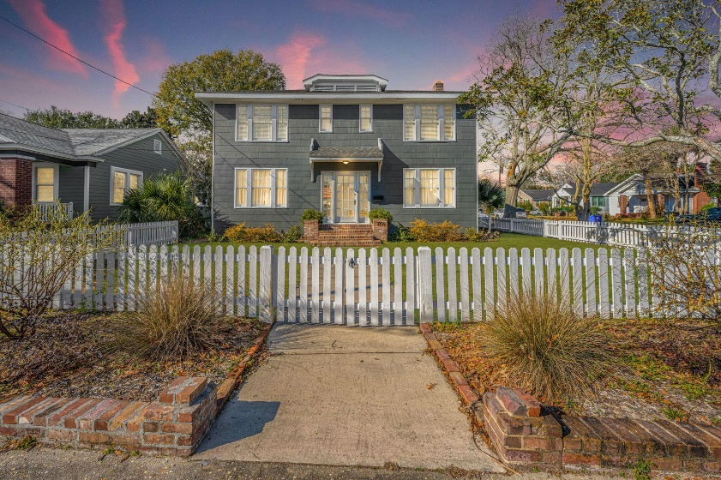
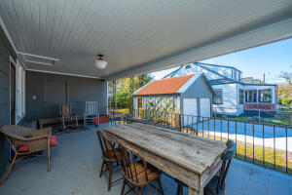
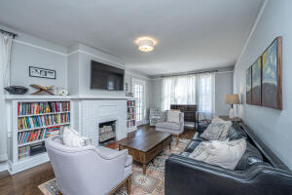
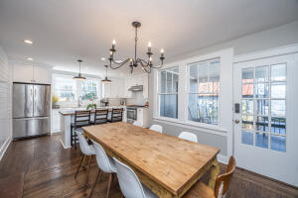
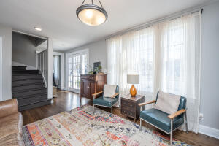
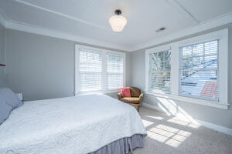
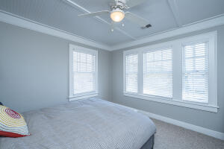
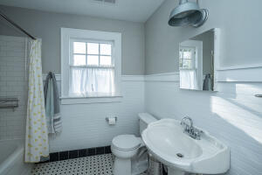



Why wait for new construction?
This Park Circle area home is LESS THAN 2 YEARS!
Back on Market - $850,000
1159 King Street
North Central · Charleston, SC 29403 · MLS# 22003273
A rare opportunity to own an updated home on King Street in downtown Charleston. This 1,897 square foot home in North Central sits on a corner lot with great curb appeal from the front, side and back. In 2018-19, owners replaced the roof, hvac, plumbing, updated electrical, put in a tankless water heater, encapsulated the crawl space and put in a dehumidifier. On the main level, they opened up a wall to a glorious bright kitchen with a reclaimed wood island built by Landrum Tables, shiplap, quartz countertops, subway tile backsplash, and gas range with hood vent. Upstairs has all four bedrooms. Outside, enjoy the covered patio and fire pit area!
Take a Virtual Tour: https://my.matterport.com/show/?m=8Sk8W8dyRMr
Del Shaffer
843.408.6821
dshaffer@carolinaoneplus.com
2713 Highway 17 North
Mt. Pleasant, SC 29466

